Slide 1
New Directions in Chicanx and Latinx Studies
Identities Overview Slides

Slide 2
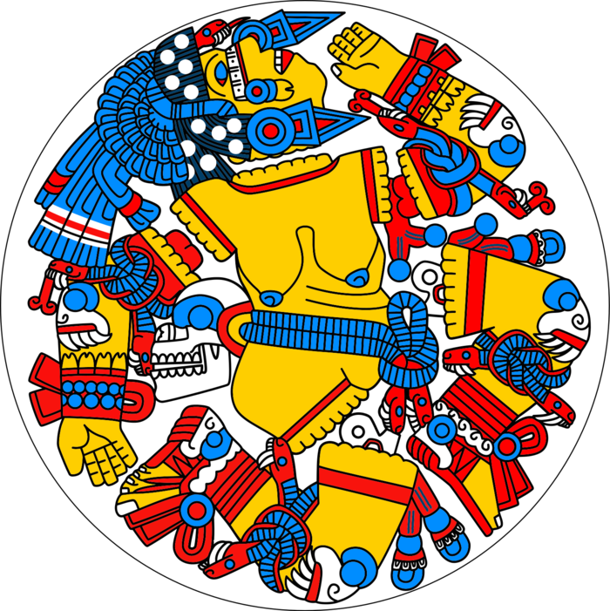
Student Learning Outcomes
Outline contemporary Latinx demographics and the factors that impact them.
Evaluate the historical, political, and social processes that have shaped the racialization of Chicanxs and Latinxs.
Summarize Chicanx/Latinx studies identity concepts, theories, and frameworks.
Image Attribution: “Coyolxāuhqui” (CC BY-SA 3.0) SJB1995 via Fandom

Slide 3
Key Terms
Chicano
Boricua
Chicana, Chicana/o
Xicana/o (Xicana/o/x Indígena)
Indigenistas
Xicanisma
Chican@, Latin@
Chicanx, Latinx
Latine
Régimen de castas
Mestizaje
Paradigm
Racial formation
Mestiza consciousness
Social identities
Social construction
Intersectionality
Hispanic
Latino
Ethnicity
Panethnicities
Latinidad/Latinidades
Interlatino subjectivities
Indígena
Critical Latinx Indigeneities
AfroLatinidad
Queer Latinidad

Slide 4
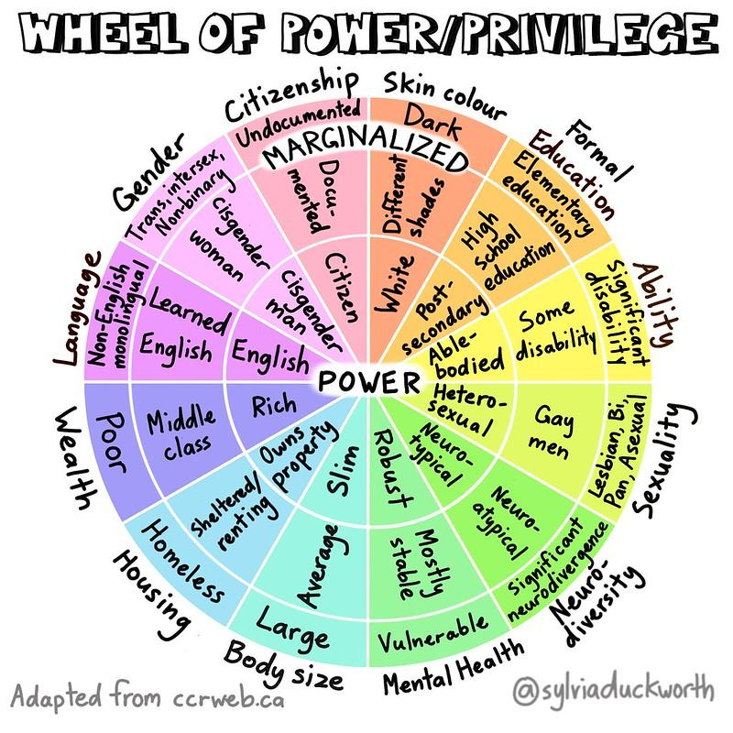
Multiple Social Identities
Social identities: shared understandings, imagined and/or real, of what it means to belong to a group.
Power structures shape particular subject positions, access to resources, experiences, and life outcomes for Latinxs.
These vary based on the intersecting dynamics of gender, class, language, religion, ability, sexuality, tribal affiliation, nationality, and immigration status.
“Wheel of Power/Privilege,” by Sylvia Duckworth, is licensed under CC BY-NC-ND 2.0

Slide 5
Image Description 2.1
The wheel includes three concentric circles that are separated by category. The center circle is labeled power, and the outer circle is labeled marginalized. From the top, clockwise, the categories and labels read:
Skin colour: Dark (marginalized), Different shades, white (power)
Formal education: Elementary education, High school education, Post-secondary
Ability: Significant disability, Some disability, Able-bodied
Sexuality: lesbian, bi, pan, asexual, Gay men, Heterosexual
Neurodiversity: Significant neurodivergence, Neuro-atypical, Neuro-typical
Mental health: Vulnerable, Mostly stable, Robust
Body size: Large, Average, Slim
Housing: Homeles, Sheltered/renting, Owns property
Wealth: Poor, Middle class, Rich
Language: non-English monolingual, Learned English, English
Gender: Trans, intersex, non-binary, Cisgender woman, Cisgender man
Citizenship: Undocumented (marginalized), Documented, Citizen (power)

Slide 6
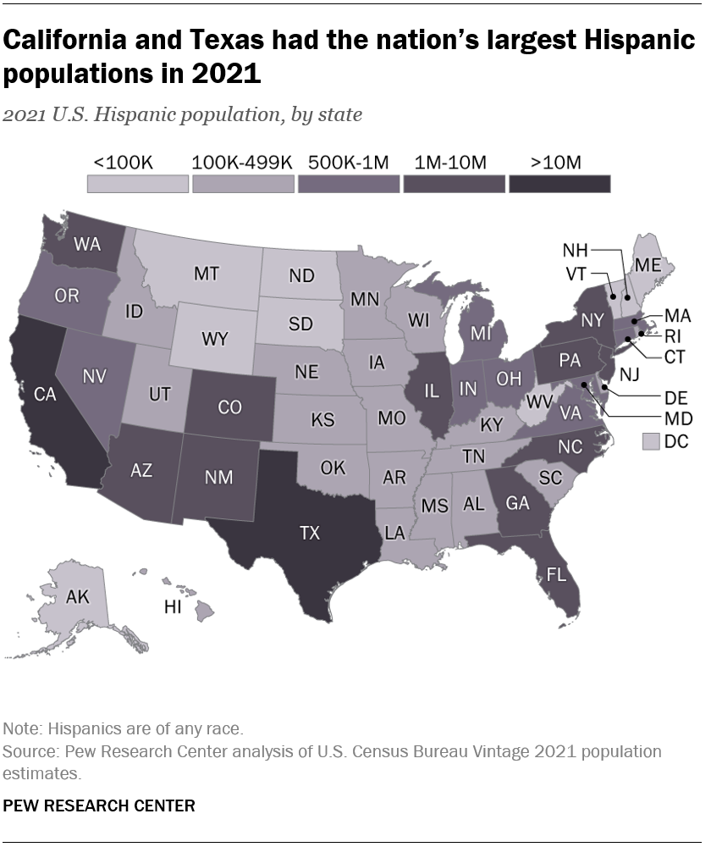
Defining Demographics
The U.S. Hispanic population totaled 62.5 million in 2021, making up nearly one-in-five people in the U.S., up from 50.5 million in 2010.
California is the state with the largest Hispanic population in the U.S.
Hispanics became the largest racial or ethnic group in the state in 2014.

Slide 7
Image Description 2.1.1
California is the state with the largest Hispanic population in the United States. Hispanics became the largest racial or ethnic group in the state in 2014, surpassing the non-Hispanic white population, whose numbers have been on the decline, reflecting a broader national trend. In 2021 there were about 15.8 million Hispanics in California, accounting for 40% of the total population, which was up from 14.0 million in 2010. Figure 2.2 displays the numbers of Latinos in each of the 50 states, with Texas at more than 10 million, Washington, Arizona, New Mexico, Colorado, Florida, New York, and others reporting 1 to 10 million, Oregon, Nevada, Michigan, and others reporting 500,000 to 1 million, Utah, Idaho, and many states in the South and Midwest reporting 100,000 to 149,000, and North and South Dakota, Maine, Vermont, and others reporting less than 100,000.

Slide 8
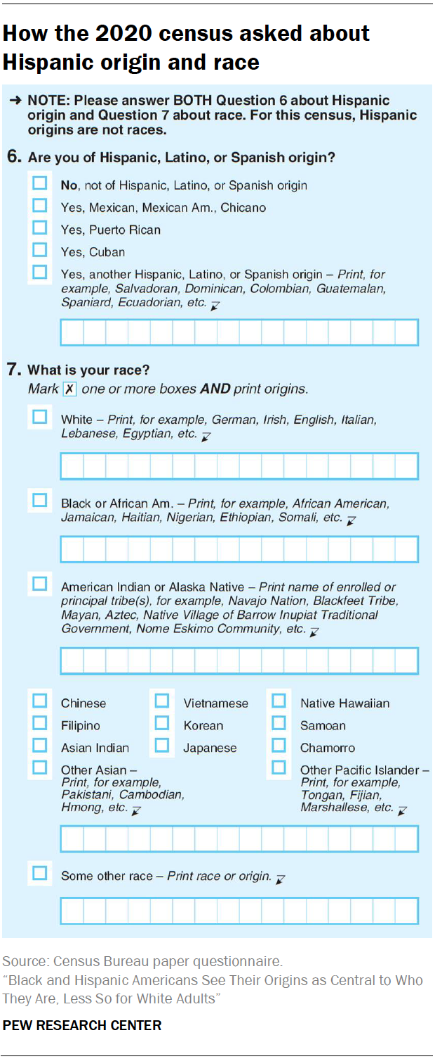
How the 2020 Census Asked About Hispanic Origin and Race
According to the United States Census Bureau, Hispanic, Latino, or Spanish origin is defined as a person of Cuban, Mexican, Puerto Rican, South or Central American, or other Spanish culture or origin, regardless of race. In other words, USCB does not consider Hispanic or Latino to be a race.
Review and respond to questions 6 and 7 on the Census. When you are finished, we will discuss the following:
Do the options provided reflect how you self-identify?
Would you change anything about the categorizations or labels?
How does this form compare to others that have asked for your race and ethnicity, such as school documents, employment applications, and medical forms?
How do your responses compare to the results of the 2020 census?

Slide 9
Image Description 2.1.2 - 1
The image features two census questions used to ask about race and ethnicity. Number 6 is “Are you of Hispanic, Latino, or Spanish origin?” The options for responses are:
No, not of Hispanic, Latino, or Spanish origin
Yes, Mexican, Mexican Am., Chicano
Yes, Puerto Rican
Yes, Cuba
Yes, another Hispanic, Latino, or Spanish origin - Print for example, Salvadoran, Dominican, Colombian, Guatemalan, Spaniard, Ecuadorian, etc.

Slide 10
Image Description 2.1.2 - 2
Question 7 is “What is your race?” with options to mark one or more boxes to identify your race and to fill in origin information within each category. The options for responses are:
White - Print for example, German, Irish, English, Italian, Lebanese, Egyptian, etc.
Black of African Am. - Print for example, African American, Jamaican, Haitian, Nigerian, Ethiopian, Somali, etc.
American Indian or Alaska Native - Print name of enrolled or principal tribe(s), for example, Navajo Nation, Blackfeet Tribe, Mayan, Aztec, Native Village of Barrow Inupiat Traditional Government, Nome Eskimo Community, etc.
Chinese
Vietnamese
Native Hawaiian
Filipino
Korean
Samoan
Asian Indian
Japanese
Chamorro
Other Aisan - Print for example, Pakistani, Cambodian, Hmong, etc.
Other Pacific Islander - Print, for example, Tongan, Fijian, Marhsallese, etc.
Some other race - Print race, or origin.

Slide 11
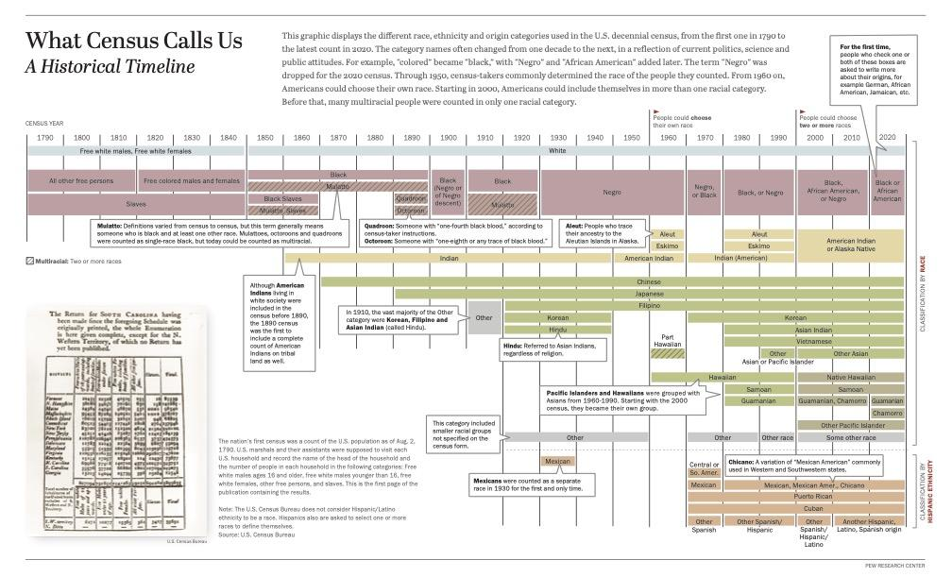
What Census Call Us: A Historical Timeline

Slide 12
Image Description 2.1.3 - 1
“This graphic displays the different race, ethnicity and origin categories used in the U.S. decennial census, from the first one in 1790 to the latest count in 2020. The category names often changed from one decade to the next, in a reflection of the current politics, science, and public attitudes. For example, “colored” became “black,” with “Negro” and “African American” added later” and “Starting in 2000, Americans could include themselves in more than one racial category. Before that, many multiracial people were counted in only one racial category.”
The timeline from 1790 to 2020 shows the ten-year cycle of Census dates and includes seven layers corresponding to six racial categories (White, Black or African American, American Indian or Alaskan Native, Asian, Pacific Islander, and some other race), and one ethnic category (Hispanic, Latino, or Spanish origin). The categories in each group are listed here by the year they were first collected, with a note if they replaced a previously used category or were newly added.
White: First included in 1790 as “Free white males, Free white males,” replaced in 1850 with “White” until the present.
Black or African American: First included in 1790 as “All other free persons” and “Slaves,” which was replaced in 1820 “Free colored males and females” and “Slaves.” In 1850, all categories were replaced with “Black,” “Mulatto,” “Black Slaves,” and “Mulatto Slaves.” In 1870, both categories of enslaved people were removed and enslaved people were accounted with other free Black and multiracial individuals categorized at the time as “Mulatto.” In 1890, “Quadroon” and “Octoroon” were added. In 1900, the previous categories were replaced with “Black (Negro of Negro descent),” which was replaced in 1910 with “Black” and “Mulatto.” Since 1930, a single category has been used, starting with “Negro,” until it changed to “Negro or Black” in 1970, then “Black or Negro” in 1980 until 2000, when it became “Black African Amreican, or Negro” and then “Black or African American” in 2020.
“Mulatto: Definitions varied from census to census, but this term generally means someone who is black and at least one other race. Mulattoes, octoroons and quadroons were counted as single-race black, but today could be counted as multiracial.”
“Quadroon: Someone with ‘one-fourth black blood,’ according to census-taker instructions.”
“Octoroon: Someone with ‘one-eighth or any trace of black blood.’”

Slide 13
Image Description 2.1.3 - 2
American Indian or Alaskan: The first category added on the Census beyond Black and white was “Indian” in 1860. “Although American Indians living in white society were included in the census before 1890, the 1890 census was the first to include a complete count of American Indians on tribal land as well.” In 1860 the Census began by asking about “Indian” identity, which continued until 1950 when it was changed to “American Indian.” In 1960, separate categories were added for Aleut and Eskimo. “Aleut: People who trace their ancestry to the Aleutian Islands in Alaska.” In 1970, all three categories were replaced with “Indian (American)” and in 1980, Aluet and Eskimo were re-added. In 2000, these categories were combined into American Indian or Alaskan Native.
Asian: In 1870, the Census started asking about Asian ancestry with the category of “Chinese.” In 1890, Japanese was added, followed by “Other” in 1910. “In 1910, the vast majority of the Other category were Korean, Filipino and Asian Indian (called Hindu).” These groups were added in 1920. As an imposed term, “Hindu: Referred to Asian Indians, regardless of religion.” In 1950, Korean and “Hindu” were removed from the options, leaving Chinese, Japanese, and Filipino. In 1960, the survey added Part Hawaiian and Hawaiian. “Pacific Islanders and Hawaiians were grouped with Asians from 1960-1990. Starting with the 2000 census, they became their own group.” In 1970, the Census re-added Korean, and in 1980 added “Asian Indian” (formerly labeled “Hindu”) and also added for the first time Vietnamese, Saomoan, and Guamanian. In 1990, “Other Asian or Pacific Islander” was included as an option. For the next census, because Asian and Pacific Islander categories were separated, this category became “Other Asian.”
Pacific Islander: Three groups, Hawaiian, Samoan, and Guamanian were originally included with the “Asian” categories. In 2000, these were recognized as “Pacific Islander,” Guamanian was changed to “Guamanian or Chamorro” and the option “Other Pacific Islander” was included. In 2020, Guamanian and Chamorro were separated.
Other: The “Other” option was first included in 1910 and largely referred to people of Asian heritage. With the inclusion of other groups, this category came to include people of smaller groups and people of multiracial backgrounds who do not want to select just one race (until 2000 when the option to select multiple categories was added). Other was included until 1960 and then re-added in 1970. In 1990 the label was changed to “Other race” and in 2000 updated to “Some other race.”
The events summarized in the section on Hispanic, Latino, and Spanish origin ethnicity are detailed in the following section.

Slide 14
Image Description 2.1.3 - 3
The image also includes a rendering of a historical Census count from South Carolina with each group tabulated by state in hand-printed script. This is accompanied by the following explanatory note: “The nation’s first census was a count of the U.S. population as of Aug. 2, 1790. U.S. marshals and their assistants were supposed to visit each U.S. household and record the name of the head of the household and the number of people in each household in the following categories: Free white males ages 16 and older, free white males younger than 16, free white females, other free persons, and slaves. This is the first page of the publication containing the results.
Note: The U.S. Census Bureau does not consider Hispanic/Latino ethnicity to be a race. Hispanics also are asked to select one or more races to define themselves.” The categorization of Hispanics and Latinos is described in the following detailed timeline:
1930 - Mexicans were counted as a separate race (not an ethnicity or nationality) for the first and only time. Prior to this, they were categorized racially as white, dating back to the first time they were included in the census in 1850.
1940 - The Mexican racial category was removed and “persons of Mexican birth or ancestry who were not defined as Indian or some other nonwhite race” were once again deemed white, and marked as a Spanish-speaking population.
1950 and 1960 - Mexicans were counted as “white persons of Spanish surname.”

Slide 15
Image Description 2.1.3 - 4
1970 - A question on “Origin or Descent” was added with an option to choose one of the following: Mexican; Puerto Rican; Cuban; Central or South American; Other Spanish. Mexican, Puerto Rican, and Cuban origins were separately identified due to these groups being the largest estimated Hispanic populations in the U.S. at the time.
1980 - “Hispanic” and “not Hispanic” were deemed distinct and separated from race. According to the Census, individuals who are Hispanic may be of any race. The Mexican category was expanded to include “Mexican, Mexican-Amer[ican], Chicano.”
1990 - For the Hispanic origin question, a list of examples and a write-in line were introduced that read, “Print one group, for example, Argentinean, Colombian, Dominican, Nicaraguan, Salvadoran, Spaniard, and so on.”
2000 - People could report more than one race for the first time. “Other Spanish/Hispanic” was changed to “Another Hispanic, Latino, Spanish origin,” introducing the Latino label for the first time.
2010 - “Another Hispanic, Latino, or Spanish origin” category now provided examples of six Hispanic origin groups “(Argentinean, Colombian, Dominican, Nicaraguan, Salvadoran, Spaniard, and so on)” and instructed respondents to “print origin.”
2020 - The example Hispanic groups were revised to represent the largest Hispanic population groups and the geographic diversity of the Hispanic or Latino category.

Slide 16
Latinxs Views of Themselves
When it comes to describing their identity, most Hispanics prefer their family’s country of origin over pan-ethnic terms.
Most Hispanics do not see a shared common culture among U.S. Hispanics.
“Hispanic” or “Latino”? Most don’t care—but among those who do, “Hispanic” is preferred.
Most Afro-Latinos identify as “Hispanic” or “Latino,” but not all do.
The racial groups Afro-Latinos identify with can be varied and diverse.
Most Hispanics use Spanish, but the use of English rises through the generations.
Hispanics also want future U.S. Hispanic generations to speak Spanish.

Slide 17
Key Terms
Ethnicity refers to the meanings, values, practices, and expressions of a group that understands itself to be linked by a shared way of life. Ethnicity often involves fictive or actual bonds of kinship and/or a related widespread sense of common collective origin, ancestry, homeland, and history and may include a common language and cultural system or customs such as religion, mythology, ritual, food, dress, and style.
Panethnicities “are confederations created when several distinct ethnic groups come together in alliance for social, economic, or cultural advantage, thereby augmenting their numeric power and influence around issues of common concern.”
Latinidad “...A political project that cultivates a broad cultural sense of belonging to a grander community that is created through ancestral links to Latin America.” Latinidad suggests a shared subjectivity among disparate ethnic and national groups with shared attributes, experiences, and realities among its members.

Slide 18
Knowledge Check In:
Why should we use the plural Latinidades? How is this defined? What does it entail?

Slide 19
An Identity Label Timeline
CHICANO Late 1960s to 1980s
XICANA, XICANO
1980s to 2000s
CHICANX, LATINX 2010s to 2020s
1970s | 1980s | 1990s | 2000s | 2010s | 2020
CHICANA, CHICANA/O Late 1960s to 1990s
CHICAN@, LATIN@ 2000s to 2010s
LATINE
2020s

Slide 20
Timeline Description
1960s
CHICANO: Late 1960s to 1980s
CHICANA, CHICANA/O: Late 1960s to 1990s
1970s
1980s
XICANA, XICANO: 1980s to 2000s
1990s
2000s
CHICAN@, LATIN@: 2000s to 2010s
2010s
CHICANX, LATINX: 2010s to 2020s
2020s
LATINE: 2020s

Slide 21
Historical Racialized and Gendered Formations
Spanish Conquest, Colonialism, and Mestizaje
When national regimes categorize populations, the very act of naming gives them a living reality. ––Ramón A. Gutiérrez
Distinct regional hybrid subcultures and affinities were developed along religious lines in Spanish settlements.
Spaniards “invented Indians,” erasing the diversity and complexity they encountered.
Españoles created rigid social hierarchies and ranked people’s calidad.
Régimen de castas took precedence over time as racial mixing between Spaniards, Indigenous, and African peoples became more common by the mid-eighteenth century.
The casta system was not abolished in Mexico until 1821, however racial and ethnic social stratification remained prevalent and echoed colonial conceptions of identity.

Slide 22
Historical Racialized and Gendered Formations
Changing Racial Paradigms Under U.S. Imperialism (1 of 2)
Knowledge of the history of relations between the United States and Latin America and the Caribbean is indispensable to putting into focus the often forgotten events and circumstances that account for the Latino/a presence here. ––José Luis Morín
Racial Formation in the U.S.-Mexico Borderlands
U.S. sought to expand its empire through the invasion and annexation of Mexico’s northern territories, culminating in the war of 1846-1848.
Mexicans troubled the existing white supremacist racial paradigm built on a Black/white dichotomy and raised the problem of racial assimilation.
Key Term: “A paradigm is a shared set of understandings or premises which permits the definition, elaboration, and solution of a set of problems defined within the paradigm. It is an accepted model or pattern…. Paradigms of race shape our understanding and definition of racial problems.”

Slide 23
Historical Racialized and Gendered Formations
Changing Racial Paradigms Under U.S. Imperialism (2 of 2)
Knowledge of the history of relations between the United States and Latin America and the Caribbean is indispensable to putting into focus the often forgotten events and circumstances that account for the Latino/a presence here. ––José Luis Morín
Racial Formation in Puerto Rico
The U.S. continued their imperial wars of conquest through the nineteenth century resulting in the capture of several island nations including the Kingdom of Hawai’i in 1893 and the Philippines, Cuba, Puerto Rico, and Guam after the Spanish American War of 1898.
The original inhabitants would have their social, political, economic, civil, and human rights repressed and their identities would now be constructed under the U.S. racial paradigm.
The rationale for not granting statehood and political debates around granting citizenship rights in Puerto Rico were based on the white supremacist views of the inferiority of mixed race people, particularly those of mixed African heritage, who were thought of as unable to govern themselves.

Slide 24
Historical Racialized and Gendered Formations
Ethnic Nationalism, Ethnic Pride
The late 1960s and early 1970s marked a period of Chicano and Boricua cultural pride, empowerment, self-determination, and liberation.
Both Chicanos and Boricuas opposed U.S. imperialism and refuted their association with whiteness, a tactic utilized by previous generations to secure civil rights.
“Heralding their personal beauty and pride, both movements affirmed the beauty of their art, language, culture, and skin color as a way to corrode the toxicity of racism” (Gutiérrez, 41).

Slide 25
Xicana Feminist Ontologies:
Indigeneity, Spirituality, and Sexuality
In Borderlands La Frontera: The New Mestiza (1987), Gloria Anzaldúa moves away from masculinist, heterosexist, nationalist, and biological notions of mestizaje attributing new meaning to identity construction through her concept of “mestiza consciousness”—one that emerges from life in the Borderlands.
Mestiza consciousness is a cognitive decolonization process of racialized, gendered, and sexed subjects wherein la mestiza becomes aware of the Borderlands and makes conscious decisions regarding the construction of her multiple and often contradictory identities.

Slide 26
Xicanisma
Chicana feminists continued to intervene in Chicano nationalist constructions of Indigeneity by unsettling myths and binaries that were delineated during El Movimiento through Xicanisma.
Xicanisma is a retrofitted form of Chicana feminism intended to create an avenue for mestizas and Indigenous women to “not only reclaim our Indigenismo––but also to reinsert the forsaken feminine into our consciousness” (Castillo, 12).
Xicanisma is a practical way for retribalizing peoples of any gender to express an Indigenous sensibility, reconnect spirituality with the body/sexuality, and to (re)claim and (re)construct their traditions in a way that serves their present needs.

