Slide 1
Safety, Health, and Nutrition in Early Childhood Education
Chapter 12: Basic Nutrition for Children
This work is licensed by Katherine Abba, adapted from “Safety, Health, and Nutrition” by Jennifer Paris, College of the Canyons under CC BY 4.0. Texas Edition

Slide 2
Textbook Objectives
• Define and explain the function of each macronutrient and type of micronutrient.
• Examine factors that affect the quality of food.
• Discuss influences on food choice.
• Outline how to achieve a healthy diet.
• Describe programs that support nutrition in early care and education programs.
• Identify ways to assess the quality of meals and snacks in early care and education programs.

Slide 3
HCC Learning Outcomes
3. Analyze principles of nutrition and the application to nutritional assessment.
3.4 Compare nutritional guidelines and regulations.
3.5 Identify policy and regulatory requirements for nutrition.
4.Identify policy and regulatory requirements for nutrition.

Slide 4
Children’s nutrition needs
Food contains nutrients. Nutrients are substances our body needs to perform basic functions (breathing, moving, digestion, etc.).
Nutrients are obtained from the foods we eat, because we cannot synthesize or produce them from foods.
Nutrients provide energy, contribute to body structure, and/or regulate chemical processes in the body.

Slide 5
Classes of nutrients
There are six classes of nutrients required for the body to function and maintain overall health: What are they? List all six, below:

Slide 6
Macronutrients
Macronutrients are the nutrients needed in large amounts.
These are carbohydrates, fats, and proteins and they allow our bodies to conduct their basic functions.
Calorie= A unit of measurement of food energy, needed to conduct basic functions of the body.
Water is also a macronutrient, but it does not yield calories.

Slide 7
Carbohydrates
Carbohydrates – molecules composed of carbon, hydrogen, and oxygen. They are soluble in water.
The major food sources of carbohydrates are grains, milk, fruits, and starchy vegetables. Non-starchy vegetables also contain carbohydrates, but in lesser quantities.
Carbohydratres provide energy, serve as building blocks for larger macromolecules and contribute to the healthy functioning of the nervous system, heart, and kidneys. (Paris, 2020)
Carbohydrates are broadly classified into two form: simple carbohydrates, often called simple sugars; and complex carbohydrates.
Examples of simple carbohydrates are:?
Complex carbohydrates are: ?

Slide 8
Fats
Fats, also known as lipids, are also molecules composed of carbon, hydrogen, and oxygen. They are not soluble in water.
Fats provide or store energy. Fats provide more energy per gram than carbohydrates.
Fats serve as a major component of cell membranes, surround and protect organs, provide insulation to aid in temperature regulation, and regulate many other functions in the body (Paris, 2020, p.298).
Fats can be found in what foods?

Slide 9
Proteins
Proteins are macromolecules composed of amino acids.
Proteins provide energy, but, primarily, proteins provide structure to bones, muscles and skin, and play a role in conducting most of the chemical reactions that take place in the body (Paris, 2020).
Food sources of protein are: ?

Slide 10
Water
Water is a nutrient we need in large quantities.
Water is responsible for transporting substances in and out of the body, chemical reactions, providing cushioning for our organs, and regulating body temperature.

Slide 11
Micronutrients
Micronutrients are nutrients required in small amounts, but are critical to carrying out bodily functions (Paris, 2020). Micronutrients include all of the 16 essential minerals and vitamins. Micronutrients aid in producing energy, digesting nutrients, and building macromolecules .
The function of minerals?-
examples of minerals?
The function of vitamins?-
examples of vitamins?-

Slide 12
Quality of food
What are nutrient-dense foods?
Are vitamins nutrient-dense foods?
Can vitamins take the place of eating nutrient-dense, high quality foods?

Slide 13
Factors that Drive Food Choices
Your environment and lifestyle can influence the foods you eat.
What else influences our food choice?

Slide 14
Type of Vegetarian Diets Complete the chart below: ?
Diet | Consumes Eggs | Consumes Dairy Products
Lacto-ovo vegetarian | Yes
Lacto-vegetarian
Ovo-vegetarian
Vegan | No | No (no animal products)

Slide 15
A healthful diet
There are five key factors that make up a healthful diet. They are?
Which factors influence YOU the most?

Slide 16
Child and Adult Care Food Program
Different programs in the United States support early care and education programs in providing nutritious meals and snacks for children. The Child and Adult Care Food Program (CACFP) is one of those. https://www.fns.usda.gov/cacfp
What are 3 facts about this program?
3 of their best practices recommendations?

Slide 17
Healthy Beverages in Child Care Act
The 4 key messages for the Healthy Beverages in Child Care Act are?

Slide 18
Dietary Guidelines for Americans
The Dietary Guidelines for Americans, produced by HHS and the U.S. Department of Agriculture every five years, analyze the latest research to help Americans make smart choices about food and physical activity so they can live healthier lives.
How are their recommendations different from the CACFP recommendations?

Slide 19
There are five overarching guidelines
1. • Follow a healthy eating pattern across the lifespan. Eating patterns are the combination of foods and drinks that a person eats over time.
2.?
3.?
4.?
5.?

Slide 20
Dietary Reference Intakes (DRI)
Issued by the Food and Nutrition Board of the Institute of Medicine, National Academy of Sciences, the DRI is the general term for a set of reference values used to plan and assess nutrient intakes of healthy people (Paris, 2020, p. 315).
The values are: ?

Slide 21
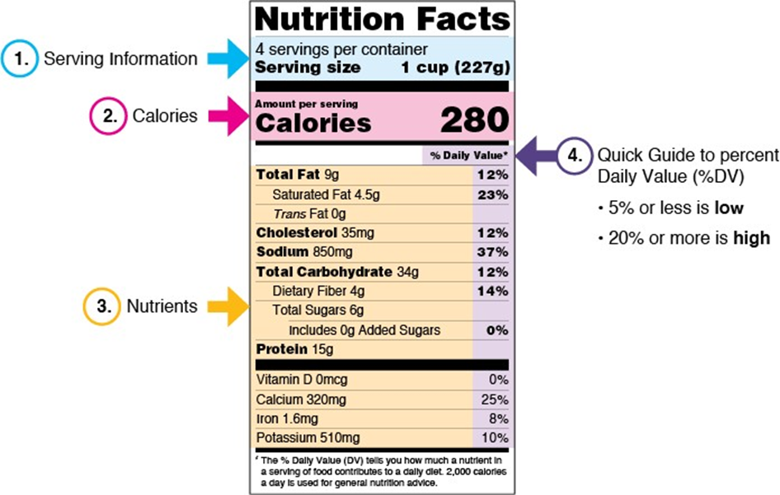
A color-coded example nutrition facts label for lasagna*
*https://www.fda.gov/food/nutrition-education-resources-materials/how-understand-and-use-nutrition- facts-label

Slide 22
Label facts
What are 4 important information provided on the nutrition facts labels?

Slide 23
Child Nutrition Programs for Schools
Feeding the Gulf Coast
https://www.feedingthegulfcoast.org/learn-more/our-programs/child-nutrition-programs
The federal government provides federal assistance to schools to provide nutritious meals to children. There are 4 such programs. List and briefly describe each, below:

