Slide 1
Safety, Health, and Nutrition in Early Childhood Education
Chapter 9 Supportive Health Care
This work is licensed by Katherine Abba, adapted from “Safety, Health, and Nutrition” by Jennifer Paris, College of the Canyons under CC BY 4.0. Texas Edition

Slide 2
Textbook Objectives
• Identify symptoms of infectious disease that is common during early childhood.
• Outline criteria for exclusion from care for ill children and staff.
• Describe considerations programs must make regarding caring for children that are mildly ill.
• Recall licensing requirements for handling medication in early care and education programs.

Slide 3
HCC Learning Outcomes
2.Describe the basic principles of healthy behavior and guidance practices that influence health promotion, safe practices and disease prevention for young children.
2.1 Examine typical growth and development characteristics of infants, toddlers, preschool-age, and school-age children and how these relate to safety and health practices.
2.2 Discuss why and how young children experience frequent communicable illness.
2.3 Identify the four stages of a communicable illness.

Slide 4
The four stages of communicable disease
1.Incubation stage- (also known as the latency stage)- the amount of time between exposure to a germ or pathogen and symptoms and signs of the illness appear.
2. Prodromal stage -infection increases and the immune system (ideally!) starts reacting . Early symptoms t might indicate the start of a disease before specific symptoms occur, such as headache, fever, and/or lack of appetite.
3.Acute- illness has increased in severity due to strong reaction of the immune system
4. Convalescence- this is the recovery period where the person is feeling better, though they may still be a source of infection.
Source: https://bio.libretexts.org/Bookshelves/Microbiology/Book%3A_Microbiology_(Boundless)/10%3A_Epidemiology/10.3%3A_Disease_Patterns/10.3B%3A_Disease_Development

Slide 5
Most common infectious disease symptoms in early care are…?
_________________________________________________________________________
_______________________________________________________________________?
Why is it important for you to know the signs and symptoms of these diseases?

Slide 6
The most common are…
Sore throat, runny nose, shortness of breath or cough, fever, vomiting and diarrhea (gastroenteritis), earaches, and rashes.

Slide 7
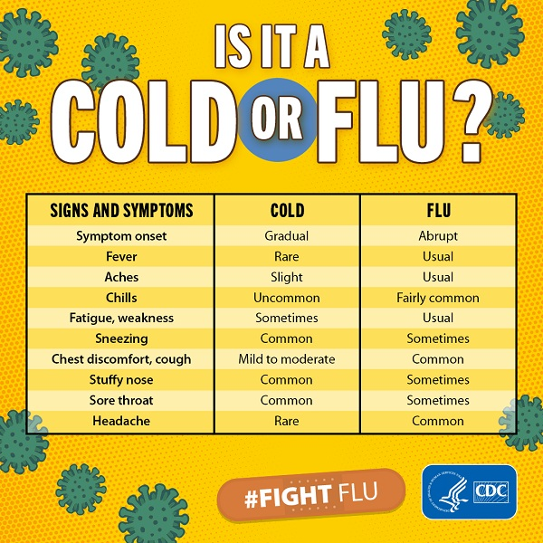
Flu or cold? These two illnesses are similar in that they are both respiratory illnesses, but the flu symptoms are generally worse. Here is a side-by-side comparison: (Source:https://www.cdc.gov/flu/symptoms/coldflu.htm)
.

Slide 8
Complete the chart
Using the common diseases previously mentioned, design a chart with the following information?
Name | Symptoms | Length of illness

Slide 9
Lice
What are lice and how are they spread?
What are the conditions or characteristics in an early learning center or school that contribute to the spread of lice?

Slide 10
What disease must be reported to the state?
In the state of Texas, what are a few of the examples of the reportable diseases? Access this helpful chart for more information:
https://dshs.texas.gov/assets/0/76/111/848/1084/1101/bce667f8-53f9-43fe-a8b6-01a71c6df4fe.png
_________________________________________________________________________
_________________________________________________________________________?
The above chart will also tell how which communicable diseases would exclude a child from a center. A few examples are ?
____________________________________________________________________________

Slide 11
Administration of Medication
See the Texas Minimum Standards for more information on Administering medication, Sections §746.3805- 3809
https://hhs.texas.gov/sites/default/files/documents/doing-business-with-hhs/provider-portal/protective-services/ccl/min-standards/chapter-746-centers.pdf

