Slide 1
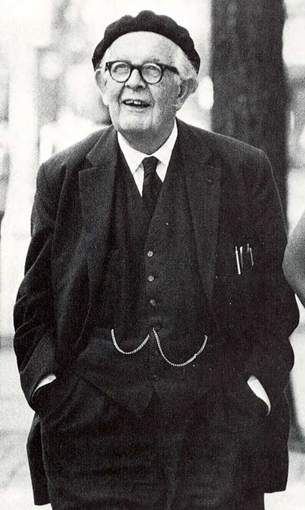
Chapter 2: Piaget's Stages of Cognitive Development
Jean Piaget (1896-1980)

Slide 2
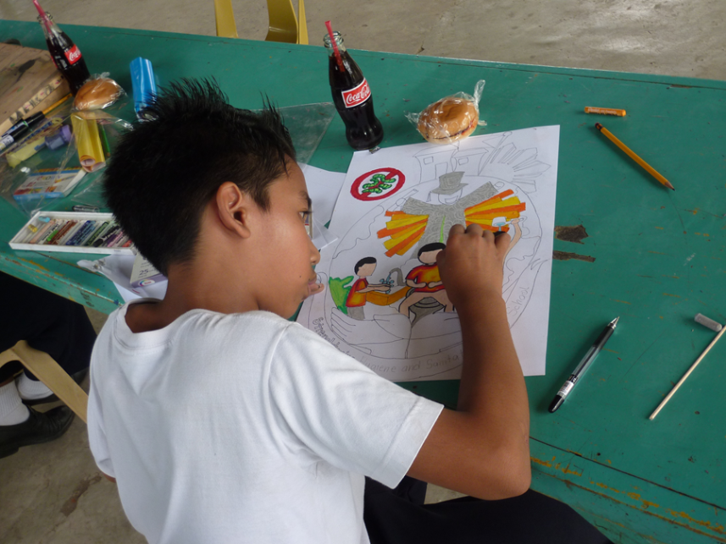
Constructionists believe that knowledge is constructed and learning occurs when children create.
Piaget was a constructionist.

Slide 3
Piaget identified four major stages in the cognitive development of children and adolescents:
Sensorimotor
Preoperational
Concrete operational
Formal operational

Slide 4
About the Stages In each stage, children demonstrate new intellectual abilities and increasingly complex understanding of the world. Stages cannot be "skipped.”

Slide 5
About the Stages Continued…. The ages at which children progress through the stages are averages. They vary with the environment and background of individual children. At any given time a child may exhibit behaviors characteristic of more than one stage.

Slide 6
First stage: Sensorimotor Birth until 18 months-2 years
Involves motor activity without the use of symbols.
Knowledge is limited in this stage, because it is based on physical interactions and experiences.
Infants must constantly experiment through trial and error.
Early language development begins during this stage.
At 7-9 months Infants realize that an object exists after it can no longer be seen.

Slide 7
Second Stage: The preoperational stage between toddlerhood (18-24months) and early childhood (7 years)
Children begin to use language.
Memory and imagination develop.
Children engage in make believe and can understand and express relationships between the past and the future.
More complex concepts, such as cause and effect relationships, have not been learned.
Intelligence is egocentric and intuitive, not logical.

Slide 8
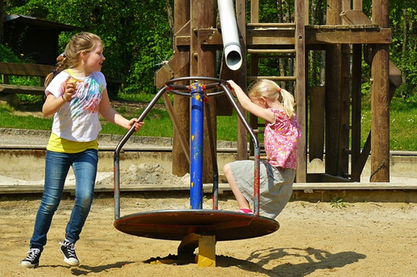
Third Stage: The concrete operational between the ages of 7-11 years
Involves the use of the use of logical and systematic manipulation of symbols.
Thinking becomes less egocentric with increased awareness of external events.
Thinking also includes concrete references and objects.

Slide 9
Fourth Stage: The formal operational stage The period from adolescence through adulthood
Symbols used to relate objects to abstract concepts.
Ability to think about multiple variables in systematic ways.
Ability to formulate hypotheses.
Able to think about abstract relationships and concepts.

Slide 10
How to Use Piaget's Stages of Cognitive Development Theory in the Classroom
Use visual aids and models.
Provide opportunities to discuss social, political, and cultural issues.
Teach broad concepts rather than facts, and situate these in a context meaningful and relevant to the learner.
Use familiar examples to facilitate learning more complex ideas, such as story problems in math.
Allow opportunities to classify and group information with increasing complexity.
Present problems that require logical analytic thinking.

Slide 11
Criticisms of Piaget's Theory
By describing tasks with confusing abstract terms and using overly difficult tasks, Piaget under estimated children's abilities.
Piaget's theory predicts that thinking within a particular stage would be similar across tasks. However, research has shown diversity in children's thinking across cognitive tasks.
Researchers now believe that children may be more competent than Piaget originally thought, especially in their practical knowledge.

Slide 12
Reference
Wood, K. C., Smith, H., & Grossniklaus, D. (2001). Piaget's stages of cognitive development. In M. Orey (Ed.), Emerging perspectives on learning, teaching, and technology. Retrieved from http://epltt.coe.uga.edu/

