Slide 1
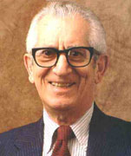
Chapter 10: Bloom’s Taxonomy
Benjamin Bloom 1913-1999

Slide 2
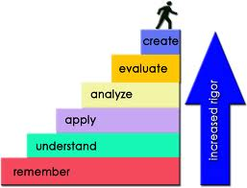
Bloom's Taxonomy is a multi-tiered model of classifying thinking according to six cognitive levels of complexity.
It is often depicted as a stairway, leading teachers to encourage their students to climb to a higher level of thought.

Slide 3
Original Bloom Taxonomy
The lowest three levels were: knowledge, comprehension, and application.
The highest three levels were: analysis, synthesis, and evaluation.
The taxonomy was and is hierarchical so each level is subsumed by the higher levels.
For example, a student functioning at the application level has also mastered the material at the knowledge and comprehension levels.

Slide 4
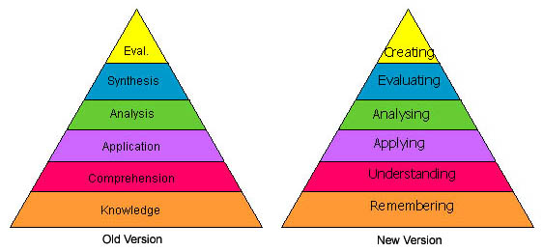
Revised Bloom Taxonomy
In the revised version, Bloom's six major categories were changed from noun to verb forms. Additionally, the lowest level of the original, knowledge, was renamed and became remembering.

Slide 5
Levels of Bloom’s Taxonomy from Bottom to Top
Remembering: Retrieving, recognizing, and recalling relevant knowledge from long-term memory.
Understanding: Constructing meaning from oral, written, and graphic messages through interpreting, exemplifying, classifying, summarizing, inferring, comparing, and explaining.
Applying: Carrying out or using a procedure through executing, or implementing.

Slide 6
Levels of Bloom’s Taxonomy Continued….
Analyzing: Breaking material into constituent parts, determining how the parts relate to one another and to an overall structure or purpose through differentiating, organizing, and attributing.
Evaluating: Making judgments based on criteria and standards through checking and critiquing.
Creating: Putting elements together to form a coherent or functional whole; reorganizing elements into a new pattern or structure through generating, planning, or producing.

Slide 7
Reasons for Using Bloom’s Taxonomy
It provides educators with a systematic classification of the processes of thinking and learning.
Measuring student learning requires a classification of levels of intellectual behavior important in learning.
It provides a clear, concise visual representation of the alignment between standards and educational goals, objectives, products, and activities.

Slide 8
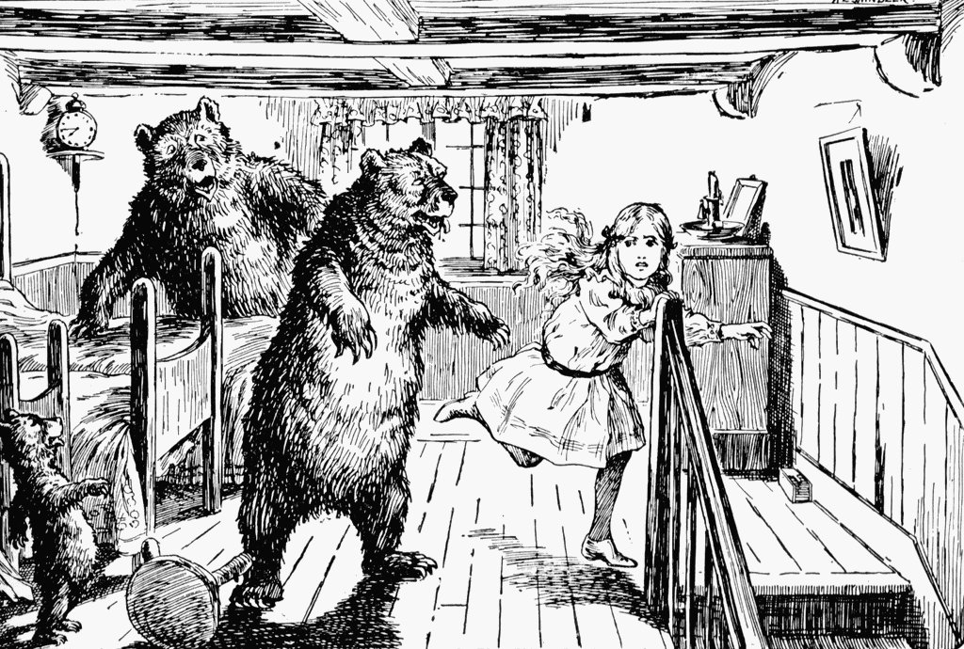
Example of How Bloom’s Taxonomy Could Be Used in the Classroom
A lesson objective based upon the story of Goldilocks and the Three Bears.

Slide 9
Using Bloom’s Taxonomy to Teach the Story of Goldilocks
Remember: Describe where Goldilocks lived.
Understand: Summarize what the Goldilocks story was about.
Apply: Construct a theory as to why Goldilocks went into the house.
Analyze: Differentiate between how Goldilocks reacted and how you would react in each story event.
Evaluate: Assess whether or not you think this really happened to Goldilocks.
Create: Compose a song, skit, poem, or rap to convey the Goldilocks story in a new form.

Slide 10
Reference
Forehand, M. (2005). Bloom's taxonomy: Original and revised. In M. Orey (Ed.), Emerging perspectives on learning, teaching, and technology. Retrieved from http://epltt.coe.uga.edu/

