Slide 1
Chapter 12: Information Processing Theory
Developed by multiple researchers in the 1950s

Slide 2
Information Processing Theory
Consists of three components:
Sensory memory
Working memory
Long-term memory

Slide 3
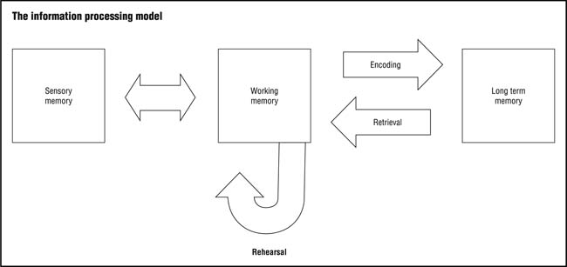
Information Processing Model

Slide 4
Sensory Memory
The main purpose of sensory memory is to screen incoming stimuli and process only those stimuli that are most relevant at the present time.
Sensory memory processes incoming sensory information for very only a few seconds
The amount of information held at any given moment in sensory memory is limited to only a few elements

Slide 5
Sensory Memory Continued
Information processing in sensory memory usually occurs too quickly for people to consciously control what they attend to.
Information that is relevant to the task at hand, and familiar are the most likely types of information to be processed and forwarded to the working memory buffer.
Information that is highly relevant receives conscious processing only if it is crucial to a task

Slide 6
Working Memory
Working memory is a multi-component temporary memory system in which information is assigned meaning, and linked to other information
After stimuli enter sensory memory, they are either forwarded to working memory or deleted from the system.

Slide 7
Three Components of Working Memory
Executive control system-Where humans make conscious meaning of the information they process
Articulatory loop- Maintains and further processes verbal information.
Visual-spatial sketch pad-Barring rehearsal (e.g., repeating a telephone number), information is either forwarded to long-term memory or is deleted from the system.

Slide 8
Long-Term Memory
Role is to provide an unlimited repository for all the facts and knowledge in memory.
Unlike sensory and working memory, long-term memory is not constrained by capacity or duration of attention limitations.
Long-term memory is capable of holding millions of pieces of information for very long periods of time.
Information in long-term memory must be organized, and therefore quickly accessible, to be of practical use to learners.

Slide 9
Working memory and long-term memory are connected by encoding and retrieval processes.

Slide 10
The table below summarizes the purpose, capacity and duration of each type of memory

Slide 11
Implications of Information Processing Theory for Teaching
Memory stores are extremely limited in both sensory and working memory
Teachers should make sure students selectively focus their attention on important information and engage in as much automated processing as possible
Relevant prior knowledge facilitates encoding and retrieval processes.
Helping students use their prior knowledge when learning new information promotes learning.

Slide 12
Importance of organization, inferences, and elaboration
Organization-Activating existing knowledge prior to instruction, or providing a visual diagram of how information is organized, is one of the best ways to facilitate learning new information.
Inferences-Constructing inferences involves making connections between separate concepts.
Elaboration-Refers to increasing the meaningfulness of information by connecting new information to ideas already known.

Slide 13
Reference
Schraw, G., & McCrudden, M. (n. d.) Information processing theory. Education.com. Retrieved from http://www.education.com/reference/article/information- processing-theory/

