Slide 1
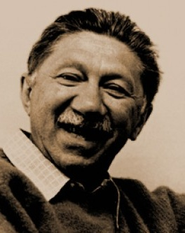
Chapter 11: Maslow’s Hierarchy of Needs Theory and Motivation
Abraham Maslow (1908-1970)

Slide 2
Maslow’s Hierarchy of Needs Theory and Motivation
Humans are motivated by unsatisfied needs.
Lower needs need to be satisfied before higher needs can be met.
Needs such as physiological, safety, love and esteem must be satisfied before a person can act unselfishly.
As long as we are motivated to satisfy needs we are moving toward self-actualization.
Satisfying needs is healthy, but not satisfying needs can make us sick or act angrily.

Slide 3
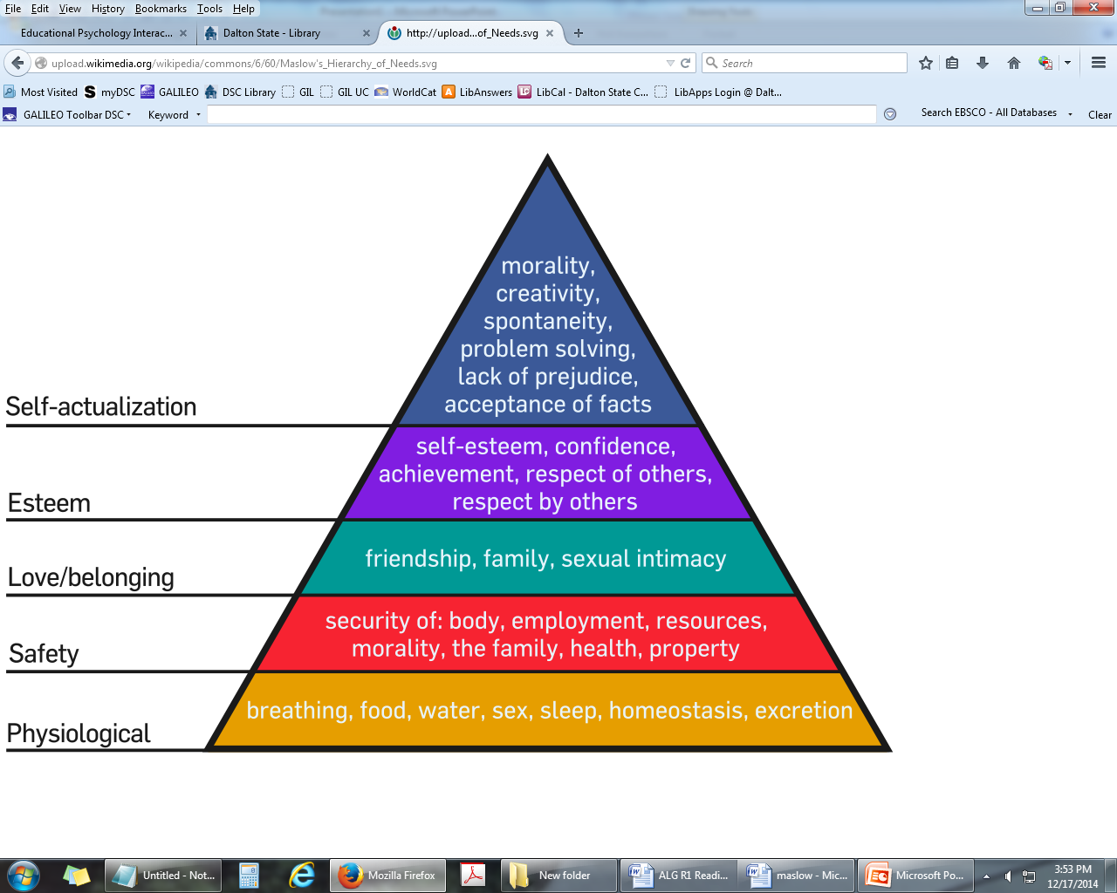
Maslow’s Theory is Often Represented as a Pyramid

Slide 4
The Majority of needs are at the lowest level- physiological needs. These needs include breathing, food, water and sleep.

Slide 5
The next level up is safety. These needs include health, employment and security of family.
Maslow believed that individuals can not satisfy needs at any level until all needs in the levels below are met.

Slide 6
The next level up includes love/belonging needs such as friendship, family and sexual intimacy

Slide 7
Esteem needs are next going up the pyramid. Some of these include self-esteem, achievement, and respect of others.
Esteem needs can be classified as internal or external.
Internal needs are related to self-esteem such as self respect and achievement.
External needs are those such as social status or recognition.

Slide 8
Self-actualization is at the top level of Maslow’s hierarchy. This includes such needs as morality, lack of prejudice and acceptance of facts.

Slide 9
Reference
Maslow, A. H. (1943). A theory of human motivation. Psychological Review, 50, 370-396.

