Slide 1
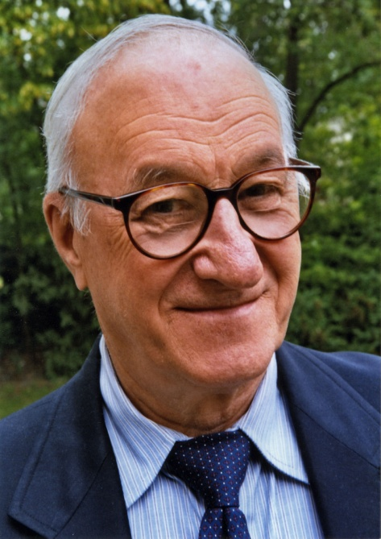
Chapter 3: Bandura’s Social Cognitive Theory
Albert Bandura (1925- )

Slide 2
Social Cognitive Theory (SCT) has been applied broadly to areas of human functioning such as career choice, organizational behavior, athletics, and mental and physical health.

Slide 3
Social Cognitive Theory
Developed with an emphasis on the acquisition of social behaviors
Learning occurs in a social context .
Much of what is learned is gained through observation.
A person's on-going functioning is a product of a continuous interaction between cognitive, behavioral, and contextual factors.

Slide 4
Five Central Concepts of Social Cognitive Theory
Observational Learning/Modeling
Outcome Expectations
Perceived Self-efficacy
Goal Setting
Self-regulation

Slide 5
First Concept: Observational Learning/Modeling
Learning is a result of watching the behavior and consequences of models in the environment.
Live demonstrations of a behavior or skill by a teacher or classmate, of course, typify the notion of modeling.
Verbal or written descriptions, video or audio recordings, and other less direct forms of performance are also considered forms of modeling.

Slide 6
Observational Learning/Modeling Continued….
Observational learning of novel behaviors is dependent on four inter-related processes: attention, retention, production, and motivation.
Attention Students must attend to a model and the relevant aspects of behavior in order to learn.
Retention Reducing and transforming what is observed into a symbolic form that can be stored for later use.
Production Students draw on their stored codes and make an effort to perform what they have observed.
Motivation Why students engage in the prior sub-processes, including whether they ever attempt to use or recreate the new skills they have observed.

Slide 7
Second Concept: Outcome Expectations
Reflect individuals' beliefs about what consequences are most likely to ensue if particular behaviors are performed.
These beliefs are formed enactively through students' own past experiences and vicariously through the observation of others.
Outcome expectations shape the decisions people make about what actions to take and which behaviors to suppress.
The frequency of a behavior should increase when the outcomes expected are valued, whereas behaviors associated with unfavorable or irrelevant outcomes will be avoided.

Slide 8
Third Concept: Perceived Self-Efficacy
Reflects individuals' beliefs about whether they can achieve a given level of success at a particular task.
Students with greater self-efficacy are more confident in their abilities to be successful when compared to their peers with lower self-efficacy.
Higher levels of perceived self-efficacy have been associated with greater choice, persistence, and with more effective strategy use.

Slide 9
Fourth Concept: Goal Setting
Reflect cognitive representations of anticipated, desired, or preferred outcomes.
People use forethought to envision the future, identify desired outcomes, and generate plans of action.
Goals are also closely related to other important processes within SCT.

Slide 10
Self-Regulation
Dependent on goal setting in that students are thought to manage their thoughts and actions in order to reach particular outcomes
Contains three sub-processes:
Self-observation- student’s ability to monitor or keep track of own behaviors and outcomes.
Self-judgment- students' evaluate whether their actions are effective and allow them to make progress toward their goals.
Self-reaction- students' respond to the evaluations they have made by modifying their behavior, rewarding it, or discontinuing it.
Self-regulation is dependent on other processes within SCT, especially goal setting and self-efficacy.

Slide 11
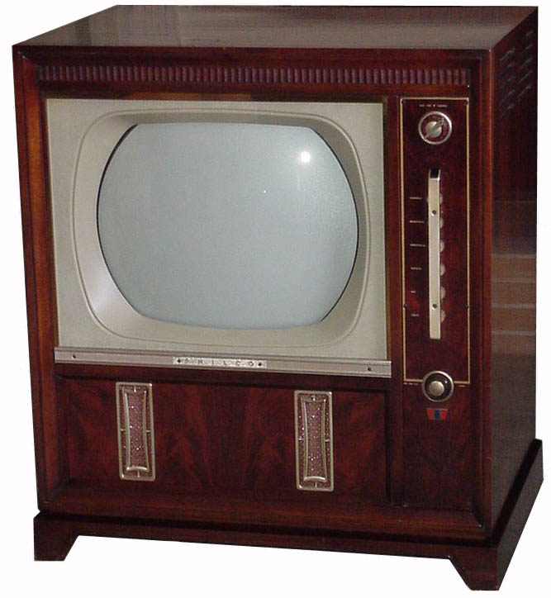
Television and Social Cognitive Theory
Young children are particularly unable to discriminate between the fiction of television and real life. Research shows that they are likely to apply the aggressive behaviors they have seen on television to the playground as early as nursery school age.

Slide 12
Television and Social Cognitive Theory continued….
If Bandura's social cognitive theory is extended to television viewing, it would indicate that children would learn aggressive behavior through observation of violence on television.
If children observe positive behaviors in television programming, they should emulate those behaviors as well.
Bandura's theory states that when children see behavior modeled, they will accept it and use it when they deem it appropriate.

Slide 13
Television and Social Cognitive Theory continued….
Research shows that violent acts in regular television programming have more of an effect on children's behavior than sports programming.
Research also shows that children who observe violence in prime time television or on Saturday morning children's shows will behave aggressively whether or not they were pre-disposed to behave aggressively.

Slide 14
Classroom Implications of Social Cognitive Theory
Teachers should model the behaviors and cognitive processes they want students to learn.
To improve motivation, teachers should also model attitudes that they want students to adopt such as enthusiasm or interest in the material.
Students must believe that, if they complete learning tasks successfully, the outcomes they achieve are meaningful, useful, or worthy of the effort necessary to reach them.
To encourage these beliefs, teachers should create lessons that emphasize real-world applications and the relevance of material to students' own lives.

Slide 15
Classroom Implications of Social Cognitive Theory Continued….
Teachers should ensure that students have the prerequisite knowledge and strategies needed to be successful at more complex and rigorous tasks.
Teachers can make direct statements to learners as a way to boost their confidence.
Instructional practices should promote students' efforts to set attainable goals that are clear, specific, and moderately challenging.
Teachers should help students become skilled at self-observation, self-judgment, and self-reaction.

Slide 16
Reference
Denler, H., Wolters, C., & Benzon, M. (2014). Social cognitive theory. Retrieved from http://www.education.com/reference/article/social-cognitive-theory/

