Slide 1
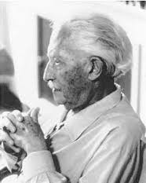
Chapter 8: Erik Erikson’s Social-Emotional Development Stages and a Comparison with the Bingham-Stryker model
Erik Erikson (1902-1994)

Slide 2
Importance of Crisis in Erikson’s Social-Emotional Development Stages
The social environment combined with biological maturation provides each individual with a set of "crises" that must be resolved.

Slide 3
According to Erikson: The individual is provided with a period to resolve each crisis before a new crisis begins.
Crisis Resolution Crisis
The results of the resolution, whether successful or not, are carried forward to the next crisis and provide the foundation for its resolution.

Slide 4
Erikson Proposed in his Theory that there were Eight Stages of Socio-emotional Development.

Slide 5
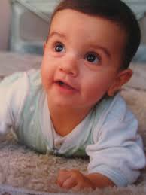
First Stage Infancy: Trust vs. Mistrust
The child develops a belief that the environment can be counted on to meet his or her basic physiological and social needs.

Slide 6
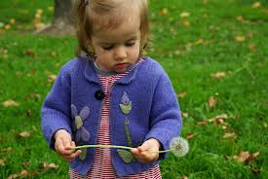
Second Stage Toddlerhood: Autonomy vs. Shame and Doubt
Child learns what he can control and develops a sense of free will and corresponding sense of regret and sorrow for inappropriate use of self-control.

Slide 7
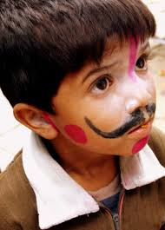
Third Stage Early Childhood: Initiative vs. Guilt
Child learns to begin action, to explore, to imagine as well as feeling remorse for actions.

Slide 8
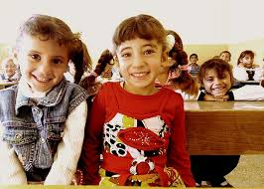
Fourth Stage Middle Childhood: Accomplishment vs. Inferiority
Child learns to do things well or correctly in comparison to a standard or to others.

Slide 9
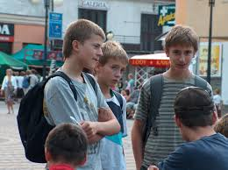
Fifth Stage Adolescence: Identity vs. Role Confusion
Develops a sense of self in relationship to others and to own internal thoughts and desires.

Slide 10
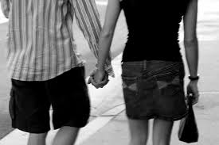
Sixth Stage Young Adult: Intimacy vs. Isolation
Develops ability to give and receive love.
Begins to make long-term commitment to relationships.

Slide 11
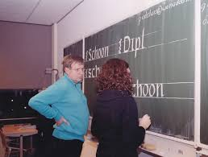
Seventh Stage Middle Adulthood: Generativity vs. Stagnation
Develops interest in guiding the development of the next generation.

Slide 12
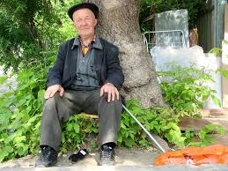
Eighth Stage Older Adulthood: Ego Integrity vs. Despair
Develops a sense of acceptance of life as it was lived and the importance of the people and relationships that the individual developed over the lifespan.

Slide 13
Expanding Upon Erikson’s Theory
Bingham and Stryker (1995) propose five stages of socio-emotional development for girls and women that parallels those proposed by Erikson.

Slide 14
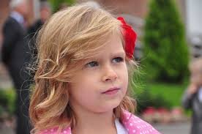
Developing the Hardy Personality Through Age 8
Feel in control of own life.
Committed to specific activities.
Look forward to challenge and opportunity for growth.

Slide 15
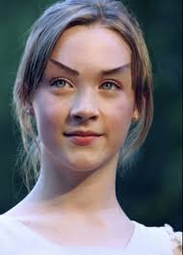
Forming an Identity as an Achiever Age 9-12
Develop steady, durable core of self as person who is capable of accomplishment in a variety of areas.

Slide 16
Skill Building for Self-Esteem Age 13-16
Feeling of being worthy and deserving.
Entitled to assert needs and wants.
Confidence in ability to cope with life.

Slide 17
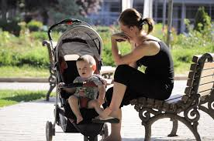
Strategies for Self-Sufficiency Age 17-22
Sense of responsibility for taking care of herself and, perhaps, a family.

Slide 18
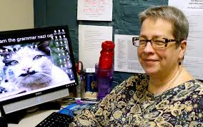
Satisfaction of Work and Love Age: Adulthood
Contentedness in personal accomplishments and social/personal relationships.

Slide 19
According to Bingham and Stryker (1995)
“The importance of self-esteem for girls in the adolescent years cannot be overemphasized.”

Slide 20
Studies show that girls have a precipitous drop in self-esteem between elementary and high school. The decline in boys self-esteem is not nearly as dramatic.

Slide 21
Difference between the Erikson and Bingham-Stryker models is in the stage of early adulthood.
In Erikson's model the crisis is intimacy versus isolation.
In the Bingham-Stryker model the crisis is emotional and financial self-sufficiency.

Slide 22
References
Bingham, M., & Stryker, S. (1995). Things will be different for my daughter: A practical guide to building her self-esteem and self-reliance. New York: Penguin Books.
Huitt, W. (2008). Socioemotional development. Educational Psychology Interactive. Valdosta, GA: Valdosta State University. Retrieved from http://www.edpsycinteractive.org/topics/affect/erikson.html

