Slide 1
Chapter 7: Urie Bronfenbrenner's Bio-Ecological Model of Development

Slide 2
Focuses on patterns of development across time as well as the interactions between the development of the child and the environment.
Also looked at social and political policies and practices affecting children and families.

Slide 3
The model describes the complex interplay between the individual - as the center-and the social contexts within which the individual develops

Slide 4
Bronfenbrenner’s model comprises five systems that contain roles, norms, and rules that can powerfully shape development.

Slide 5
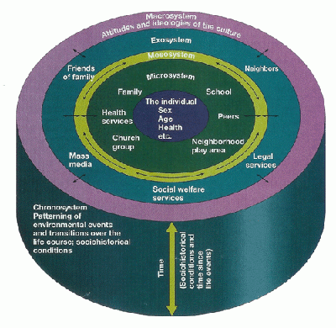
The Five Systems of The Bio-Ecological Theory of Human Development: Microsystem, Mesosystem, Exosystem, Macrosystem, and the Chronosystem

Slide 6
Microsystem:
The setting in which the individual spends considerable time - e.g. in direct reciprocal interaction with family, peers, school and neighborhood vs. being a passive recipient.

Slide 7
Mesosystem:
The linkages between microsystems such as the connections between family experiences and school experiences.

Slide 8
Exosystem
The individual does not have any control over what she or her experiences-e.g. a parent's workplace or school district.

Slide 9
Macrosystem:
The broader cultural context, e.g. the roles of ethnicity and socioeconomic factors that impact on the individual's development.

Slide 10
Chronosystem
The socio-historical conditions affecting an individual's development.
Examples: The pervasiveness of technology in society, the breakdown of traditional family model or the impact of urban city dwelling.

Slide 11
Criticism of Bio-Ecological Model
Focuses too much on the biological and cognitive aspects of development.
Not enough information about human development.

Slide 12
Integrated Ecological System Framework Model
Three domains of human development were added to Bronfenbrenner’s Bio-Ecological Model to make a model that is called the Integrated Ecological System Framework.
These three domains of human development that were added are:
Biological Processes: the physical changes in an individual’s body.
Cognitive Processes: the changes in an individual’s thinking and intelligence.
Socio-Emotional Processes: the changes in an individual's relationship with other people in emotions, in personality and in the role of social contexts in development.

Slide 13
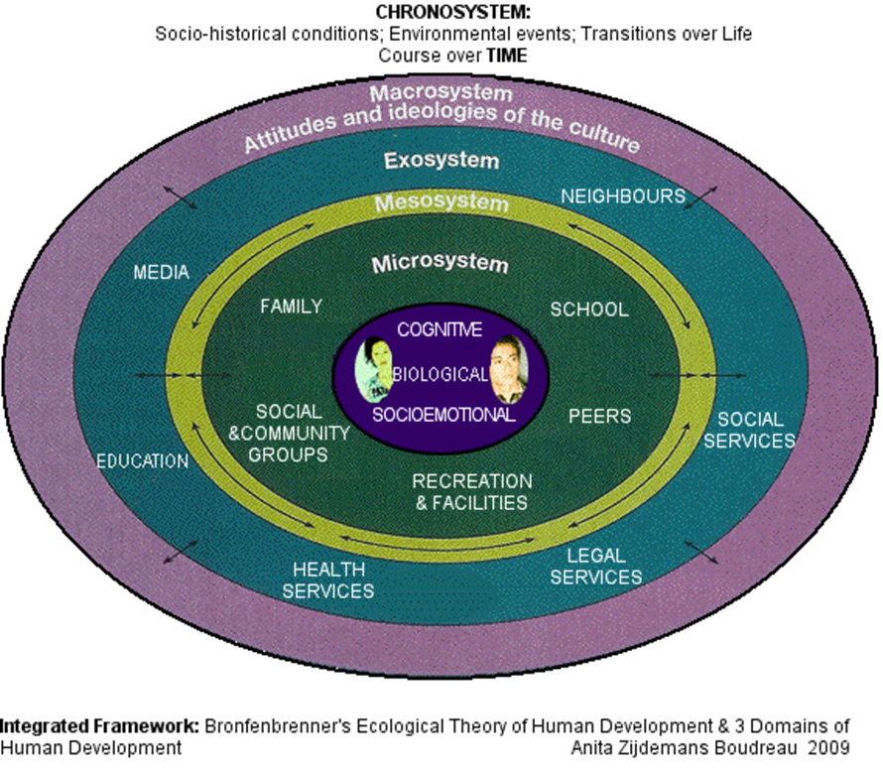
Integrated Ecological Systems Framework

Slide 14
Reference
Integrated Ecological Systems and Framework. (n.d.). Retrieved from https://sites.google.com/site/humandevelopmentlearning/ integrated-framework

