Slide 1
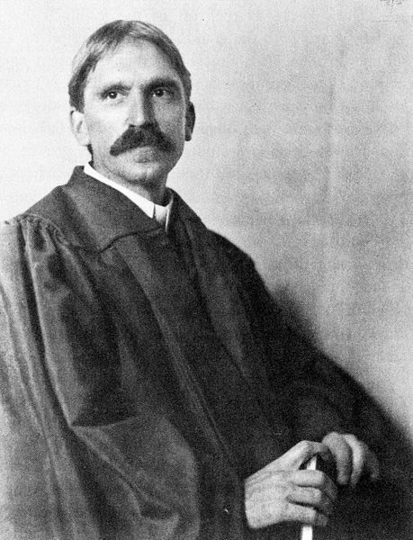
Experiential Learning Theory
John Dewey 1859-1952
David Kolb 1940-

Slide 2
Experiential Learning Theory
Focus of theory is experience, which serves as the main driving force in learning, as knowledge is constructed through the transformative reflection on one's experience.

Slide 3
Two distinct modes of gaining experience that are related to each other on a continuum:
Concrete experience (apprehension)
Abstract conceptualization (comprehension)

Slide 4
Two distinct modes of transforming the experience so that learning is achieved:
Reflective observation (intension)
Active experimentation (extension)

Slide 5
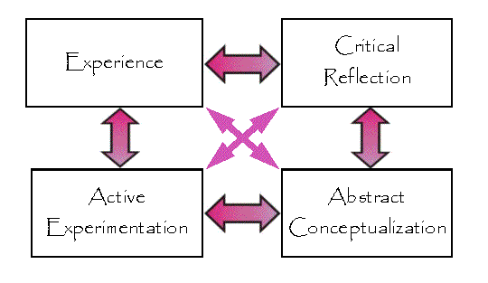
These four modes constitute a learning cycle that learners go through during the experiential learning process:

Slide 6
Summary of the Four Mode Learning Cycle
Learners begin with a concrete experience, which then leads them to observe and reflect on their experience.
The learners then piece their thoughts together to create abstract concepts about what occurred, which will serve as guides for future actions.
With these guides in place, the learners actively test what they have constructed leading to new. experiences and the renewing of the learning cycle
Perception alone is not sufficient for learning; something must be done with it.
Transformation alone cannot represent learning, for there must be something to be transformed.

Slide 7
Applications of Experiential Learning Theory
Cooperative Education (co-op) is a structured educational strategy integrating classroom studies with work-based learning related to a student's academic or career goals.
An internship is typically a temporary position, which may be paid or unpaid, with an emphasis on on-the-job training, making it similar to an apprenticeship.
Service learning is a teaching and learning strategy that integrates meaningful community service with instruction and reflection to enrich the learning experience, teach civic responsibility, and strengthen communities with the emphasis on meeting community needs.

Slide 8
Integrating Experiential Learning in the Classroom
Set up the experience by introducing learners to the topic and covering basic material that the learner must know beforehand.
Engage the learner in a realistic experience that provides intrigue as well as depth of involvement (mock trial).
Allow for discussion of the experience including the happenings that occurred and how the individuals involved felt (discussion afterwards).
The learner will then begin to formulate concepts and hypotheses concerning the experience through discussion as well as individual reflection (discussion afterwards, but also could be done with journaling).
Allow the learners to experiment with their newly formed concepts and experiences (interpreting current conflict and conflict resolution scenario).
Further reflection on experimentation (discussion, but could also be done through journaling).

Slide 9
Criticisms
The concrete experience part of the learning cycle is not appropriately explained in the theory and remains largely unexplored.
The idea of immediate and concrete experience is problematic and unrealistic.
The concepts outlined ELT are too ill-defined and open to various interpretations.

Slide 10
Reference
Oxendine, C., Robinson, J., & Willson, G. (2004). Experiential learning. In M. Orey (Ed.), Emerging perspectives on learning, teaching, and technology. Retrieved from http://epltt.coe.uga.edu/index.php?title=Experiential_Learning

