Slide 1
Module 2 CHLD105
Developmental and Theoretical Foundations
This slide show was created by Laura Paciorek as a companion to
"Principles and Practices of Teaching Young Children" by Cindy Stephens, Gina Peterson, Sharon Eyrich, and Jennifer Paris, College of the Canyons is licensed under CC BY 4.0 / A derivative from the original work
The book contains text with various licenses. Images all contain license information.

Slide 2
Domains of Development
Physical/Motor
Child
Cognitive or Intellectual
Affective

Slide 3
Pause to Reflect… Personal Growth and Development
Think about your own growth and development.
Do you favor one side of the nature vs nurture debate?
Which premise seems to make more sense – continuous or discontinuous development?

Slide 4
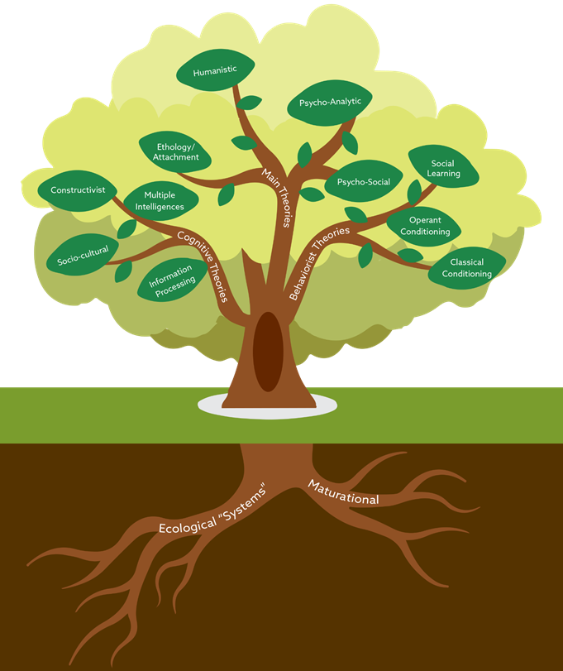
Make notes about what each theory suggests about child development and learning.
Which theories do you feel best explain how children develop and learn?

Slide 5
Brain Functioning
Identity Formation
Current Topics in ECE
Developmentally Appropriate Practice
Attachment
Value of Play in Early Childhood
Trauma-Informed Care

Slide 6
Types of Play
Symbolic Play
Rough and Tumble Play
Socio-Dramatic Play
Social Play
Creative Play
Communication Play
Locomotor Play
Deep Play
Fantasy Play
Object Play

