Slide 1
Module 4 CHLD105
Observation and Assessment
This slide show was created by Laura Paciorek as a companion to
"Principles and Practices of Teaching Young Children" by Cindy Stephens, Gina Peterson, Sharon Eyrich, and Jennifer Paris, College of the Canyons is licensed under CC BY 4.0 / A derivative from the original work
The book contains text with various licenses. Images all contain license information.

Slide 2
Observation versus Supervision
According to Gordon and Browne (2016) “Observing is more than ordinary supervision. It takes energy and concentration to become an accurate observer.”[i]
[i] Gordon, A. M., & Browne, K. W. (2016). Beginning essentials in early childhood education. Boston, MA: Cengage Learning

Slide 3
Define these concepts
Objectivity
Bias
How do you know if you are being objective?
How do you keep your bias in check?

Slide 4
Improve teaching practices
Assess children’s development
Purposes of Observation
Plan curriculum
Partner with families

Slide 5
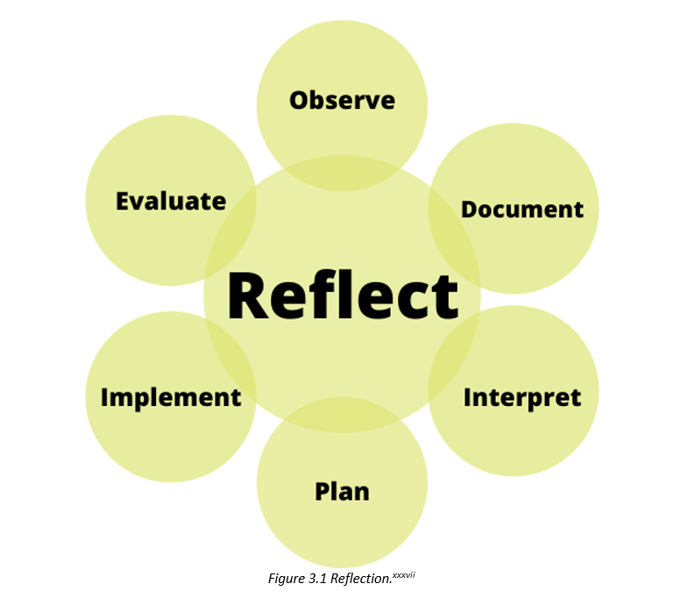
[i] Image by COC OER Team is licensed under CC BY 4.0.

Slide 6
Observations
May be spontaneous
OR
May be planned

Slide 7
Developmental checklists
Frequency counts
Observation Tools
Work samples (authentic evidence)
Running record
Anecdotal record

Slide 8
Documentation Boards or Panels contain...
Learning goal and objectives
Children’s language development
The process and complete project
The milestones of development

Slide 9
Observation informs every step in the process
Interpret observations
Use interpretations to plan
Implement plans
Observe and evaluate plans
Use observations to inform next steps
The cycle continues...

Slide 10
Assessment is Not testing...
Step 1: Gather Baseline Data
Step 2: Monitor Each Child’s Progress
Step 3: Have a Systematic Plan in Place

Slide 11
Portfolios
Learning stories
Some Assessment Tools
Desired Results Developmental Profile (DRDP)

Slide 12
Partner with Families
Families provide valuable input in the assessment process!

