Slide 1
This PowerPoint
Is created as a companion to Child Growth and Development by College of the Canyons, Jennifer Paris, Antoinette Ricardo, and Dawn Rymond and is used under a CC BY 4.0 international license
The text comes from content in the book which has varied licensing
The images all include licensing information

Slide 2
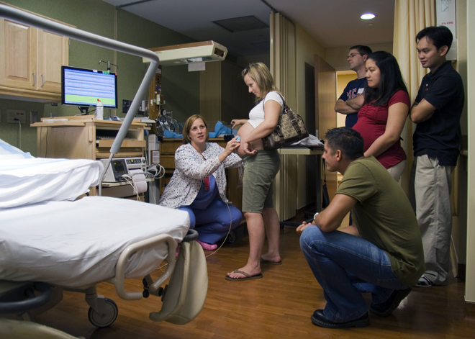
Childbirth
Image by liz.schrenk is licensed under CC BY-NC-ND 2.0

Slide 3
Approaches to Childbirth
Method | Description
The Lamaze Method | The emphasis of this method is on teaching the woman to be in control in the process of delivery. It includes learning muscle relaxation, breathing through contractions, having a focal point (usually a picture to look at) during contractions and having a support person who goes through the training process with the mother and serves as a coach during delivery
The Leboyer Method | This method involves giving birth in a quiet, dimly lit room and allowing the newborn to lie on the mother’s stomach with the umbilical cord intact for several minutes while being given a warm bath.
Dick-Read Method / Mongan Method / Hypnobirthing | This method comes from the suggestion that the fear of childbirth increases tension and make the process of childbearing more painful. It emphasizes the use of relaxation and proper breathing with contractions as well as family support and education.

Slide 4
Childbirth
Onset
Bloody show (losing the mucus plug)
Hormone changes
Mother’s and fetal pituitary glands secrete oxytocin
Fetal membranes secrete prostaglandins
Results in contractions
Fetus’ head stretches cervix
Results in contractions

Slide 5
Stage 1 of Childbirth by Vaginal Delivery
Image by OpenStax is licensed under CC BY 3.0

Slide 6
Stage 2 of Childbirth by Vaginal Delivery
Image by OpenStax is licensed under CC BY 3.0

Slide 7
Stage 3 of Childbirth by Vaginal Delivery
Image by OpenStax is licensed under CC BY 3.0

Slide 8
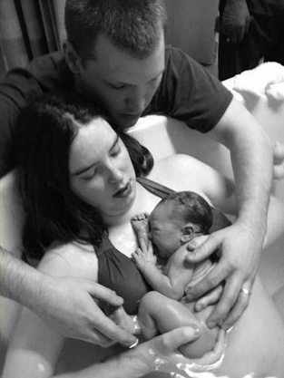
Additional Considerations – Managing Pain
More than 50% of women giving birth in hospitals get an epidural
Can use other pain medications
May choose not to use pain medication
Can use alternate positions
Can give birth in warm tub of water
Image by U.S. Army Alaska is licensed under CC BY 2.0

Slide 9
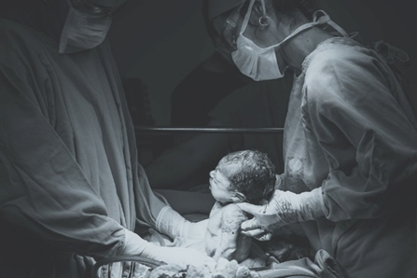
Medical Interventions in Childbirth
Induction – stimulating labor before it begins naturally
Cesarean section – removing the baby surgically
Vaginal Birth After Cesearan (VBAC)
Image by Patricia Prudente on Unsplash

Slide 10
This PowerPoint was created by Jennifer Paris. Except where otherwise noted, it is licensed under a Creative Commons Attribution 4.0 International License.

