Slide 1
This PowerPoint
Is created as a companion to Child Growth and Development by College of the Canyons, Jennifer Paris, Antoinette Ricardo, and Dawn Rymond and is used under a CC BY 4.0 international license
The text comes from content in the book which has varied licensing
The images all include licensing information

Slide 2
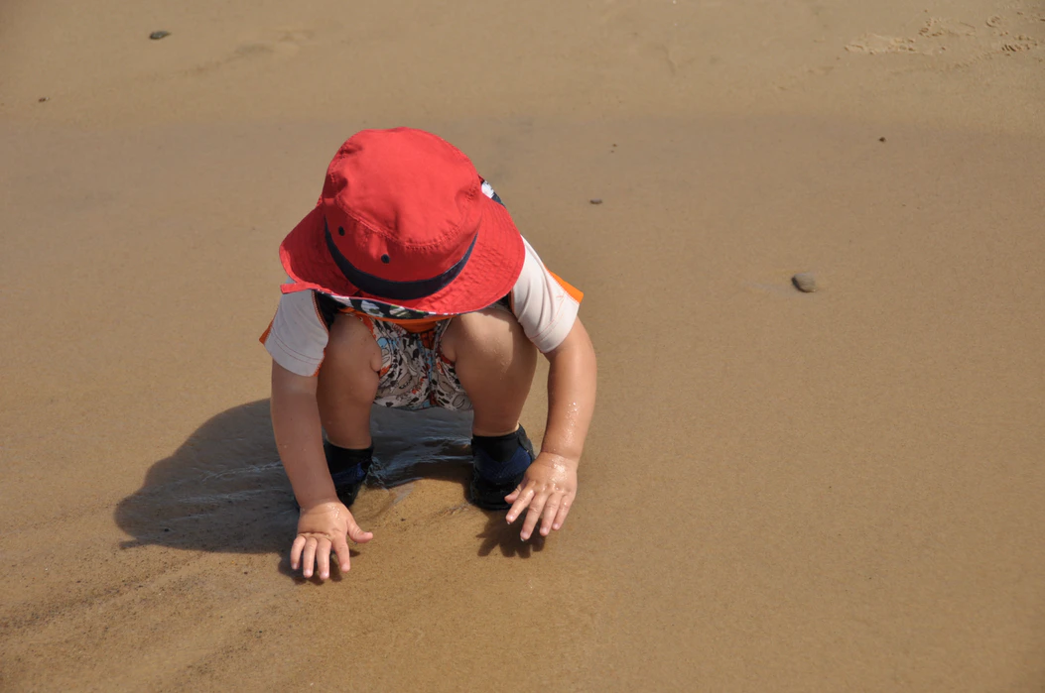
Piaget’s Preoperational Intelligence
Image by Brad Dodson on freely available on Unsplash

Slide 3
Piaget’s Theory During Early Childhood
During the early childhood years, children are in Piaget’s preoperational stage
This stage is characterized by the beginning of use of language and symbolism
Image is in the public domain

Slide 4
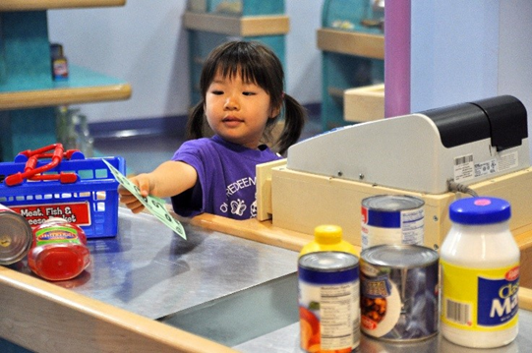
Pretend Play
A favorite early childhood activity
An item can stand for something else
This helps children solidify their schemas
It is not just a product of their learning, but a process of learning
Image by Ermalfaro is licensed under CC BY-SA 4.0

Slide 5
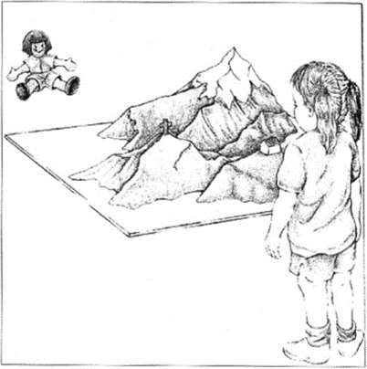
Egocentrism
Tendency for children to believe that everyone sees things the same way as they do
Piaget’s used the 3 Mountain Task to assess children’s ability to understand the views of others
Image by Rosenfeld Media is licensed under CC BY 2.0

Slide 6
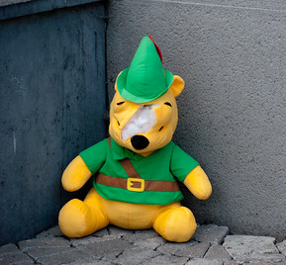
Syncretism, Animism, & Classification Errors
Syncretism
Animism
Classification Errors
Image by Phillippe Put is licensed under CC BY 2.0
Image by Jennifer Paris is licensed under CC BY 4.0
Image by Ibai is licensed under CC BY 2.0

Slide 7
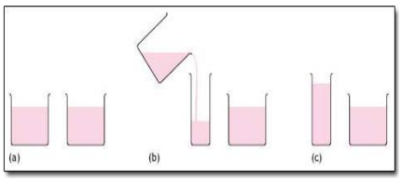
Conservation Errors
Centration keeps young children from understanding conservation - that moving or rearranging matter does not change its quantity
Image by Martha Lally and Suzanne Valentine-French is licensed under CC BY-NC-SA 3.0

Slide 8
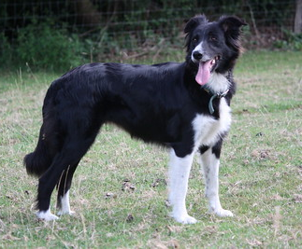
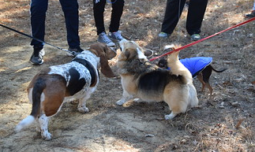
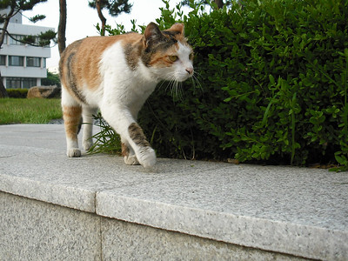
Cognitive Schemas
Use schemas to make sense of the world
Strive for cognitive equilibrium
Schema: 4 legged animals with fur are dogs
Accommodation would be used to add a new schema for this
These would assimilate into the schema
Image by Virginia State Parks is licensed under CC BY 2.0
Image by koi ko is in the public domain
Image by Tamsin Cooper is licensed under CC BY-SA 2.0

Slide 9
This PowerPoint was created by Jennifer Paris. Except where otherwise noted, it is licensed under a Creative Commons Attribution 4.0 International License.

