Slide 1
This PowerPoint
Is created as a companion to Child Growth and Development by College of the Canyons, Jennifer Paris, Antoinette Ricardo, and Dawn Rymond and is used under a CC BY 4.0 international license
The text comes from content in the book which has varied licensing
The images all include licensing information

Slide 2
Cognitive Development in Infancy and Toddlerhood
Image by U.S. Air Force is in public domain

Slide 3
Substages of Piaget’s Sensorimotor Stage.
Substage | Age | Description
Substage 1: Simple Reflexes | Birth to 1 month | This active learning begins with automatic movements or reflexes. A ball comes into contact with an infant’s cheek and is automatically sucked on and licked.
Substage 2: Primary Circular Reactions | 1 to 4 months | The infant begins to discriminate between objects and adjust responses accordingly as reflexes are replaced with voluntary movements. An infant may accidentally engage in a behavior and find it interesting such as making a vocalization. This interest motivates trying to do it again and helps the infant learn a new behavior that originally occurred by chance. At first, most actions have to do with the body, but in months to come, will be directed more toward objects.
Substage 3: Secondary Circular Reactions | 4 to 8 months | The infant becomes more and more actively engaged in the outside world and takes delight in being able to make things happen. Repeated motion brings particular interest as the infant is able to bang two lids together from the cupboard when seated on the kitchen floor.

Slide 4
Substages of Piaget’s Sensorimotor Stage.
Substage | Age | Description
Substage Four: Coordination of circular reactions | 8 to 12 months | The infant can engage in behaviors that others perform and anticipate upcoming events. Perhaps because of continued maturation of the prefrontal cortex, the infant become capable of having a thought and carrying out a planned, goal-directed activity such as seeking a toy that has rolled under the couch. The object continues to exist in the infant’s mind even when out of sight and the infant now is capable of making attempts to retrieve it.
Substage Five: Tertiary Circular Reactions | 12 to 18 months | The infant more actively engages in experimentation to learn about the physical world. Gravity is learned by pouring water from a cup or pushing bowls from high chairs. The caregiver tries to help the child by picking it up again and placing it on the tray. And what happens? Another experiment! The child pushes it off the tray again causing it to fall and the caregiver to pick it up again!
Substage Six: Internalization of Schemes and Early Representational thought | 18 months to 2 years | The child is now able to solve problems using mental strategies, to remember something heard days before and repeat it, to engage in pretend play, and to find objects that have been moved even when out of sight. Take for instance, the child who is upstairs in a room with the door closed, supposedly taking a nap. The doorknob has a safety device on it that makes it impossible for the child to turn the knob. After trying several times in vain to push the door or turn the doorknob, the child carries out a mental strategy learned from prior experience to get the door opened-he knocks on the door! The child is now better equipped with mental strategies for problem-solving.

Slide 5
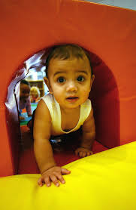
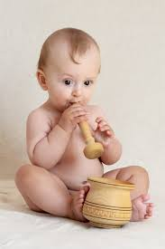
Evaluating Piaget
Provided helpful framework for understanding how infants and toddlers learn about the world
But it’s not quite so neatly packaged in reality
Object permanence is developed before he proposed
A-not-B error is not crucial for progression into Stage 4
Image by U.S. Air Force is in the public domain
Image on pxhere

Slide 6
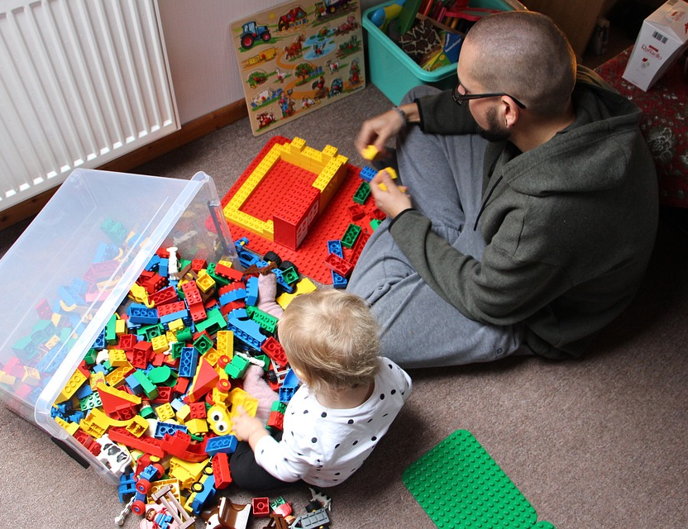
Vygotsky
Agreed with Piaget that children learn through physical interaction with the world
But differed by believing that the social and cultural environment is also important
The child is an apprentice, learning through interactions with others who have more experience
Image by Tabeajaichhalt on Pixabay

Slide 7
Cognitive Milestones
Typical Age | What Most Children Do By This Age
2 months | Pays attention to faces Begins to follow things with eyes and recognize people at a distance Begins to act bored (cries, fussy) if activity doesn’t change
4 months | Lets you know if she is happy or sad Responds to affection Reaches for toy with one hand Uses hands and eyes together, such as seeing a toy and reaching for it Follows moving things with eyes from side to side Watches faces closely o Recognizes familiar people and things at a distance
6 months | Looks around at things nearby Brings things to mouth Shows curiosity about things and tries to get things that are out of reach Begins to pass things from one hand to the other
9 months | Watches the path of something as it falls Looks for things he sees you hide Plays peek-a-boo Puts things in her mouth Moves things smoothly from one hand to the other Picks up things like cereal o’s between thumb and index finger

Slide 8
Cognitive Milestones
Typical Age | What Most Children Do By This Age
1 year | Explores things in different ways, like shaking, banging, throwing Finds hidden things easily Looks at the right picture or thing when it’s named Copies gestures Starts to use things correctly; for example, drinks from a cup, brushes hair Bangs two things together Puts things in a container, takes things out of a container Lets things go without help Pokes with index (pointer) finger Follows simple directions like “pick up the toy”
18 months | Knows what ordinary things are for; for example, telephone, brush, spoon Points to get the attention of others Shows interest in a doll or stuffed animal by pretending to feed Points to one body part Scribbles on his own Can follow 1-step verbal commands without any gestures; for example, sits when you say “sit down”
2 years | Finds things even when hidden under two or three covers Begins to sort shapes and colors Completes sentences and rhymes in familiar books Plays simple make-believe games Builds towers of 4 or more blocks Might use one hand more than the other Follows two-step instructions such as “Pick up your shoes and put them in the closet.” Names items in a picture book such as a cat, bird, or dog

Slide 9
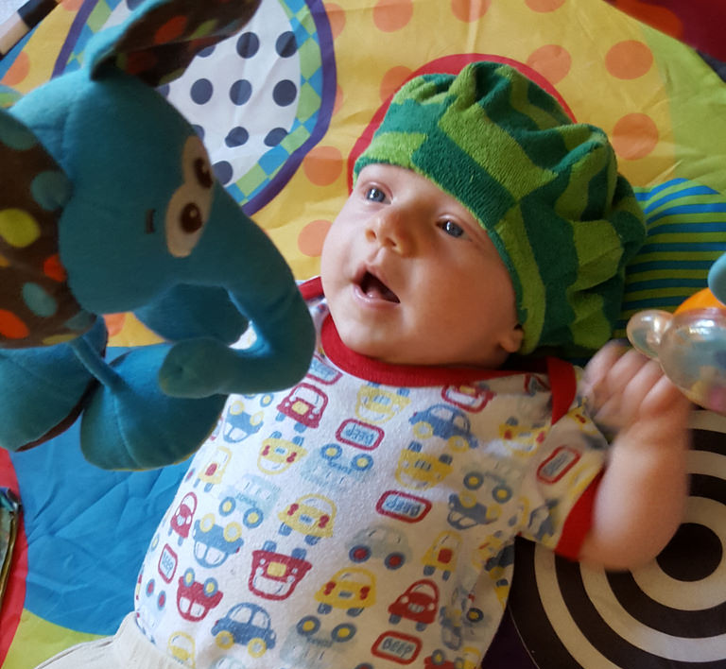
Language Development in Infancy and Toddlerhood
Image by Quinn Dombrowski is licensed under CC BY-SA 2.0

Slide 10
Stages of Language Development.
Stage | Age | Description
Intentional Vocalizations | First couple months | Gurgling, musical vocalization called cooing is practice for vocalization Begin alternate their vocalization with that of someone else and then take their turn again when the other person’s vocalization has stopped
Babbling and Gesturing | 4 to 6 months | Vocalizations include sounds for any language Gestures seem to be easier than vocalizations and can allow babies that are hearing and deaf to communicate
Understanding | 10 months | Understands more than can be communicated
Holophrasic speech | 12-13 months | May use partial words to convey thought (“ju” for “juice”) called holophrases
Telegraphic speech | 18 months | Two words are combined (“baby bye-bye” for “the baby is leaving”)

Slide 11
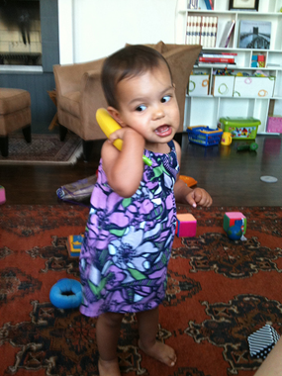
Characteristics of Language Development
Babies can use gestures before they can use words
Culture influences language
In English first words are usually nouns
In Chinese, the focus may be verbs
Vocabulary experiences a growth spurt
Receptive language will outpace expressive language
Children may under- or overextend
Image by Salim Virji is licensed under CC BY-SA 2.0

Slide 12
Language Milestones
Typical Age | What Most Children Do By This Age
2 months | Coos, makes gurgling sounds Turns head toward sounds
4 months | Begins to babble Babbles with expression and copies sounds he hears Cries in different ways to show hunger, pain, or being tired
6 months | Responds to sounds by making sounds Strings vowels together when babbling (“ah,” “eh,” “oh”) and likes taking turns with parent while making sounds Responds to own name Makes sounds to show joy and displeasure Begins to say consonant sounds (jabbering with “m,” “b”)
9 months | Understands “no” Makes a lot of different sounds like “mamamama” and “bababababa” Copies sounds and gestures of others Uses fingers to point at things
1 year | Responds to simple spoken requests Uses simple gestures, like shaking head “no” or waving “bye-bye” Makes sounds with changes in tone (sounds more like speech) Says “mama” and “dada” and exclamations like “uh-oh!” Tries to say words you say

Slide 13
Language Milestones
Typical Age | What Most Children Do By This Age
18 months | Knows what ordinary things are for; for example, telephone, brush, spoon Points to get the attention of others Shows interest in a doll or stuffed animal by pretending to feed Points to one body part Scribbles on his own Can follow 1-step verbal commands without any gestures; for example, sits when you say “sit down”
2 years | Points to things or pictures when they are named Knows names of familiar people and body parts Says sentences with 2 to 4 words Follows simple instructions Repeats words overheard in conversation Points to things in a book

Slide 14
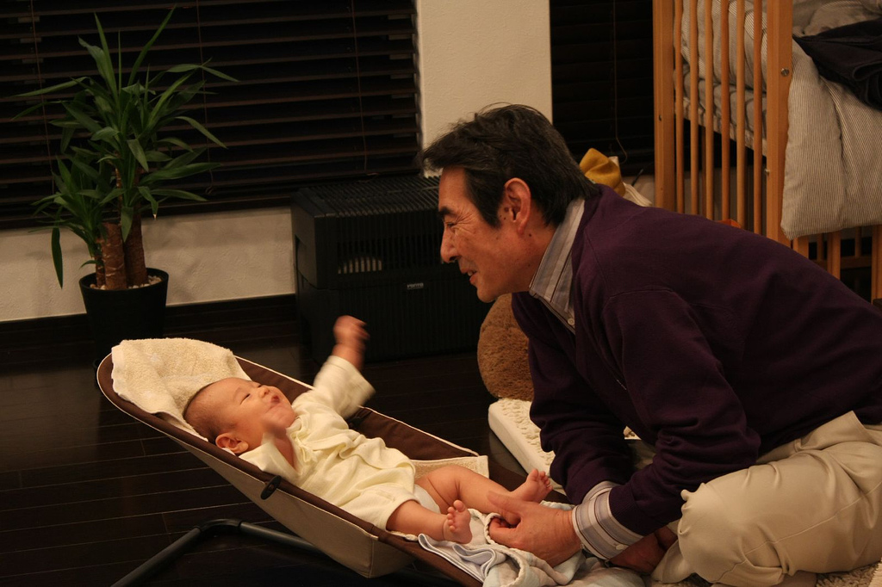
Child-Directed Speech
Why do adults talk to babies in a high-pitched, sing-song voice with exaggerated sounds and facial expressions?
Because it works!
But it is NOT the same as baby talk
Image by Toshimasa Ishibashi is licensed under CC bY 2.0

Slide 15
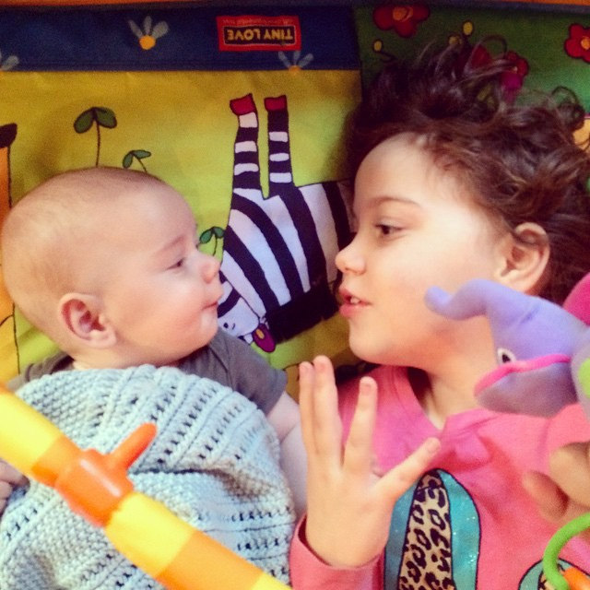
Theories of Language Development
Chomsky believed infants have a language acquisition device that makes them ready for language
Others argue that children learn language because they need to communicate and do so through hearing language of others
Image by cheeseslave is licensed under CC BY 2.0

Slide 16
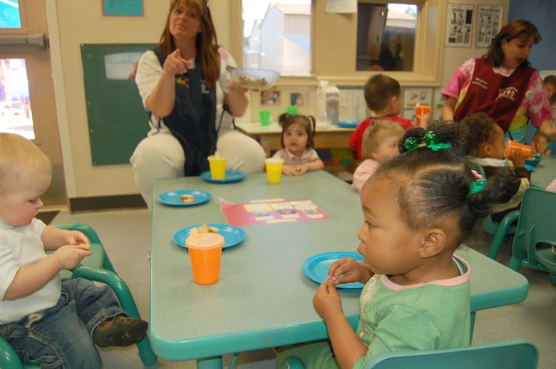
Theories of Learning and Memory
Image by U.S Air Force is in the public domain

Slide 17
Pavlov & Classical Conditioning
Image by Maxxl² is licensed under CC BY-SA 4.0

Slide 18
Skinner & Operant Conditioning
Image by Curtis Neveu is licensed under CC BY-SA 3.0 (Modified from source image)

Slide 19
Watson and Behaviorism
Image is in the public domain

Slide 20
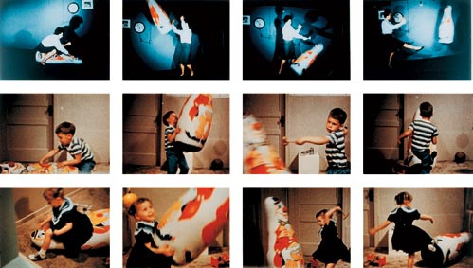
Bandura & Social Learning Theory
Image is in the public domain

Slide 21
Two More Things
Sometimes we experience vicariously reinforcement
There is an interplay between children and their environment called reciprocal determinism
Image by Harsha K R is licensed under CC BY-SA 2.0

Slide 22
Memory
Image by Wikipedia is licensed under CC BY-SA 3.0
Explicit memory
Episodic memory
Implicit memory

Slide 23
This PowerPoint was created by Jennifer Paris. Except where otherwise noted, it is licensed under a Creative Commons Attribution 4.0 International License.

