Slide 1
This PowerPoint
Is created as a companion to Child Growth and Development by College of the Canyons, Jennifer Paris, Antoinette Ricardo, and Dawn Rymond and is used under a CC BY 4.0 international license
The text comes from content in the book which has varied licensing
The images all include licensing information

Slide 2
Understanding the Self In Early Childhood
Image by Kiana Bosman is freely available on Unsplash

Slide 3
Developing a Self-Concept
During early childhood children are working on forming their initial sense of self
This requires interactions with others
Cooley suggests the looking-glass self
Mead looked at how moving from “I” to “me”
It’s often exaggerated
Biggest, fastest, best
Image is in the public domain

Slide 4
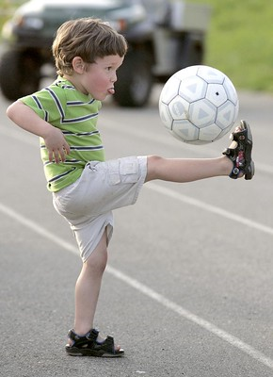
Self-Esteem
Involves an evaluative judgment of who we are
Begins as categorical
Physical traits, preferred activities and favorite possessions
Generally is positive
Image by martha_chapa95 is licensed under CC BY 2.0

Slide 5
Self-Control
Includes
Response initiation
Response inhibition
Delayed gratification
The beginning of a process that takes many years
Play support this process
Image by Nathan Dumlao on Unsplash

Slide 6
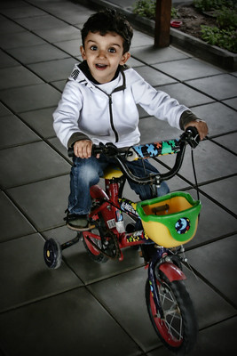
Erikson’s Stage of Initiative vs. Guilt
If children are placed in an environment to explore, make decisions, and initiate activities they achieve initiative
But if they criticized and controlled, they will develop sense of guilt
Image by emifaulk is licensed under CC BY 2.0

Slide 7
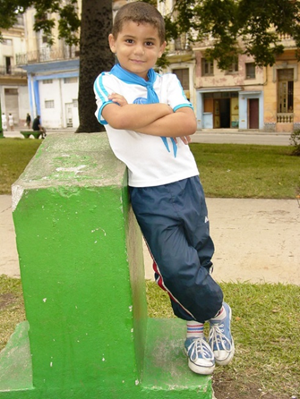
Gender Identity, Gender Constancy, and Gender Roles
Another important dimension of the self is the sense of self as male or female
Increased interest at this age in finding difference between boys and girls
Gender identity ➔ constancy
Image by Adam Jones is licensed under CC BY-SA 2.0
Image by Free-Photos is freely available on Pixabay

Slide 8
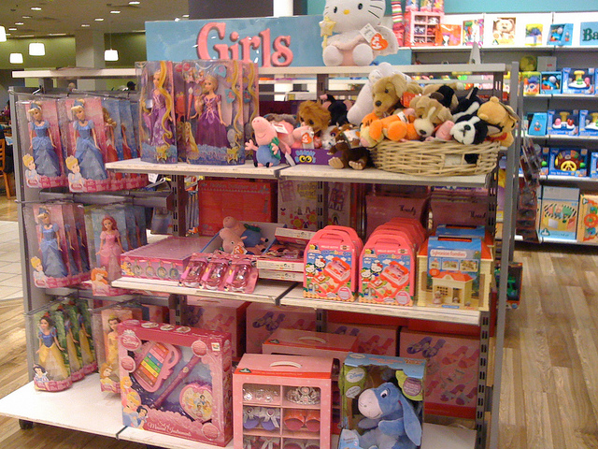
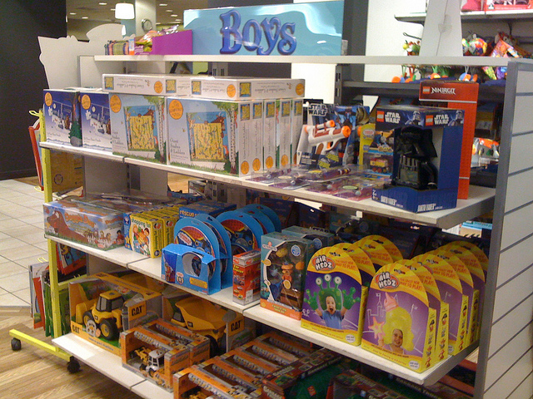
Gender Roles & Socialization
Gender roles are learned throughout childhood and into adulthood
Socialized through reinforcement and modeling
Become gender schemas
Gender stereotypes are pervasive
Some children may experience gender dysphoria
Image by Janet McKnight is licensed under CC BY 2.0
Image by Janet McKnight is licensed under CC BY 2.0

Slide 9
This PowerPoint was created by Jennifer Paris. Except where otherwise noted, it is licensed under a Creative Commons Attribution 4.0 International License.

