Slide 1
This PowerPoint
Is created as a companion to Child Growth and Development by College of the Canyons, Jennifer Paris, Antoinette Ricardo, and Dawn Rymond and is used under a CC BY 4.0 international license
The text comes from content in the book which has varied licensing
The images all include licensing information

Slide 2
Physical Development in Infancy & Toddlerhood
Image by Andres and Antoinette Ricardo used with permission

Slide 3
Introduction
This age has received the most attention
The changes are dramatic
Is the significance overstated though?
Image by Carlo Navarro on Unsplash

Slide 4
Rapid Growth
Average of 7.5 pounds and 20 inches at birth
Doubles weight by 4 months
Triples weight by 1 year and is 26 to 32 inches tall
And by age 2, weight quadruples
Sleep is important for growth hormones that are released
Image by Andres and Antoinette Ricardo used with permission

Slide 5
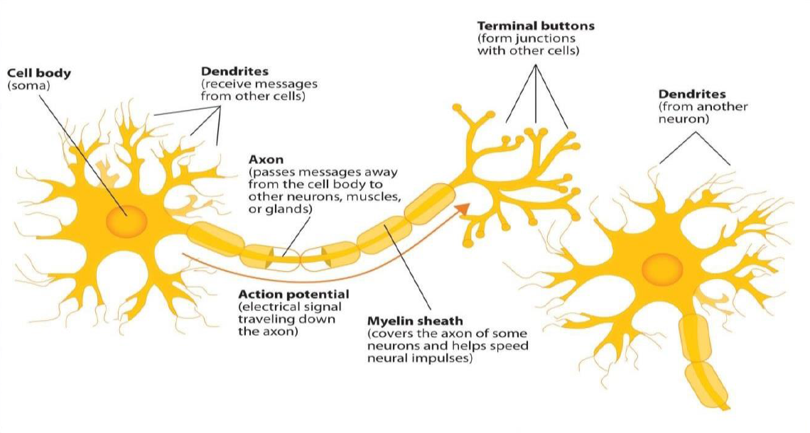
Changes in the Brain
At birth, brain is 25% of adult weight
By age 2, it’s 75%!
Synaptic blooming and myelination of central nervous system during first two years

Slide 6
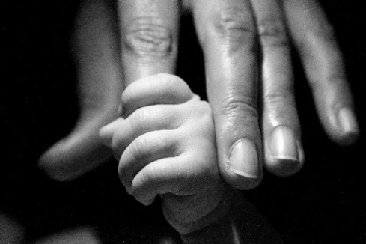
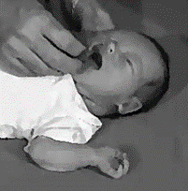
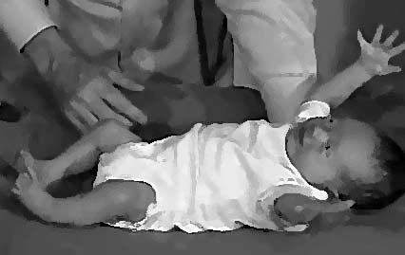
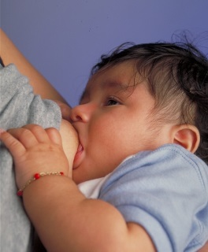
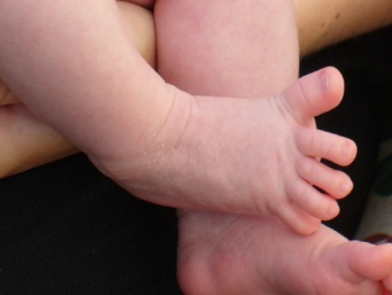
Reflexes
Grasping
Rooting
Moro
Sucking
Image by Raul Luna is licensed under CC BY 2.0
Image is in the public domain
Image is in the public domain
Tonic Neck
Image is in the public domain
Stepping
Babinski
Image by Samuel Finlayson is licensed under CC BY-SA 4.0
Image by Medicus of Borg is licensed under CC BY-SA 3.0
Image is in the public domain

Slide 7
Gross Motor Milestones
Typical Age | What Most Children Do By This Age
2 months | Can hold head up and begins to push up when lying on tummy Makes smoother movements with arms and legs
4 months | Holds head steady, unsupported Pushes down on legs when feet are on a hard surface May be able to roll over from tummy to back Brings hands to mouth When lying on stomach, pushes up to elbows
6 months | Rolls over in both directions (front to back, back to front) Begins to sit without support When standing, supports weight on legs and might bounce Rocks back and forth, sometimes crawling backward before moving forward
9 months | Stands, holding on Can get into sitting position Sits without support Pulls to stand Crawls
1 year | Gets to a sitting position without help Pulls up to stand, walks holding on to furniture (“cruising”) May take a few steps without holding on May stand alone
18 months | Walks alone May walk up steps and run Pulls toys while walking Can help undress herself
2 years | Stands on tiptoe Kicks a ball Begins to run Climbs onto and down from furniture without help Walks up and down stairs holding on Throws ball overhand

Slide 8
Fine Motor Milestones
Typical Age | What Most Children Do By This Age
2 months | Grasps reflexively Does not reach for objects Holds hands in fist
4 months | Brings hands to mouth Uses hands and eyes together, such as seeing a toy and reaching for it Follows moving things with eyes from side to side Can hold a toy with whole hand (palmar grasp) and shake it and swing at dangling toys
6 months | Reaches with both arms Brings things to mouth Begins to pass things from one hand to the other
9 months | Puts things in her mouth Moves things smoothly from one hand to the other Picks up things between thumb and index finger (pincer grip)
1 year | Reaches with one hand Bangs two things together Puts things in a container, takes things out of a container Lets things go without help Pokes with index (pointer) finger
18 months | Scribbles on his own Can help undress herself Drinks from a cup Eats with a spoon with some accuracy Stacks 2-4 objects
2 years | Builds towers of 4 or more blocks Might use one hand more than the other Makes copies of straight lines and circles Enjoys pouring and filling Unbuttons large buttons Unzips large zippers Drinks and feeds self with more accuracy

Slide 9
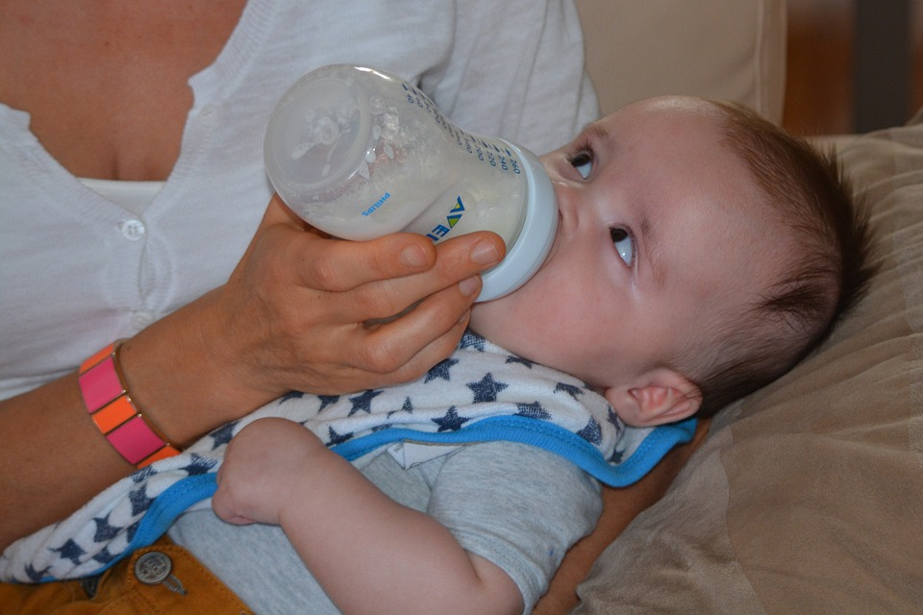
Sensory Capacities - Vision
Visual acuity is about 20/400, see around 8-16 inches from face, and have poor color vision at birth
Within months acuity increases to 20/25, color vision fully develops, and gain depth perception
Image by Ben_Kerckx on Pixabay

Slide 10
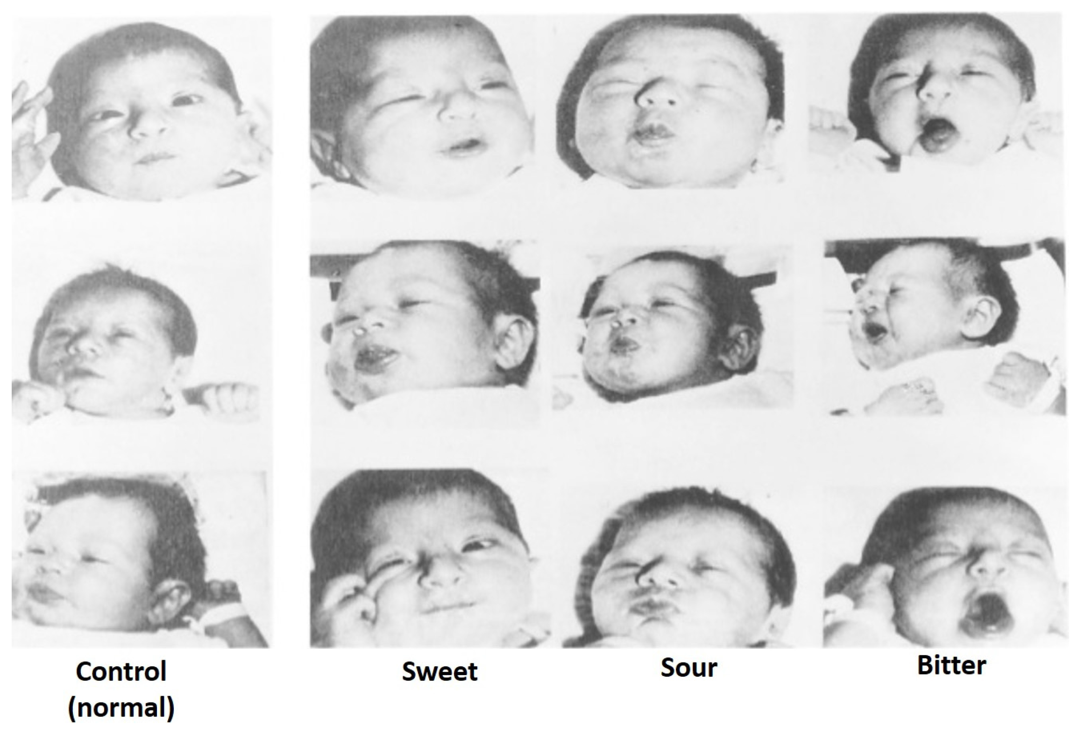
Sensory Capacities – Other Senses
Well developed at birth
Respond to sounds from any language (until 7 or 8 months)
Prefer mother’s voice and smell
Image by Alice Vilela and Fernanda Cosme is licensed under CC BY 4.0

Slide 11
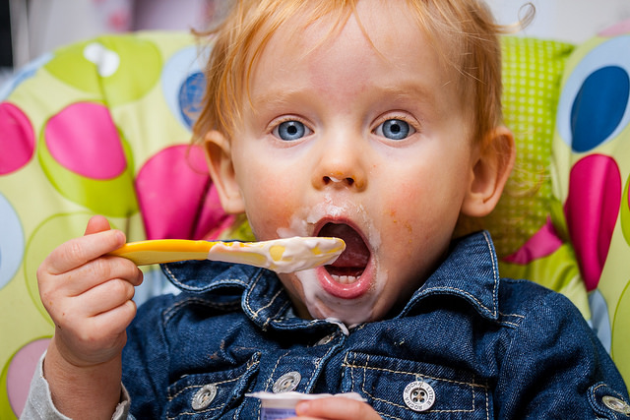
Nutrition in Infancy and Toddlerhood
Image by Matt Preston is licensed under CC BY-SA 2.0

Slide 12
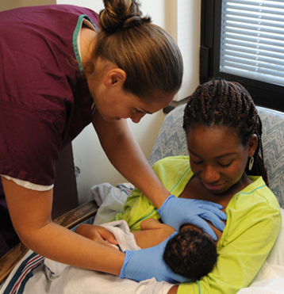
Nutrition - Breastfeeding
Breastmilk is considered ideal
Rich in nutrients and antibodies
Easier to digest
Health benefits for infant and mother
Recommended for at least 6 months
Most U.S. mothers stop by 6-8 weeks
Challenging for some mothers
Image by the Military Health System is in the public domain

Slide 13
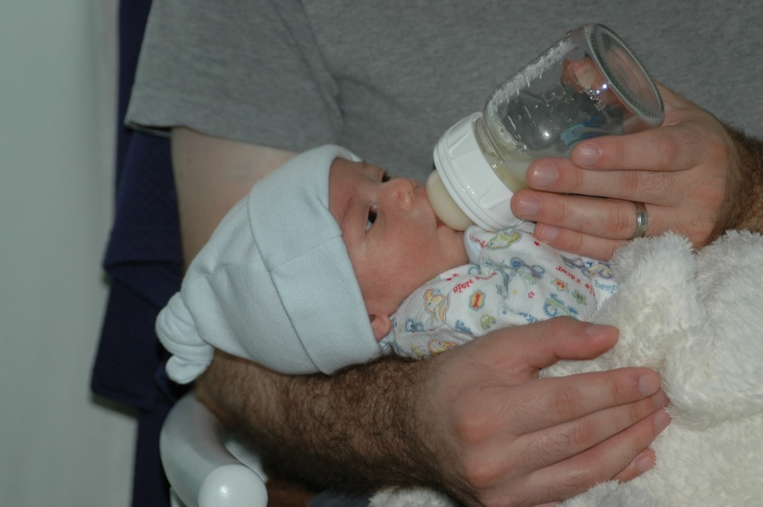
Nutrition – Alternatives to Breastfeeding
Formula is an alternative to breastfeeding
Breastfed and bottle-fed infants adjust equally well emotionally
Image by Ilya Haykinson is licensed under CC BY-SA 2.0

Slide 14
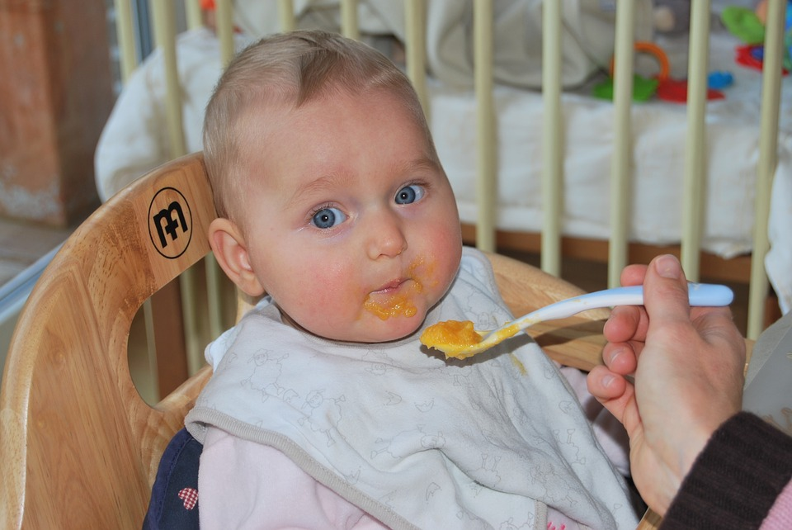
Introducing Solid Foods
At about 6 months with signs of readiness
Do not need to be introduced in specific order
By 7 to 8 months that includes cereals, meat/proteins, fruits, vegetables, grains, yogurt, cheeses, and more
One food at a time to wait for problems
Image by Ben_Kerckx on Pixabay

Slide 15
Meal | 0-5 months | 6-11 months
Breakfast | 4-6 fluid ounces breastmilk or formula | 6-8 fluid ounces breastmilk or formula 0-4 tablespoons infant cereal, meat, fish, poultry, whole eggs, cooked dry beans or peas; or 0-2 ounces cheese; or 0-4 ounces (volume) cottage cheese; or 0-4 ounces yogurt; or a combination* 0-2 tablespoons vegetable, fruit, or both*
Lunch or Supper | 4-6 fluid ounces breastmilk or formula | 6-8 fluid ounces breastmilk or formula 0-4 tablespoons infant cereal, meat, fish, poultry, whole eggs, cooked dry beans or peas; or 0-2 ounces cheese; or 0-4 ounces (volume) cottage cheese; or 0-4 ounces yogurt; or a combination* 0-2 tablespoons vegetable, fruit, or both*
Snack | 4-6 fluid ounces breastmilk or formula | 2-4 fluid ounces breastmilk or formula 0-½ bread slice; or 0-2 crackers; or 0-4 tablespoons infant cereal or ready-to-eat cereal* 0-2 tablespoons vegetable, fruit, or both*
Infant Meal Patterns

Slide 16
Toddler Meal Pattern
Meal | Ages 1-2
Breakfast | ½ cup milk ¼ cup vegetables, fruit, or both ½ ounce equivalent grains
Lunch or Supper | ½ cup milk 1 ounce meat or meat alternative 1/8 cup vegetables 1/8 cup fruits ½ ounce equivalent of grains
Snack | Select two of the following: ½ cup of milk ½ ounces meat or meat alternative ½ cup vegetables ½ cup fruit ½ ounce equivalent of grains

Slide 17
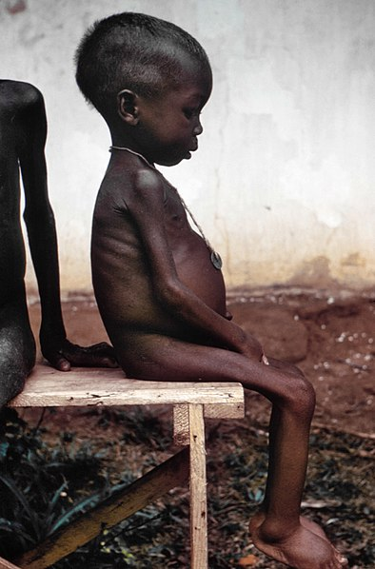
Malnutrition
Wasting
Marasmus
Kwashiorkor
Milk anemia
Failure to Thrive (FTT)
Image by the CDC is in the public domain

Slide 18
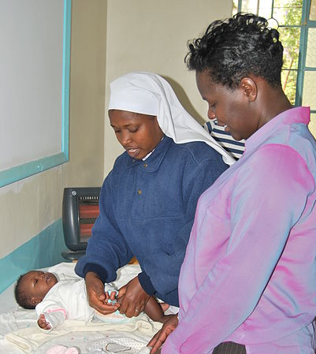
Health in Infancy and Toddlerhood
Image by Maria Immaculata Hospital is licensed under CC BY-SA 4.0

Slide 19
Health
Bowel Movements
Colic
Diaper Rash
Spitting Up/Vomiting
Teething
Urination
Jaundice
Image by Kevin Phillips is licensed under CC BY 2.0
Image by Andres and Antoinette Ricardo used with permission

Slide 20
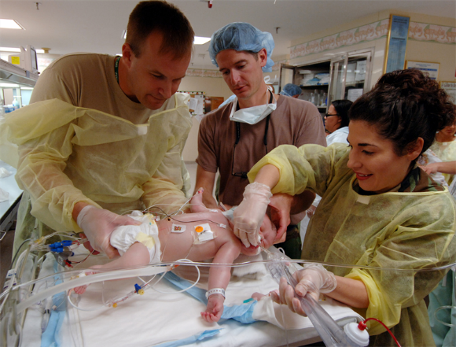
Shaken Baby Syndrome
Babies cry, some babies cry A LOT
Need to find healthy ways to deal with crying
As shaking a baby can cause permanent damage or even death
Image by the U.S. Air Force is in the public domain

Slide 21
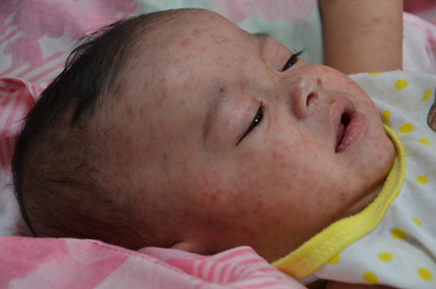
Protecting Health through Immunizations
Trigger the immune system to create immunity against killed or weakened versions of viruses
Minor side effects and very rarely serious side effects
Declining vaccination rates are causing resurgence in vaccine preventable disease.
Image by CDC Global is licensed under CC BY 2.0

Slide 22
Image by the CDC is in the public domain

Slide 23
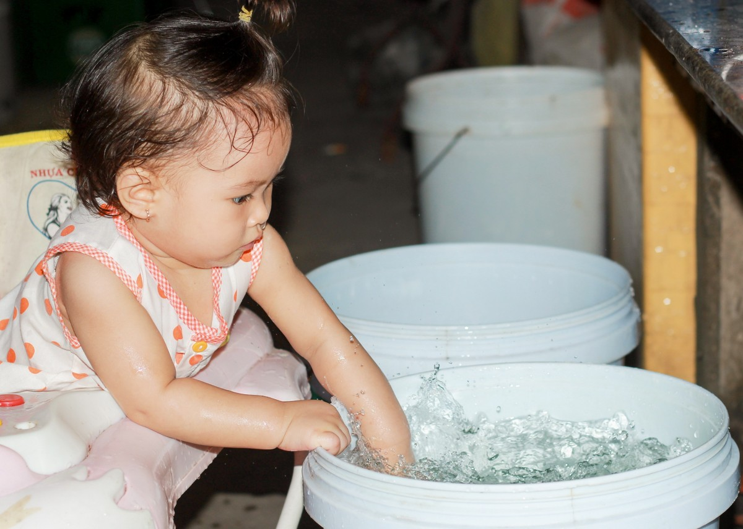
Safety in Infancy and Toddlerhood
Image on pxhere

Slide 24
Safety
Must protect children from injuries due to
Suffocation
Drowning
Fire/burns
Falls
Poisoning
Image by Your Best Digs is licensed under CC BY 2.0

Slide 25
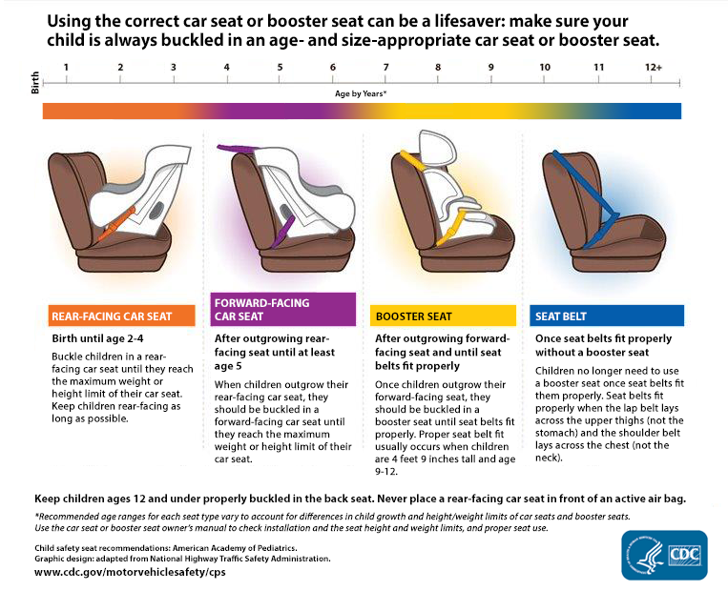
Car Seat Safety

Slide 26
Sleep
16.5 hours at birth
15 hours at 1 month
14 by 6 months
By 2, around 10 hours
Go from 50% in REM to 25-30%
Image by Sudipta Mallick is licensed under CC BY 2.0

Slide 27
Safe Sleep
Important to follow recommendations to reduce the risk of Sudden Infant Death Syndrome
Image by the U.S. Department of Health and Human Services is in the public domain

Slide 28
This PowerPoint was created by Jennifer Paris. Except where otherwise noted, it is licensed under a Creative Commons Attribution 4.0 International License.

