Slide 1
This PowerPoint
Is created as a companion to Child Growth and Development by College of the Canyons, Jennifer Paris, Antoinette Ricardo, and Dawn Rymond and is used under a CC BY 4.0 international license
The text comes from content in the book which has varied licensing
The images all include licensing information

Slide 2
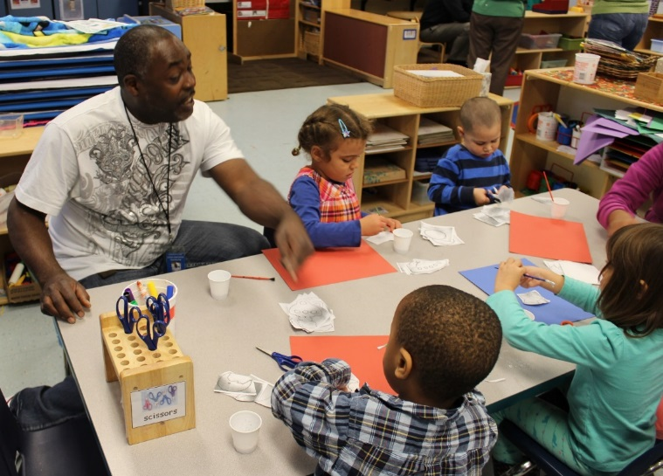
Early Childhood Education
Image by Seattle City Council is in the public domain

Slide 3
Montessori
MacDowell Montessori, Milwaukee, Primary Classroom by KJJS is licensed under CC BY 2.0

Slide 4
Waldorf
This image was snipped from the video Waldorf – Be In the World by Endless Echo which is licensed under CC BY 3.0

Slide 5
Reggio Emilia
Reggio Emilia profilo panorama by Paolo Picciati is licensed under CC BY-SA 3.0

Slide 6
Creative Curriculum
Image by Ellswoth Air Force Base is in public domain

Slide 7
Bank Street
Bank Street College of Education Entrance by Jnguy001 is licensed under CC BY-SA 3.0

Slide 8
High Scope
Hutchinson House & High Scope Education Research Foundation, (c.1903), 600 North River Street, Ypsilanti, Michigan by Dwight Burdette is licensed under CC BY 3.0

Slide 9
Head Start
Image by Office of Head Start is in the public domain

Slide 10
This PowerPoint was created by Jennifer Paris. Except where otherwise noted, it is licensed under a Creative Commons Attribution 4.0 International License.

