Slide 1
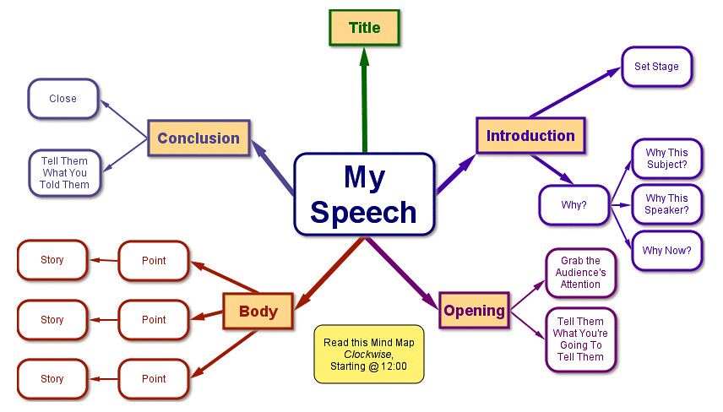
Chapter 6: Organizing/Outlining Your Speech
The Open Educational Resource College Public Speaking Textbook
This Photo by Unknown Author is licensed under CC BY
Exploring Public Speaking, v. 4.1 (2020)

Slide 2
Chapter 6 Learning Objectives
Explain why ORGANIZATION IS NECESSARY AND VALUABLE to public speaking;
Differentiate the DIFFERENT TYPES OF ORGANIZATIONAL PATTERNS;
Choose an organizational pattern that is MOST LOGICAL to the speech’s specific purpose;
Construct an outline for an EXTEMPORANEOUS SPEECH;
Create CONNECTIVE STATEMENTS that will help the audience understand the logic and structure of a speech.

Slide 3
Chapter 6
Overview
Outline Of Topics
Why We NEED ORGANIZATION in speeches
PATTERNS of ORGANIZATION
CONNECTIVE STATEMENTS
OUTLINING

Slide 4
Why Do We Need Organization in Speeches?
We can ONLY HOLD SO MANY THOUGHTS in our mind
at one time
Categories of information should be DISTINCT, DIFFERENT AND CLEAR.
You will appear to be
MORE CREDIBLE
So, have 3-5 main points.
Any more is "too much".

Slide 5
The Importance of Grouping
Find patterns and connections of data and research
Avoid having too many points in a speech. Have 3-5 and no more than that.
“Chunk” into 5 or fewer number of main groups (main ideas)
Organized speakers gain credibility and audience will understand and retain better

Slide 6
INFORMATIVE Speech Organizational Patterns
Topical/Parts Of The Whole
Cause And Effect
Chronological
Spatial
Highly used organizational structure
Refers to TIME ORDER
Can be used for long-term or short-term processes
Refers to MOVEMENT IN SPACE OR DIRECTION--like maps or layouts or layers
Must be presented logically
The most "ALL PURPOSE" FORM
Used for concepts like types/kinds of, varieties, categories or parts, divisions, units, characteristics
Consider strongest point last
Refers to speeches about CAUSES, origins, roots, foundations, basis, grounds, source OR EFFECTS, results, outcomes, consequences

Slide 7
PERSUASIVE
Organizational Patterns
Problem-Solution
Problem-Solution
Once you explain the problem, you convince your audience of the best solution.
When you identify a problem, explain the solution.
Problem-Cause-Solution
Similar to above but also discusses the cause of the problem.
Problem-Cause-Solution
A variation of the above that also explains cause.
Monroe's Motivated Sequence
Follows specific pattern of attention, need, solution, visualization and action.

Slide 8
Additional Organizational Principles
Main points must be RELATIVELY EQUAL in emphasis, value and
time spent.
You can use MORE THAN ONE ORGANIZATIONAL PATTERN--one for main points;
one for subpoints.
Use FULL SENTENCES AND PARALLELISM. Make sure others can understand your points.

Slide 9
Order of Speech Development
1. Create the BODY of your speech FIRST
2. THEN, create you INTRODUCTION, CONCLUSION and CONNECTIVES

Slide 10
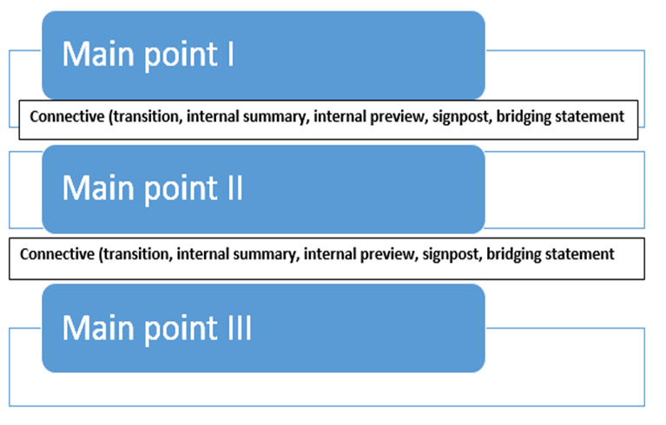
Connectives
Phrases or sentences that CONNECT PARTS OF THE SPEECH AND SHOW RELATIONSHIPS between them
Perform a number of FUNCTIONS:
Reminding
Forecasting
Explaining logic
Keeping attention

Slide 11
Types of
Connectives
(often interchangeable)
Internal summaries or previews
Emphasize what was just covered and what is upcoming
Transitions
"Now that we have talked about X, let's look at Y."
Signposts
First, second, next, last...
Bridging statements
Psychologically moves the audience through the speech

Slide 12
Guidelines on Connectives
They are only to connect, NOT PROVIDE EVIDENCE
They might be a SENTENCE OR TWO
You should plan for them and NOT AD LIB
VARY them
Sometimes, your subpoints may need them
You probably want more than just one or two words
Your instructor may want them on your outline
Don't use the same one each time

Slide 13
Outlining
Follow your instructor's design for the outline.
Outlining is the blueprint of what you will present; it's the plan for practicing and giving the speech.
There are two types of outlines:
PREPARATION--the blueprint
SPEAKING OUTLINES (note cards)

Slide 14
Think About It!
More To Consider
Listen to a speech by a professional speaker, such as a TED Talk, and see if you can detect their structure and use of transitions. Then talk about how they help (or don’t) your understanding and retention of what they say.

Slide 15
End of Chapter 6
Please message your instructor with any questions!
THAT CONCLUDES CHAPTER 6!

