Slide 1
Chapter 11: Delivery
The Open Educational Resource College Public Speaking Textbook
Exploring Public Speaking, v. 4.1 (2020)
This Photo by Unknown Author is licensed under CC BY-NC-ND

Slide 2
Chapter 11 Learning Objectives
Identify the DIFFERENT METHODS of speech delivery;
Identify KEY ELEMENTS IN PREPARING to deliver a speech;
Understand the BENEFITS of DELIVERY-RELATED BEHAVIORS;
Utilize SPECIFIC TECHNIQUES to ENHANCE speech delivery.

Slide 3
Chapter 11
Overview
OUTLINE OF TOPICS
The Importance of Delivery
Methods of Speech Delivery
Preparing for your Delivery
Practicing your Delivery
What to Do When Delivering your Speech

Slide 4
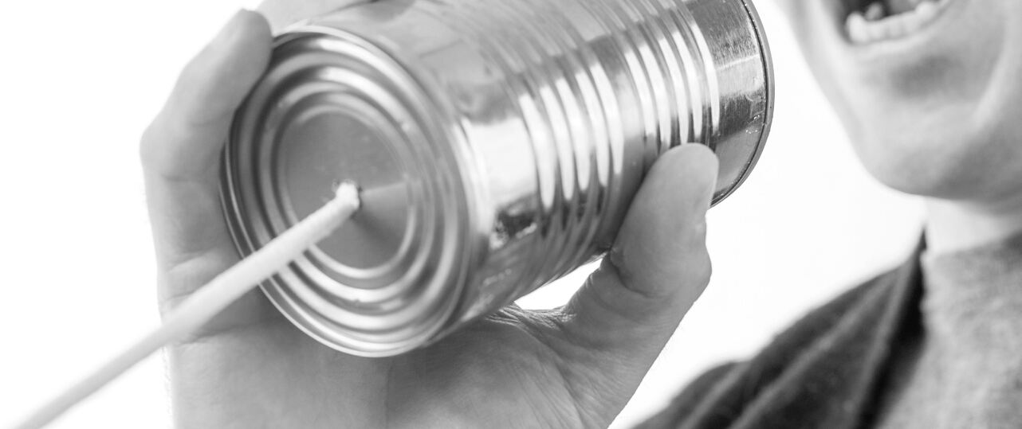
The Importance of Delivery
Our fear of public speaking normally comes from thinking about delivery
"A poorly-written speech delivered superbly is still a poorly-written speech."
Public speaking requires more formality than talking but less formality than reading

Slide 5
Four Standard Methods of Speech Delivery
IMPROMPTU—
no time for preparation
MANUSCRIPT--reading from a script or autocue device
EXTEMPORANEOUS--planned and rehearsed speech delivered in a conversational manner
MEMORIZED--committing to memory and not using notes

Slide 6
IMPROMPTU speeches are common in everyday experiences.
If you must give one....
Do not mention that it's impromptu.
Take a minute to devise a general structure.
Use previews and other structural helps.
Say "thank you" and finish.

Slide 7
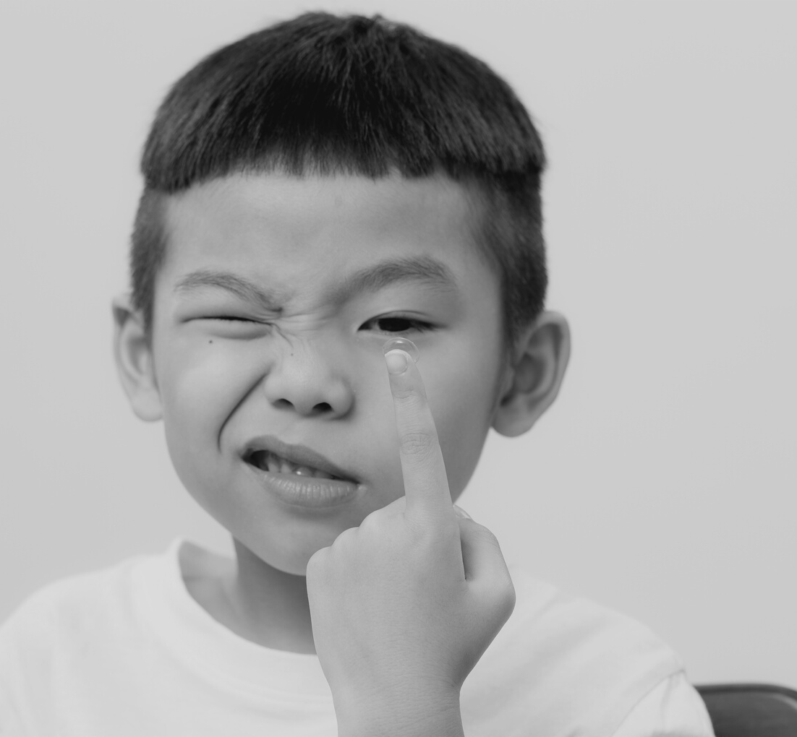
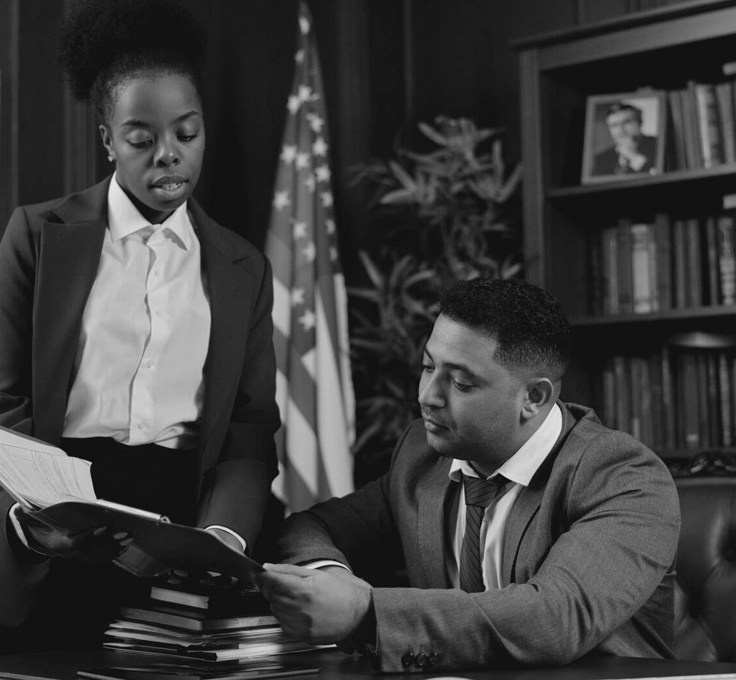
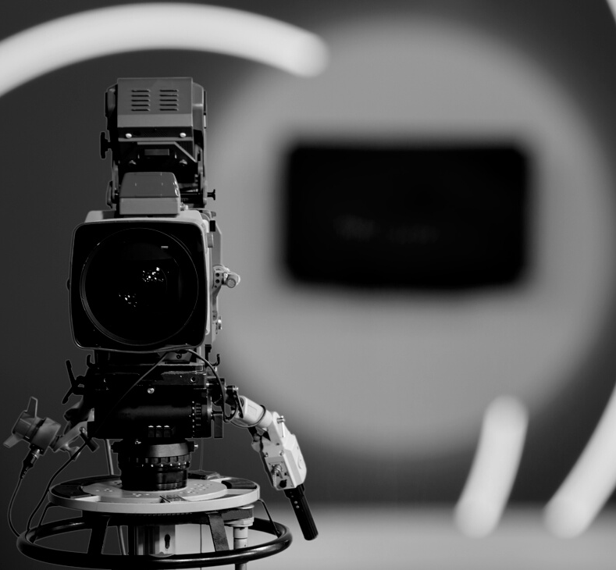
MANUSCRIPT speeches are generally NOT USED in a basic public speaking course.
They limit the amount of eye contact, spontaneity and vocal cues
They are best used for when specific wording is needed (e.g. for legal or political issues)
Sometimes, political speakers, etc. may use an autocue device (teleprompter) to appear more connected with audience

Slide 8
EXTEMPORANEOUS speeches are the MOST COMMON TYPE of speech and generally used in speech classes.
Based on a full preparation outline
Allows for flexibility
Demands practice

Slide 9
Although MEMORIZED speeches enables a speaker to have eye contact, they have DISADVANTAGES:
Takes too much time to memorize
Can lack natural voice cues
Cannot ad lib or go back to the beginning if you forget something

Slide 10
Issues to Think About When Preparing for your Delivery
Will there be a lectern or platform for you to use?
What is the size of the speaking space?
Will the presentation be indoors or outdoors?
Is a microphone available/needed?
How many will be in the audience?

Slide 11
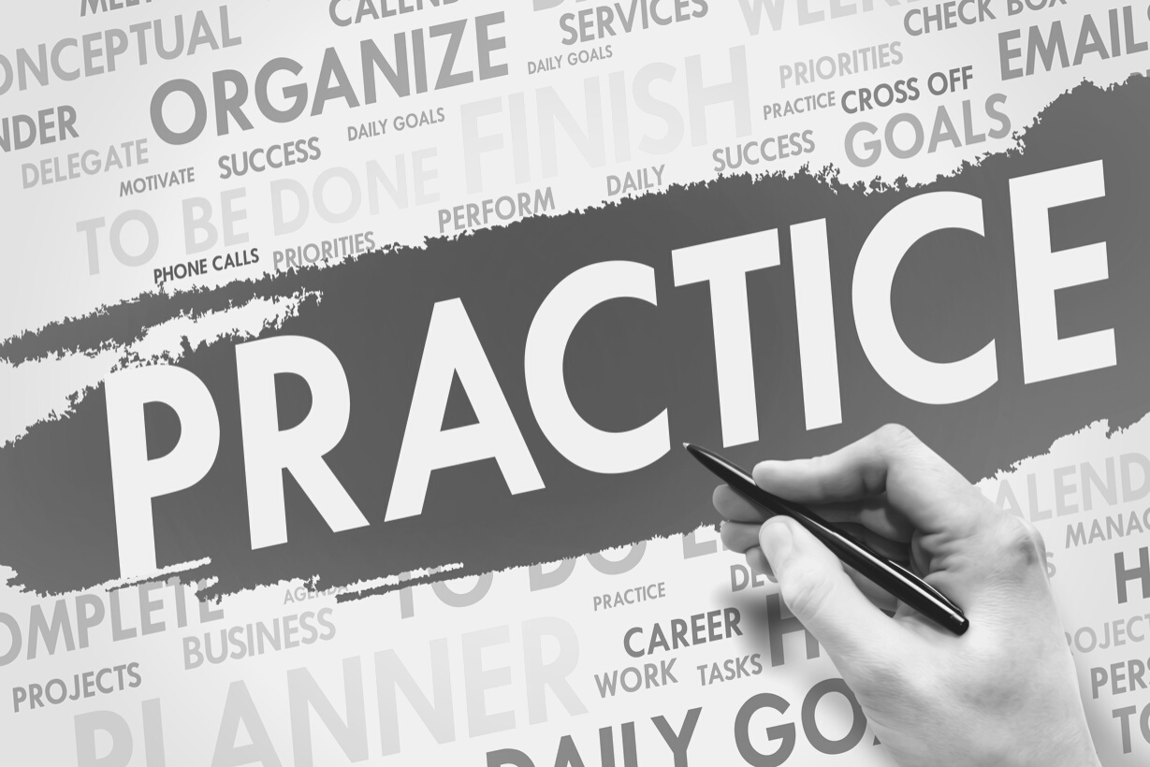
Practice
PRACTICE MAKES PERMANENT
It only makes perfect if you practice perfectly!
PRACTICE, PRACTICE, PRACTICE
Practice even if you feel comfortable speaking in public.
PRACTICE THE WAY YOU WILL PRESENT IT
Practice your speech beforehand at home or elsewhere the way you will give it to a live audience.

Slide 12
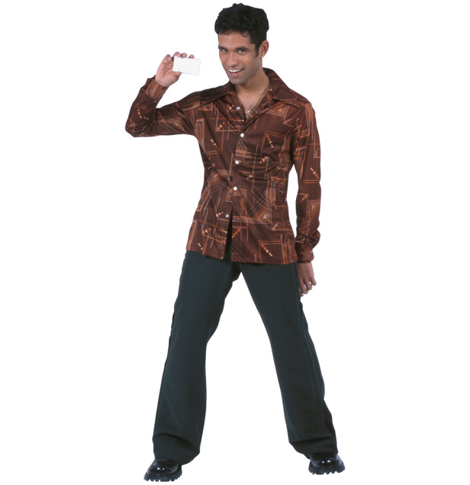
PRACTICE TIPS
Out Loud
Standing Up
With a Lectern ( if you will have one)
With an Audience (even just a few)
For Time
By Recording Yourself

Slide 13
How to Use Your Hands
Use gestures as you normally would.
The larger the audience, the larger the gestures needed.
If not gesturing, place hands on side of lectern.
Be mindful of excessive energy coming through your hands from adrenaline.

Slide 14
How to Manage your FEET and POSTURE
Keep feet about shoulder-width apart.
Keep a firm foundation and try to AVOID TWISTING feet around.
Bend your knees, don't lock them.
ROLL SHOULDERS BACK for more breath support and better appearance.
Remember the lectern is not part of your skeletal system.
This Photo by Unknown Author is licensed under CC BY-SA-NC

Slide 15
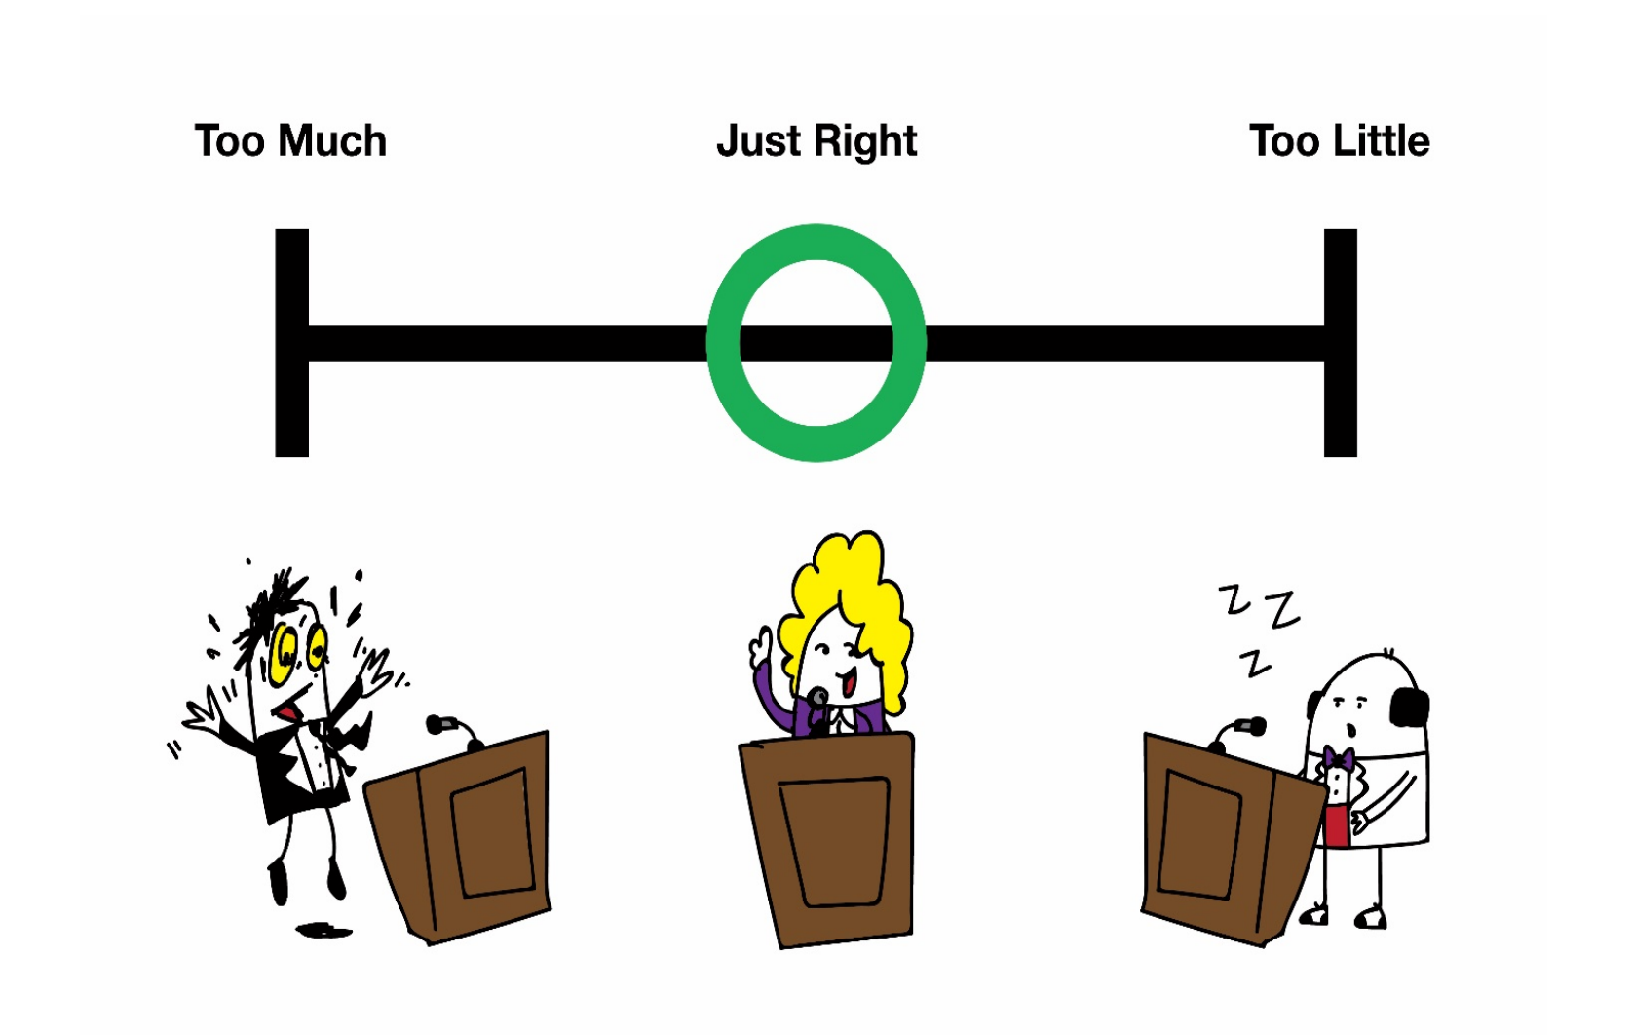
Too much, Just right or too little energy?

Slide 16
Consider OBJECTS in your speech
Only bring what you ABSOLUTELY NEED to the speech.
Be mindful of jewelry, fringe, hair in face; these can be distracting.
Wear COMFORTABLE SHOES with strong support.

Slide 17
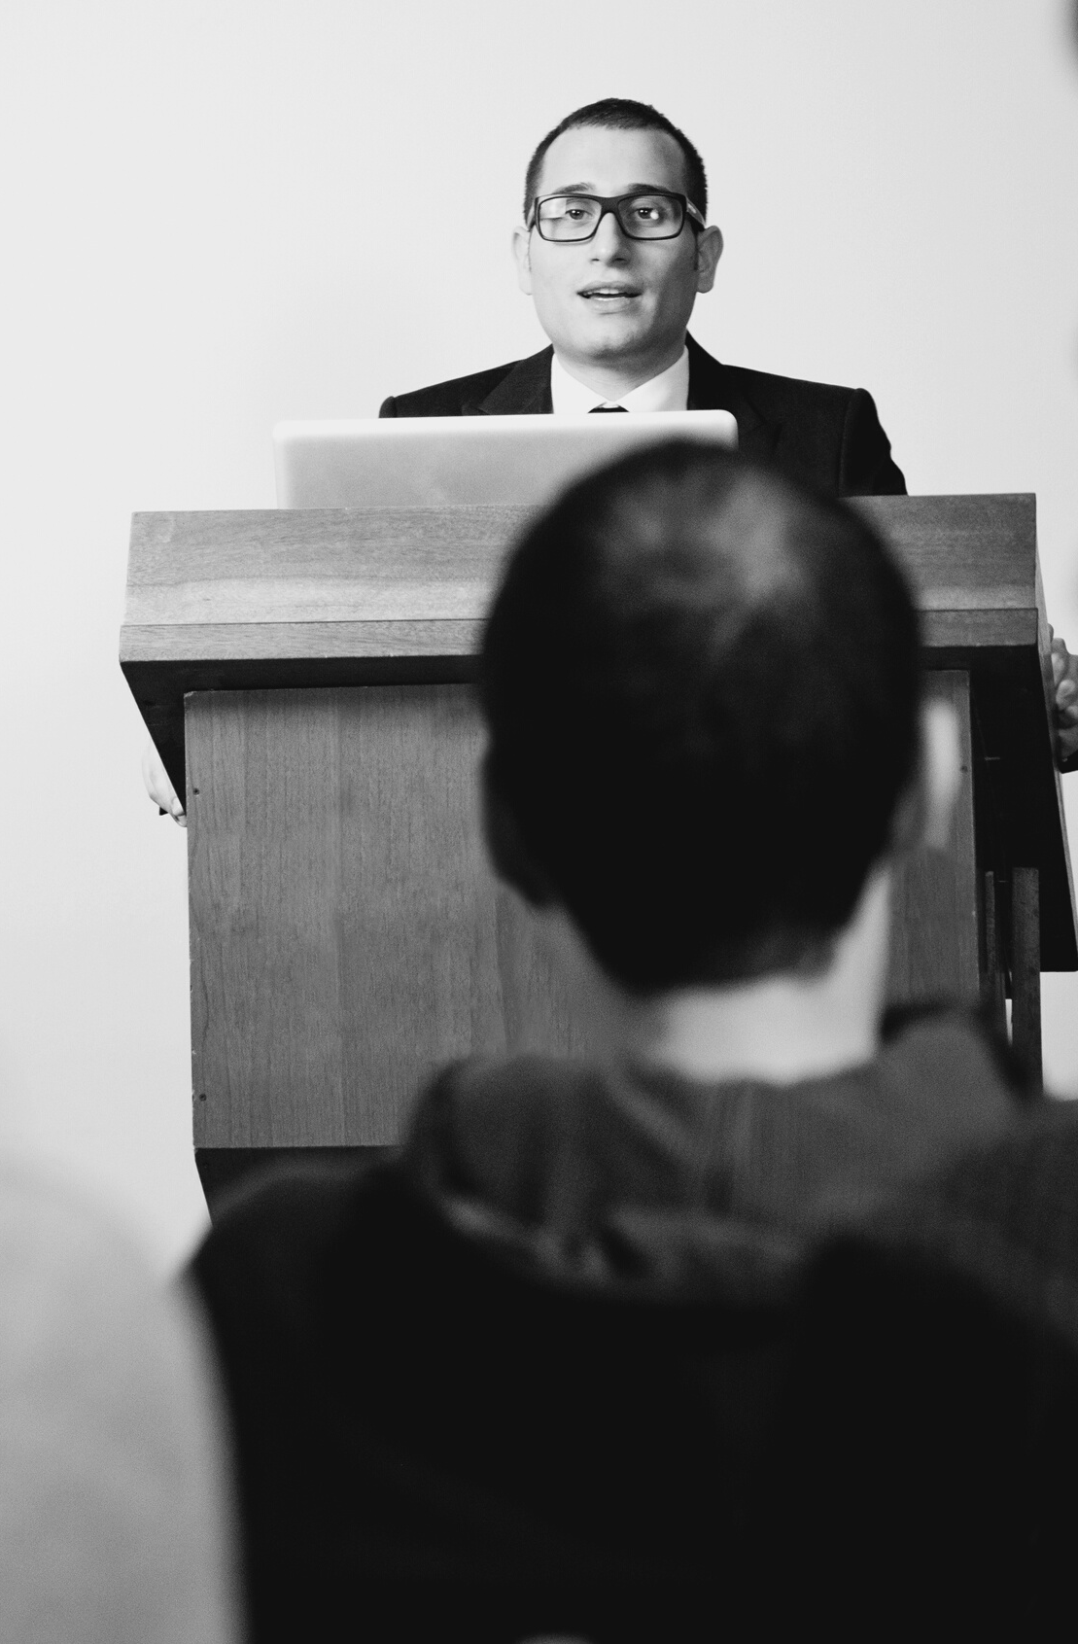
How to Use a LECTERN
Use it for your notes.
AVOID LEANING ON IT, TIPPING IT, HUGGING IT OR GRIPPING IT for emotional support!

Slide 18
How to Make Good EYE CONTACT
Because eye contact is the most important means of connection in Western cultures,
Try to maintain eye contact approximately 80% OF THE TIME.
Focus on individuals for about FIVE SECONDS.
Be sure to BALANCE to the right, left, back and front of your audience.
DON'T STARE down an individual.
IT TAKES PRACTICE!

Slide 19
How to Use YOUR VOICE
VOLUME--Speak to the back of the room
PITCH--need variety
RATE--need variety
PAUSES--can be effective for attention
VOCALIZED PAUSES--try to avoid (ums, etc.)

Slide 20
Remember the IMPORTANCE of:
PRACTICE
ENERGY
There is no substitute.
Have it in your voice and body.

Slide 21
Think About It!
More To Consider
EACH OF US STRUGGLES with a certain aspect of delivery: voice, posture, eye contact, distracting movement, vocalized pauses, etc. What is yours?
Based on this chapter and what you have already experienced in class, what is your BIGGEST TAKEAWAY ABOUT IMPROVING DELIVERY?

Slide 22
End of Chapter 11
Please message your instructor with any questions!
THAT CONCLUDES CHAPTER 11!

