Slide 1
Exploring Public Speaking (HACC Edition, 2021)
Chapter 1
Introduction to Public Speaking

Slide 2
Chapter 1 Overview
1.1 What is Public Speaking
1.2 The Value of Public Speaking
1.3 Speaking Compentencies

Slide 3
Quote about Public Speaking
According to most studies, people’s number one fear is public speaking. Number two is death. Death is number two.
Does that sound right? This means to the average person, if you go to a funeral, you’re better off in the casket than doing the eulogy.
Garber (2018)

Slide 4
What IS public speaking?
What IS Public Speaking?
1.1

Slide 5
Public Speaking Defined
To Inform, Entertain or Persuade a Group of People
Using:
Words
Physical Delivery
Visual or Audio Aids
Organized
Prepared
Intentional

Slide 6
Public Speaking
Is An "Enlarged" Conversation
Content
More Purposeful
Highly Organized
Dependent on Outside Resources
Delivery
Louder and Energetic
More Formal

Slide 7
Public Speaking
Is An "Enlarged" Conversation
Comparison to conversations
Awareness and sensitivity to audience
Exchange of explicit messages about content and less explicit ones about relationships
Dependent on feedback
Almost always face-to face

Slide 8
What is the VALUE of Public Speaking?
What is the VALUE of Public Speaking?
1.2

Slide 9
Benefits of this Course
A desired skill for employers
Will benefit you in other classes
Personal benefits

Slide 10
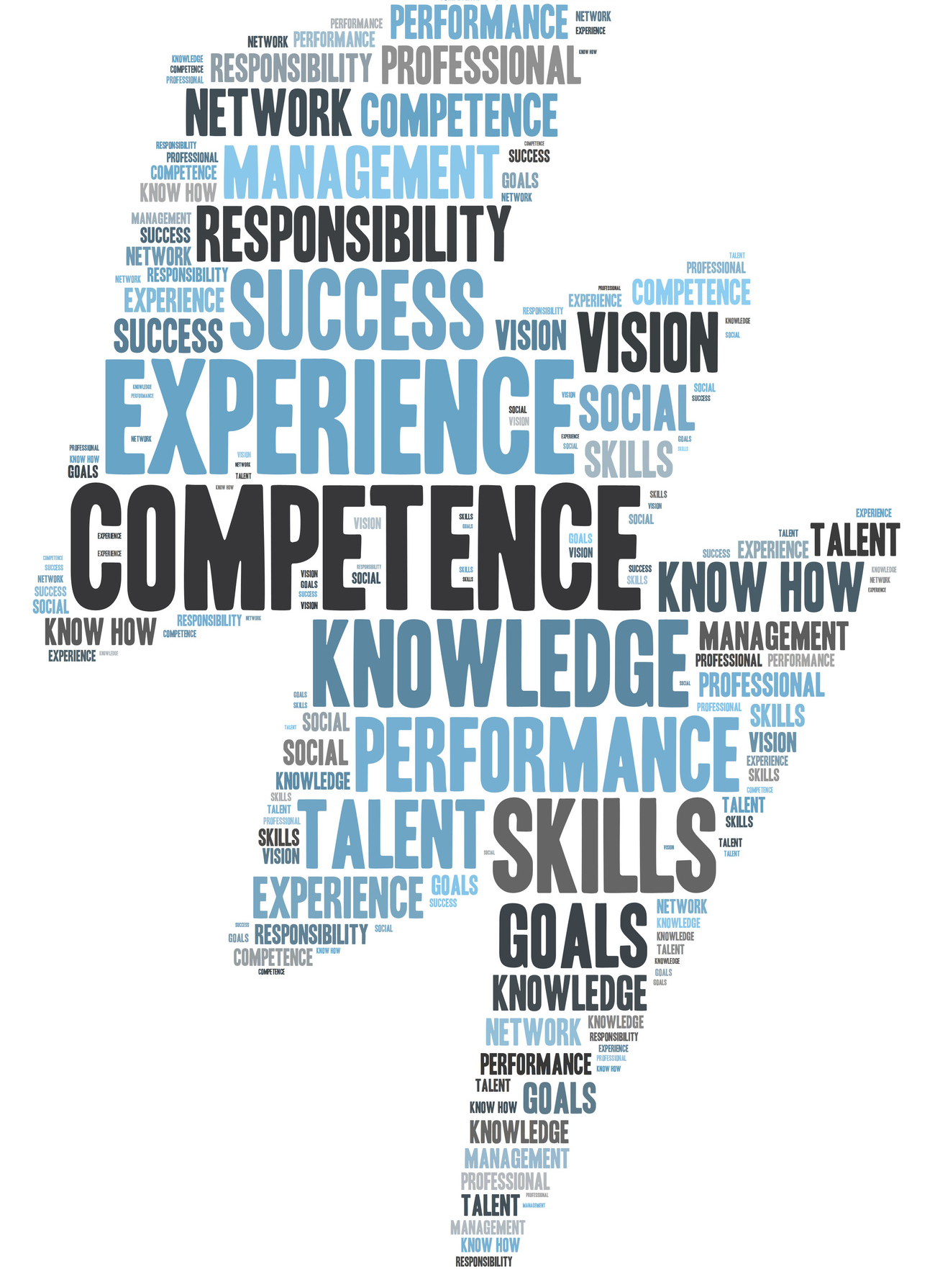
Speaking Competencies
1.3
Speaking Competencies
1.3

Slide 11
Useful Topic Appropriate to Audience and Occasion
Avoid topics that are out of date or lacks originality.
It should teach something new.
11 Public Speaking Competencies

Slide 12
Engaging Introduction
Orients the Audience to Topic and Speaker
Attention getter
Speaker credibility
Thesis
11 Public Speaking Competencies

Slide 13
Clear Organization
Uses an effective pattern
Clear points that relate directly to the thesis
Effective transitions and signposts
11 Public Speaking Competencies

Slide 14
Well-Supported Ideas
Synthesized and Compelling
Credible sources
Support the thesis
Clearly cited
11 Public Speaking Competencies

Slide 15
Closure in Conclusion
Reinforces Thesis and Provides Psychological Closure
Clear and memorable summary
Refers back to thesis
Ends with strong clincher or call to action
11 Public Speaking Competencies

Slide 16
Clear and Vivid Language
Careful Choice of Words
Clear, imaginative, and vivid
Free from bias, grammatical errors, and inappropriate usage
11 Public Speaking Competencies

Slide 17
Suitable Vocal Expression
Engages the Audience
Vocal variation, intensity, and pacing
Natural and enthusiastic
Avoids fillers
11 Public Speaking Competencies

Slide 18
Corresponding Nonverbals
Support the Verbal Message
Postures, gestures, facial expressions and eye contact that are natural
High level of poise and confidence
11 Public Speaking Competencies

Slide 19
Adapted to the Audience
Shows Importance
Tailored to beliefs, values, and attitudes
Culturally-shared experiences
11 Public Speaking Competencies

Slide 20
Of high professional quality
Adept Use of Visual Aids
Provide Powerful Insights
11 Public Speaking Competencies

Slide 21
Convincing Persuasion
Credible Evidence and Sound Reasoning
Clear, compelling manner
Avoid reasoning fallacies
Memorable call to action
11 Public Speaking Competencies

Slide 22
Chapter 1 Review
1.1 What is Public Speaking
1.2 The Value of Public Speaking
1.3 Speaking Compentencies

