Slide 1
Exploring Public Speaking (HACC Edition, 2021)
Chapter 2
Transactional Model of Communication

Slide 2
Chapter 2 Overview
2.1 Model of Communication
2.2 Elements of Communication Process

Slide 3
Models of Communication
Models of Communication
2.1

Slide 4
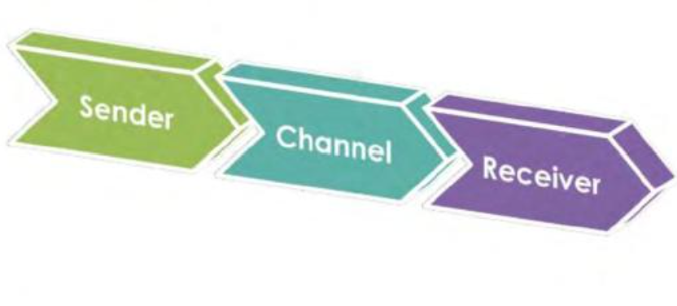
Linear Model of Communication
Sender—person who is speaking
Channel—apparatus for carrying the message
Receiver—person who picks up the message

Slide 5
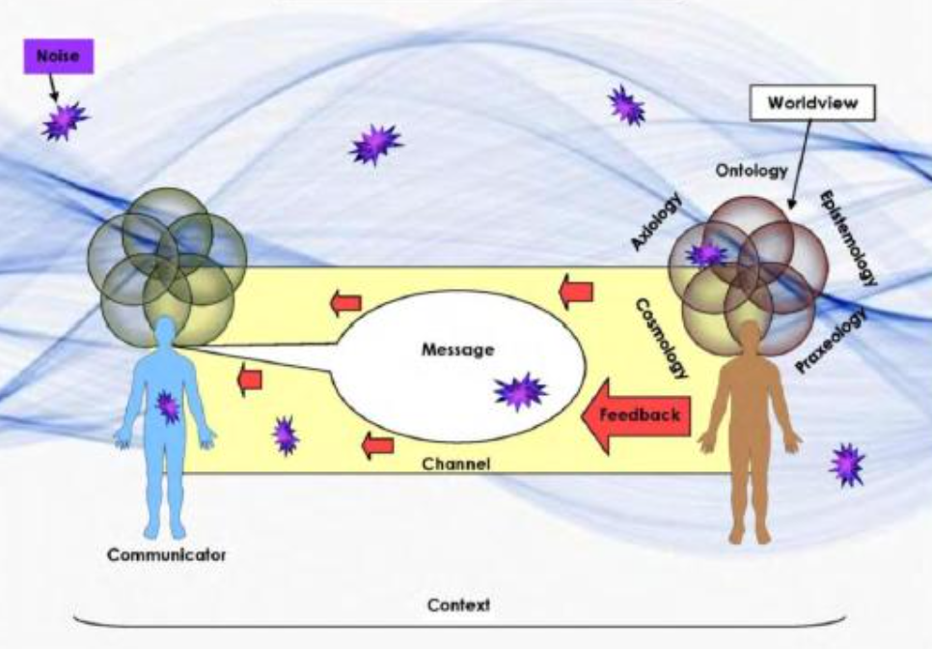
Transactional Model of Communication
Ongoing and circular process
Interdependent Processes/Components
Encoding
Decoding
Communicator
Message
Channel
Noise

Slide 6
Elements of Communication Process
Elements of Communication
Process
This Photo by Unknown Author is licensed under CC BY-NC
2.2

Slide 7
Encoding
Process of taking an idea and putting it into words, then speaking them
Elements of Communication

Slide 8
Decoding
Taking words and turning them into mental images (reverse of encoding)
Elements of Communication

Slide 9
Communicator
All the people in the interaction or speech setting
The information we gain is known as feedback.
Elements of Communication

Slide 10
Message
Involves verbal and nonverbal communication
Can be intentional or unintentional
Elements of Communication

Slide 11
Channel
The means by which the message travels
Face-to-face, online, phone, etc.
Elements of Communication

Slide 12
Noise
Anything that interferes with the message:
Psychological
Physical
Cultural
Elements of Communication

Slide 13
Worldview
Overall framework through which a person thinks about the world and interacts with it
Elements of Communication

Slide 14
Context
Where the interaction takes place and the relationship between the communicators
Elements of Communication

Slide 15
Chapter 2 Review
2.1 Model of Communication
2.2 Elements of Communication Process

