Slide 1
Exploring Public Speaking (HACC Edition, 2021)
Chapter 3
Communication Apprehension

Slide 2
Chapter 3 Overview
3.1 Anxiety and Public Speaking

Slide 3
Glossophobia Defined
Combines Greek words for:
Tongue
Fear or Dread
Severe fear of public speaking
Freezing up
Dry mouth
Weak voice
Shaking body
Good News!
It does not rise to the level of a true “phobia” for most people

Slide 4
Glossophobia Results From
All or Nothing Thinking
“If I’m not perfect, I’ve failed.”
“I’m not good at public speaking.”
Fortune Telling
Tendency to anticipate that things will turn out badly

Slide 5
Why Anxiety and Public Speaking
Why Anxiety and Public Speaking?
3.1.1

Slide 6
Other Fears of Public Speaking
Fear of Failure Due To
Real or perceived bad past public speaking experiences
Lack of preparation or knowledge
Uncertainty of assigned task
Fear of Rejection Due To
Fear of failure
Who you are as a person

Slide 7
Addressing Public Speaking Anxiety
Addressing Public Speaking Anxiety
3.1.2

Slide 8
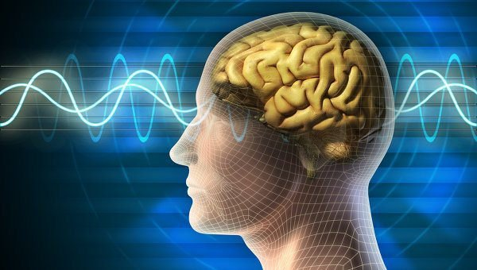
Mental Preparation
Ask
Why am I so anxious?
What is the worst that can happen?
Remember
We often make situations worse than they are
This Photo by Unknown Author is licensed under CC BY-ND

Slide 9
Physical Preparation
Get adequate sleep
Eat protein, not sugar
Wear clothing you like AND match the dress code
Use stretching or relaxation techniques

Slide 10
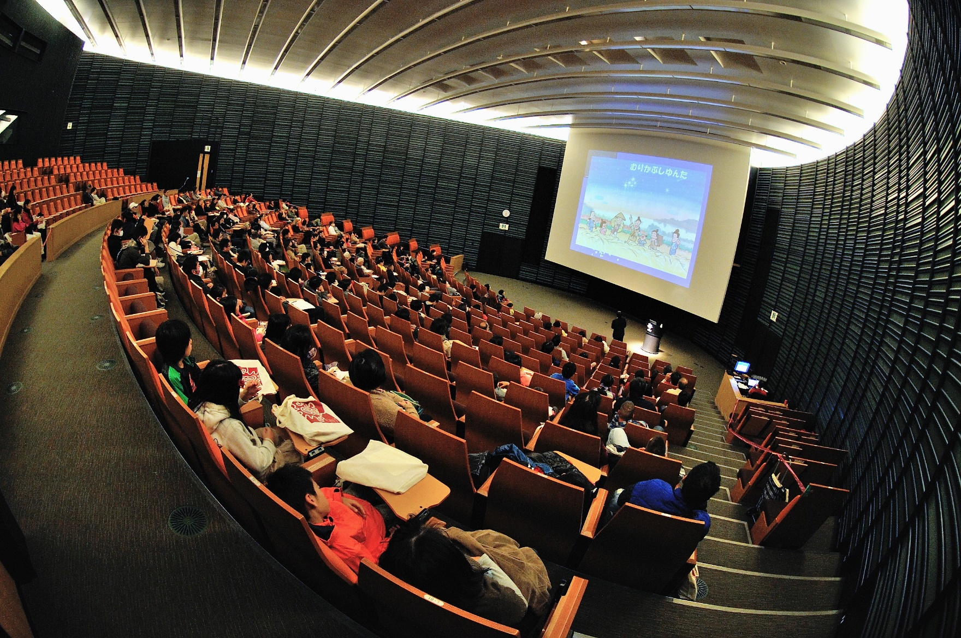
Contextual Preparation
Check room set up
Find out how many people to expect
Be early!
This Photo by Unknown Author is licensed under CC BY

Slide 11
Speech Preparation
Practice, Practice, Practice
Out loud
Standing up
Practice builds confidence
Will help ensure you meet time limits

Slide 12
Quote about Public Speaking
You never look as nervous as you feel!

Slide 13
Chapter 3 Review
3.1 Anxiety and Public Speaking

