Slide 1
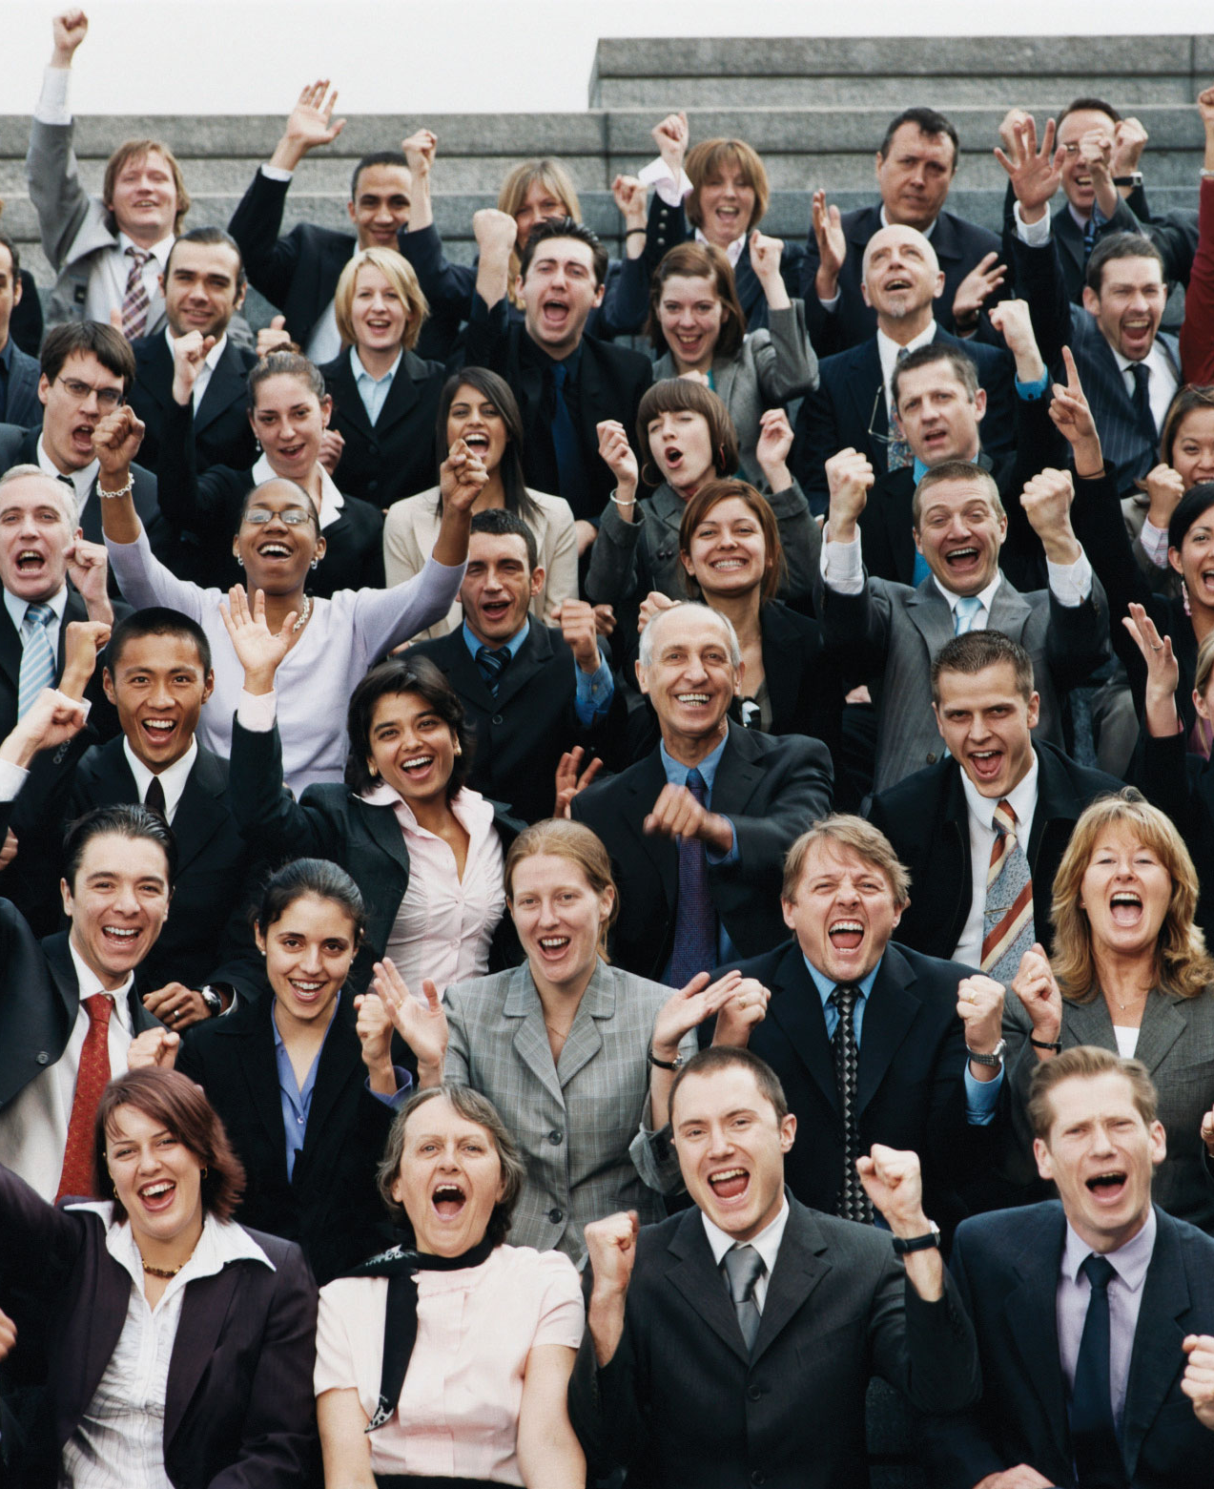
Exploring Public Speaking (HACC Edition, 2021)
Chapter 4
Audience Analysis
This Photo by Unknown Author is licensed under CC BY-SA-NC

Slide 2
Chapter 4 Overview
4.1 The Importance of Audience Analysis
4.2 Demographic Characteristics
4.3 Psychographic Characteristics
4.4 Contextual Factors
4.5 Cultural Diversity and Public Speaking

Slide 3
The Importance of Audience Analysis
The Importance of Audience Analysis
This Photo by Unknown Author is licensed under CC BY
4.1

Slide 4
Quote about Audience Analysis
“You are not using the speech to dump a large amount of content on the audience; you are making that content important, meaningful, and applicable to them.”
From the Text

Slide 5
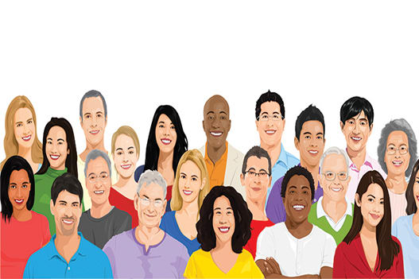
Demographic Characteristics
Demographic Characteristics
This Photo by Unknown Author is licensed under CC BY-SA-NC
4.2

Slide 6
Demographics Defined
Outward characteristics of your audience
“Demo” comes from Greek word “demos” meaning people
“Graphic” means description

Slide 7
Three Principles of Demograhics
Avoid stereotyping or totalizing.
Decide which demographics are important for that speech.
Demographics will help you decide what to cover or avoid.

Slide 8
Demographics Include
Age
Gender
Race, Ethnicity, Culture
Religion
Group Affiliation
Region
Occupation
Education
Socio-economic level
Sexual orientation
Family status

Slide 9
Psychographic Characteristics
Psychographic Characteristics
4.3

Slide 10
Beliefs
What we hold to be true"
Hard, but not impossible to change
Come from experience and authority
Psychographic Characteristics

Slide 11
Attitudes
Stable, positive or negative response to a person, idea, object or policy"
Not the same as mood or emotion
Most direct link to behavior
Come from many places
Psychographic Characteristics

Slide 12
Values
"Goals as we strive for and what we consider important and desirable"
Not the same as wants or physical objects
Psychographic Characteristics

Slide 13
Needs
"Important deficiencies we are motivated to fill"
Maslow's Hierarchy shows that lower levels must be met before going to the next level
Psychographic Characteristics

Slide 14
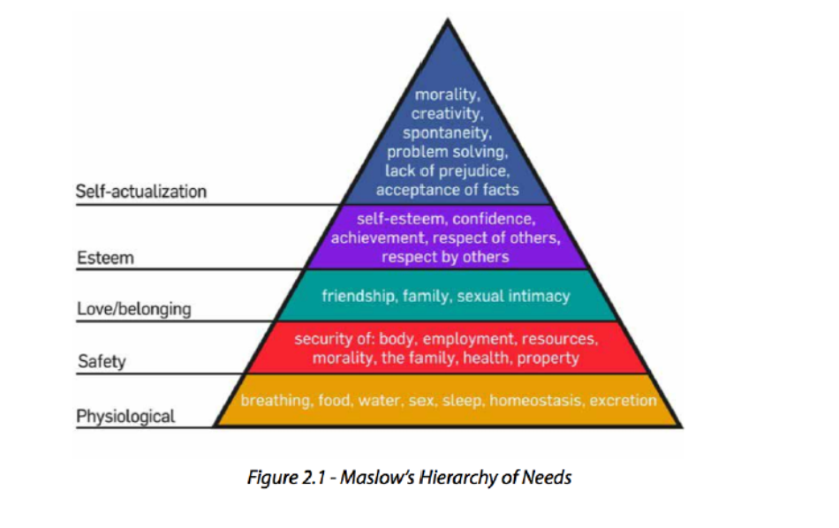
Maslow’s Hierarchy of Needs

Slide 15
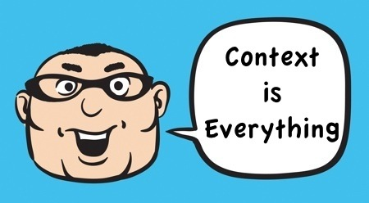
Contextual Factors of Audience Analysis
Contextual Factors of Audience Analysis
This Photo by Unknown Author is licensed under CC BY-SA-NC
4.4

Slide 16
Contextual Factors In Public Speaking
How much time do I have for this speech?
Why is the audience gathered and what are their expectations?
What does the physical space look like (# of seats/audience members, set-up, etc.)

Slide 17
Quote about Public Speaking
Practice will make permanent, not perfect!

Slide 18
Cultural Diversity in Public Speaking
Cultural Diversity in Public Speaking
This Photo by Unknown Author is licensed under CC BY-SA-NC
4.3

Slide 19
Benefits and Challenges of Considering Cultural Diversity
Will help if speaker has been exposed to different groups.
Diversity of thought is often more important than surface differences.
The more diverse the audience, the more challenging it will be to accommodate different perspectives.
The more we study cultures, the more sensitive we become but no one can know every culture well.

Slide 20
Categorizing Cultures (1)
Collectivist
Emphasis is placed on the family or larger community
Individualistic
Emphasis is placed on the individual

Slide 21
Categorizing Cultures (2)
High Context
Norms are not explicit; they are just understood and learned through observation
Low Context
Norms are explicit and stated outright

Slide 22
Categorizing Cultures (3)
Communication is logical, rational and straightforward
Public speaking exists in terms of debate
Communication is more narrative
Public speakers rely more on storytelling

Slide 23
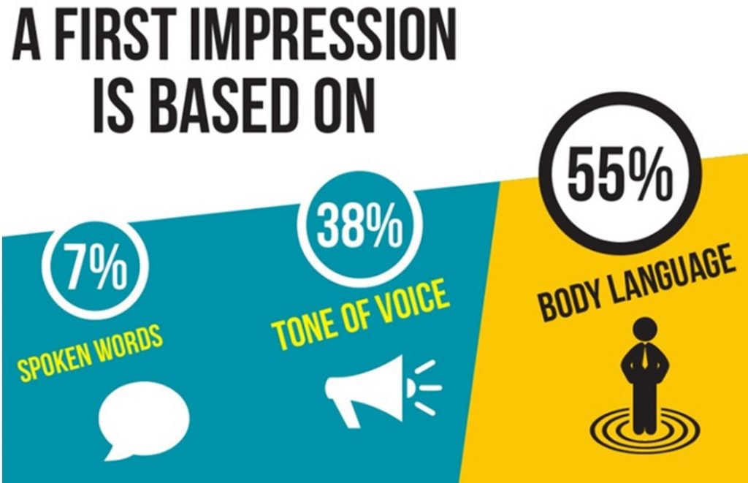
Nonverbal Communication Categories
Eye behavior
Touch behavior
Distance from others
Voice characteristics
Use of time
Use of body
Meaning of smell
Use of objects to convey meaning
This Photo by Unknown Author is licensed under CC BY

Slide 24
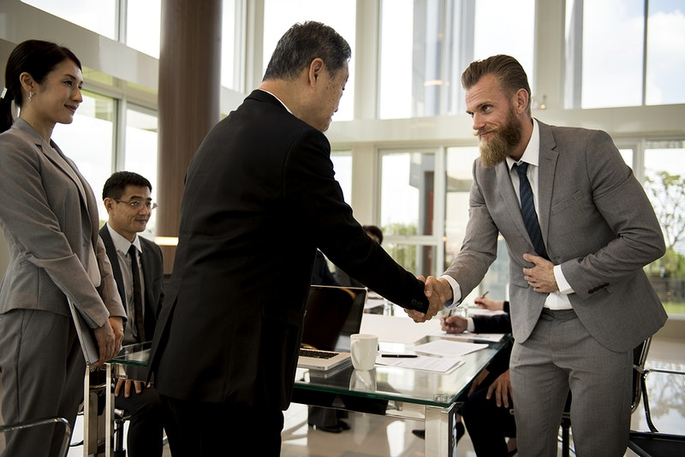
Culture Affects Nonverbal Communication

Slide 25
Quote from Dave Barry
“Americans who travel abroad for the first time are often shocked to discover that, despite all the progress that has been made in the last 30 years, many foreign people still speak in foreign languages”
(“Dave Barry Quotes,” 2013)

Slide 26
Expressions
Avoid metaphors, slang and figurative language.
They may have no significance to others.
Some phrases refer to ethnic stereotypes.
Implications for Cultural Considerations in Public Speaking

Slide 27
Narratives
Storytelling is more descriptive, relational and powerful.
Implications for Cultural Considerations in Public Speaking

Slide 28
Values
Recognize that other values may not be similar to yours.
Implications for Cultural Considerations in Public Speaking

Slide 29
Standards
Avoid holding others to Western standards (e.g. time)
Implications for Cultural Considerations in Public Speaking

Slide 30
Audience
Know what your audience would appreciate and what would concern them.
Implications for Cultural Considerations in Public Speaking

Slide 31
Humor
Approach humor carefully. It is highly contextual, personal and cultural.
Implications for Cultural Considerations in Public Speaking

Slide 32
Knowledge of Culture
If you are speaking to a group who primarily speaks a different language, learn a greeting or phrase from their language.
Implications for Cultural Considerations in Public Speaking

Slide 33
Marginalization
Avoid assuming all share exactly the same values or practices.
Implications for Cultural Considerations in Public Speaking

Slide 34
Differences
Avoid “tokenizing” someone by calling them out for differences unless you have their permission.
Implications for Cultural Considerations in Public Speaking

Slide 35
Terms
Find out and use terms preferred by the group.
Implications for Cultural Considerations in Public Speaking

Slide 36
Commonalities
Discover what you have in common.
Implications for Cultural Considerations in Public Speaking

Slide 37
Chapter 4 Review
4.1 The Importance of Audience Analysis
4.2 Demographic Characteristics
4.3 Psychographic Characteristics
4.4 Contextual Factors
4.5 Cultural Diversity and Public Speaking

