Slide 1
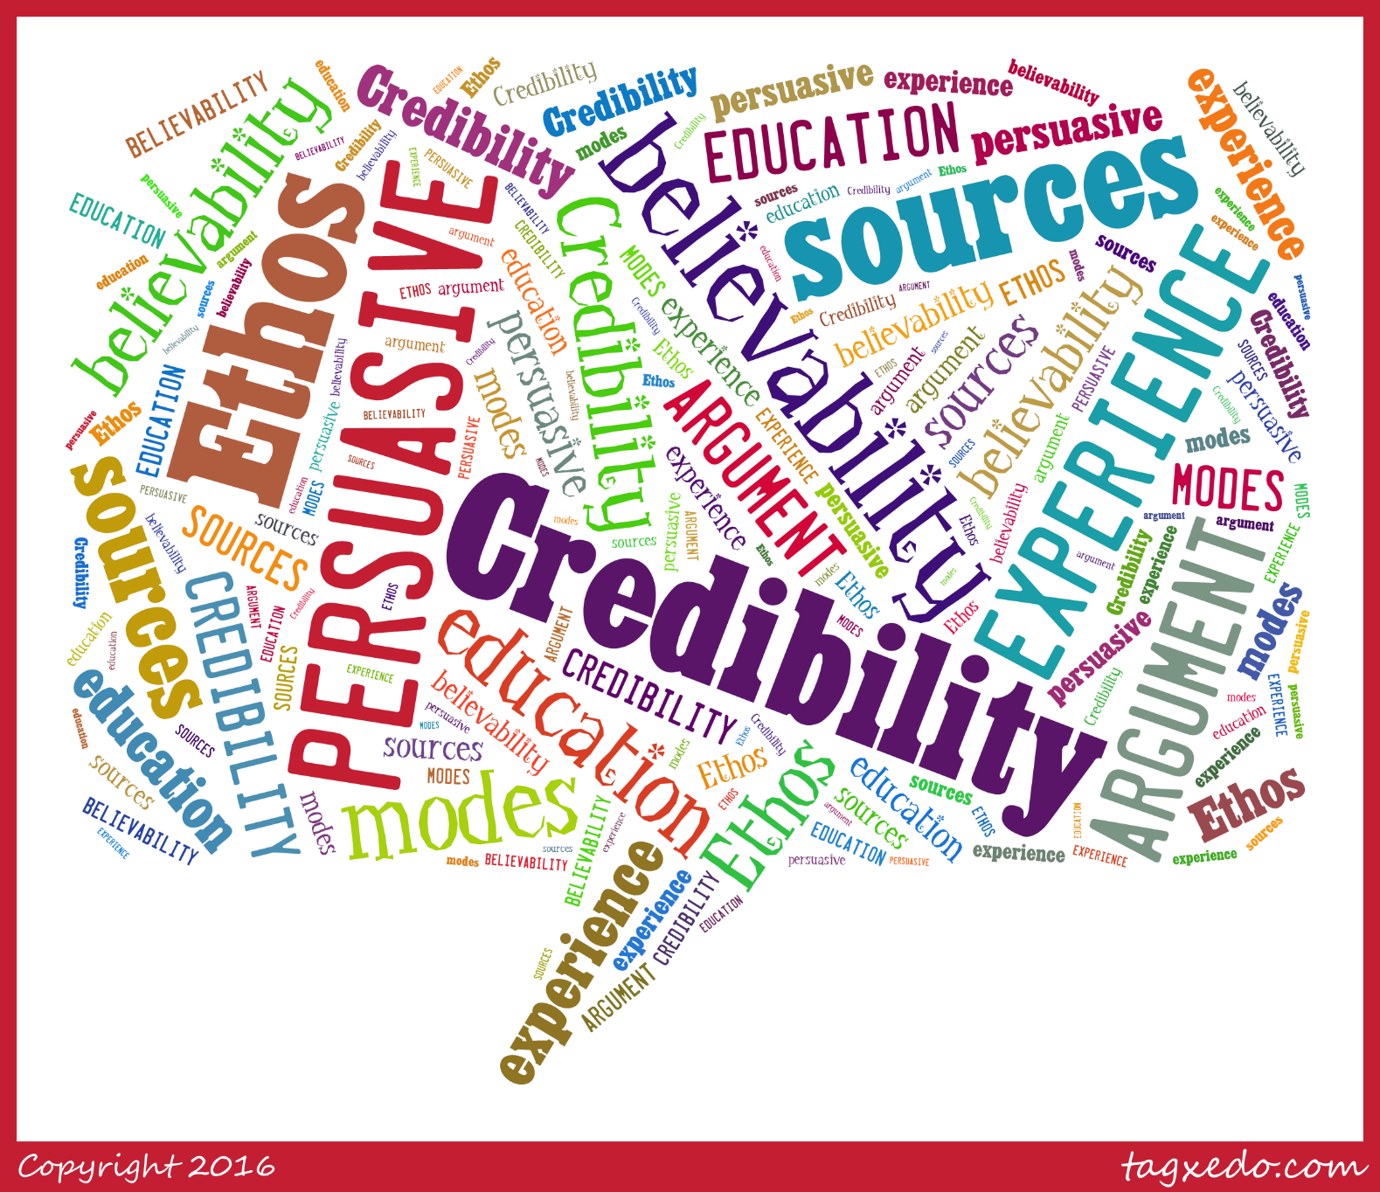
Exploring Public Speaking (HACC Edition, 2021)
Chapter 5
Speaker Credibility and Ethics

Slide 2
Chapter 5 Overview
5.1 Credibility and Ethics
5.2 Plagiarism
5.3 Logical Fallacies

Slide 3
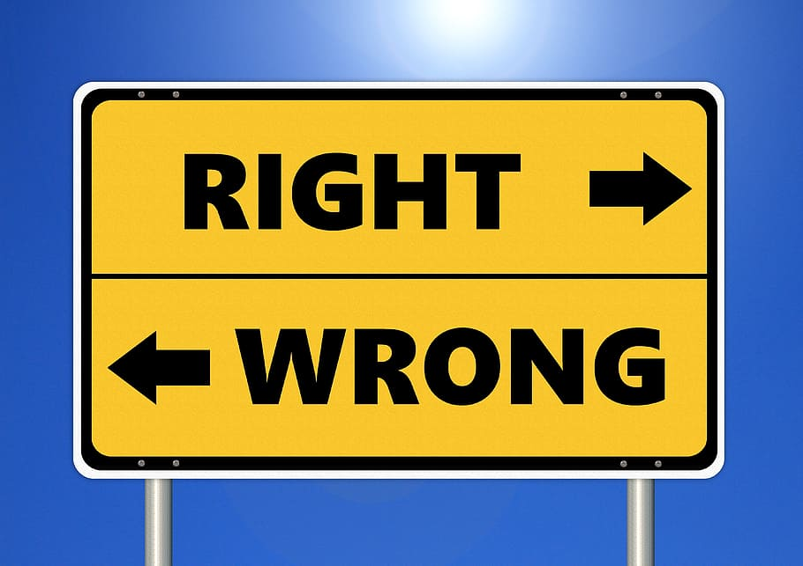
Credibility and Ethics
Credibility and Ethics
5.1

Slide 4
Credibilty Then vs. Now
According to Aristotle
Wisdom, sagacity and character of the speaker.
Today
Attitude of the audience toward the speaker based on reality and perception

Slide 5
Sources of Credibility
Similarity between speaker and audience
Character of the speaker
Competence of the speaker
Goodwill towards the speaker
Things like likeability, poise, appearance, humor

Slide 6
Quote about Audience Analysis
“Not only does a speaker’s level of credibility change or vary from audience to audience, it is also likely to change even during the presentation.”
From the Text

Slide 7
Types of Credibility
Initial
Beginning or before the speech
Will influence the audience
Why speech introduction matters
Derived
During the speech
Can be based on perceptions of open-mindedness, honesty, etc.
Terminal
End of the speech
Factors into speaker’s persuasiveness
Goal is to have higher than initial thoughts

Slide 8
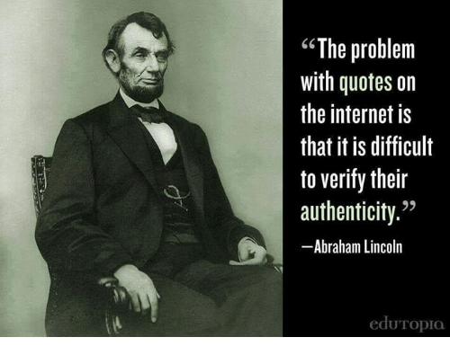
Plagiarism
Plagiarism
5.2

Slide 9
Plagiarism Definition
Plagiarism is “the act of using another person’s words or ideas without giving credit to that person”
Merriam-Webster, 2015

Slide 10
Plagiarism Includes
Turning in someone else's work as your own
Copying words or ideas without giving credit or copying verbatim
Failing to identify a quote
Giving incorrect information about the source of material
Copying the structure of someone else's work

Slide 11
Ethically Crediting Sources
Provide full information about the source
Ensure information is presented in context and relevant to your points
Summarize and paraphrase correctly by putting source material into your own words

Slide 12
Final Words
“Ignorance of the law is no excuse.”
Common Saying

Slide 13
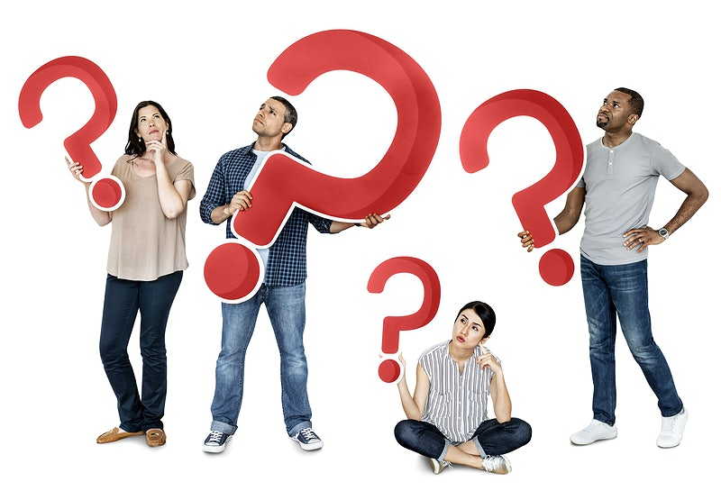
Logical Fallacies
Logical
Fallacies
5.3

Slide 14
False Analogy
Two things are compared that shouldn’t be
Logical Fallacies

Slide 15
False Cause
Assumes one thing causes another but there is no logical connection
Logical Fallacies

Slide 16
Slippery Slope
Assumes that taking one step will cause others to happen that can’t be prevented; fails to look at alternate factors
Logical Fallacies

Slide 17
Hasty Generalization
Makes a generalization without a lot of examples that back it up
Logical Fallacies

Slide 18
Straw Man
Shows the weaker side of an argument to tear it down
Logical Fallacies

Slide 19
Post hoc ergo propter hoc
Means “After the fact, therefore because of the act.”
Also caused historical fallacy that wrongly attributes things that happen to a past event
Logical Fallacies

Slide 20
Argument from Silence
Assuming that silence about an issue means something;
Example: “Knowing something is true because no one has ever proven it isn’t true”
Logical Fallacies

Slide 21
Statistical Fallacies
Using too small of a sample
Unrepresentative sample
Appeal to popularity of idea rather than hard data
Logical Fallacies

Slide 22
Non Sequitur
Latin for “it does not follow”
Logical Fallacies

Slide 23
Inappropriate Appeal to Authority
Using a source that may be knowledgeable, experienced and credible, but not about the topic at hand
Logical Fallacies

Slide 24
False Dilemma
Either/Or Fallacy
Logical Fallacies

Slide 25
Appeal to Tradition
“We’ve always done it this way”
Logical Fallacies

Slide 26
Bandwagon
“Everybody is doing it”
Logical Fallacies

Slide 27
Red Herring
Using a distraction to avoid the topic at hand
Logical Fallacies

Slide 28
Ad Hominen
Attacking the person rather than the argument
Logical Fallacies

Slide 29
Ad Misericordium
Latin term for “appeal to pity”
Logical Fallacies

Slide 30
Plain Folks
Making a person appear to be more “common” than they are
Logical Fallacies

Slide 31
Guilt by Association
False idea that if two things are related in any way, they are alike
Logical Fallacies

Slide 32
Chapter 5 Review
5.1 Credibility and Ethics
5.2 Plagiarism
5.3 Logical Fallacies

