Slide 1

Exploring Public Speaking (HACC Edition, 2021)
Chapter 6
Researching Your Speech Topic
This Photo by Unknown Author is licensed under CC BY-SA-NC

Slide 2
Chapter 6 Overview
6.1 Research
6.2 Accessing Information Through a Library
6.3 Research on the Internet
6.4 Conducting Your Own Research
6.5 Decide When to Cite

Slide 3

Research
Research
This Photo by Unknown Author is licensed under CC BY
6.1

Slide 4
Primary vs. Secondary
Research
Primary Research
New Research carried out to acquire data first-hand rather than from previously published
Primary Sources
Information that is first-hand or straight from the source; information that is unfiltered by interpretation or editing
Secondary
Information that is not directly from the first-hand source; information that has been compiled, filtered, edited or interpreted in some way

Slide 5

Accessing Information
Through a Library
Accessing Information
Through a Library
6.2

Slide 6
Library
Catalog
  Good place to begin searching
  Will allow you to search the library’s collection of books, periodicals and media
  Also links to electronic books, videos and other resources

Slide 7
Databases
  Google search engines only give you access to information that’s been shared for free
  Online library databases give you access to full-text information behind a paywall (Libraries have paid!)
  You can find information from eBooks and periodicals
  Can also access peer-reviewed information

Slide 8
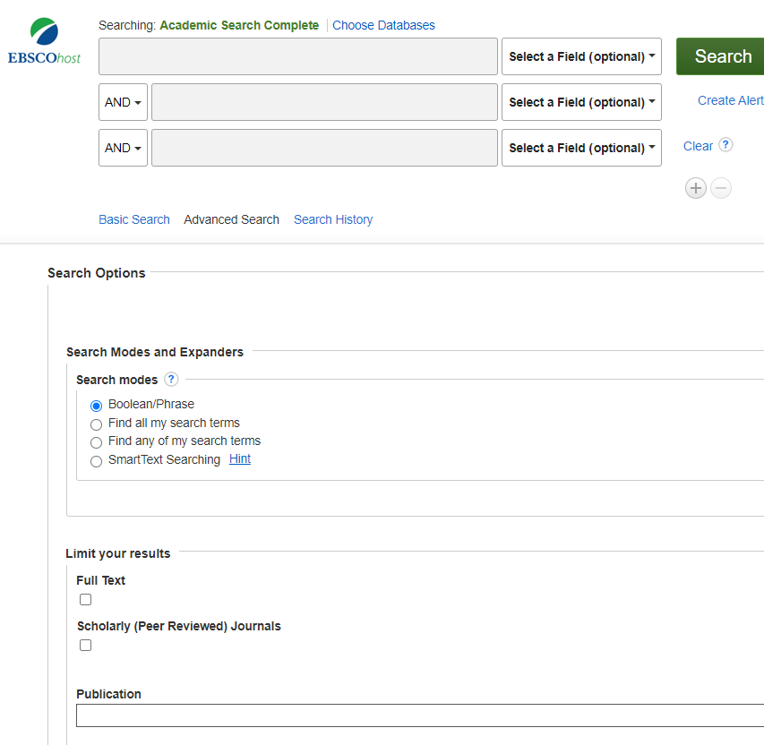
Filter
Your Results
Put search phrases in quotation marks, e.g “attention deficit disorder”

Slide 9
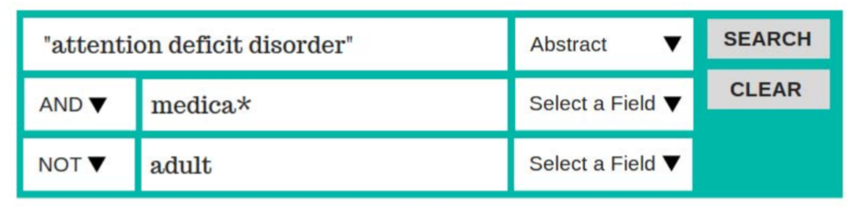
Combine
Search Terms
Use Boolean operators (AND, OR, and NOT)
Use truncation to find similar words with the same root. ( Typing “medica*” will give results including medical, medication, etc.

Slide 10

Logical Fallacies
Research
On the Internet
This Photo by Unknown Author is licensed under CC BY-SA
This Photo by Unknown Author is licensed under CC BY
6.3

Slide 11
Know what you are looking for and at on the Internet
  Is the information current and relative to your needs?
  Does it address your topic?
  What is the source of the information?
  Why was the information created?

Slide 12
Check for Previous Work
  Has someone else already fact-checked the claim or provided a synthesis of research?
Tips for Evaluating Information on the Internet

Slide 13
Go Upstream to the Source
  Most web content is not original. Find the original source to determine trustworthiness.
Tips for Evaluating Information on the Internet

Slide 14
Read
Laterally
  Read what others say about the publication and author.
Tips for Evaluating Information on the Internet

Slide 15
Use a
Test
  CRAP (currency, reliability, authority and purpose)
  SIFT (stop, investigate, find better coverage, trace claims)
Tips for Evaluating Information on the Internet

Slide 16
What About
Wikipedia?
  Generally, not considered an academic source
  BUT can give you a place to obtain basic information and/or references
Tips for Evaluating Information on the Internet

Slide 17

Conducting Your Own Research
Conducting
Your Own Research
6.4

Slide 18

Conducting
Surveys
Use objective questions
Keep it short
Be specific, not vague
Avoid personal questions
Consider what tool you might use (survey monkey, google forms, etc.)

Slide 19
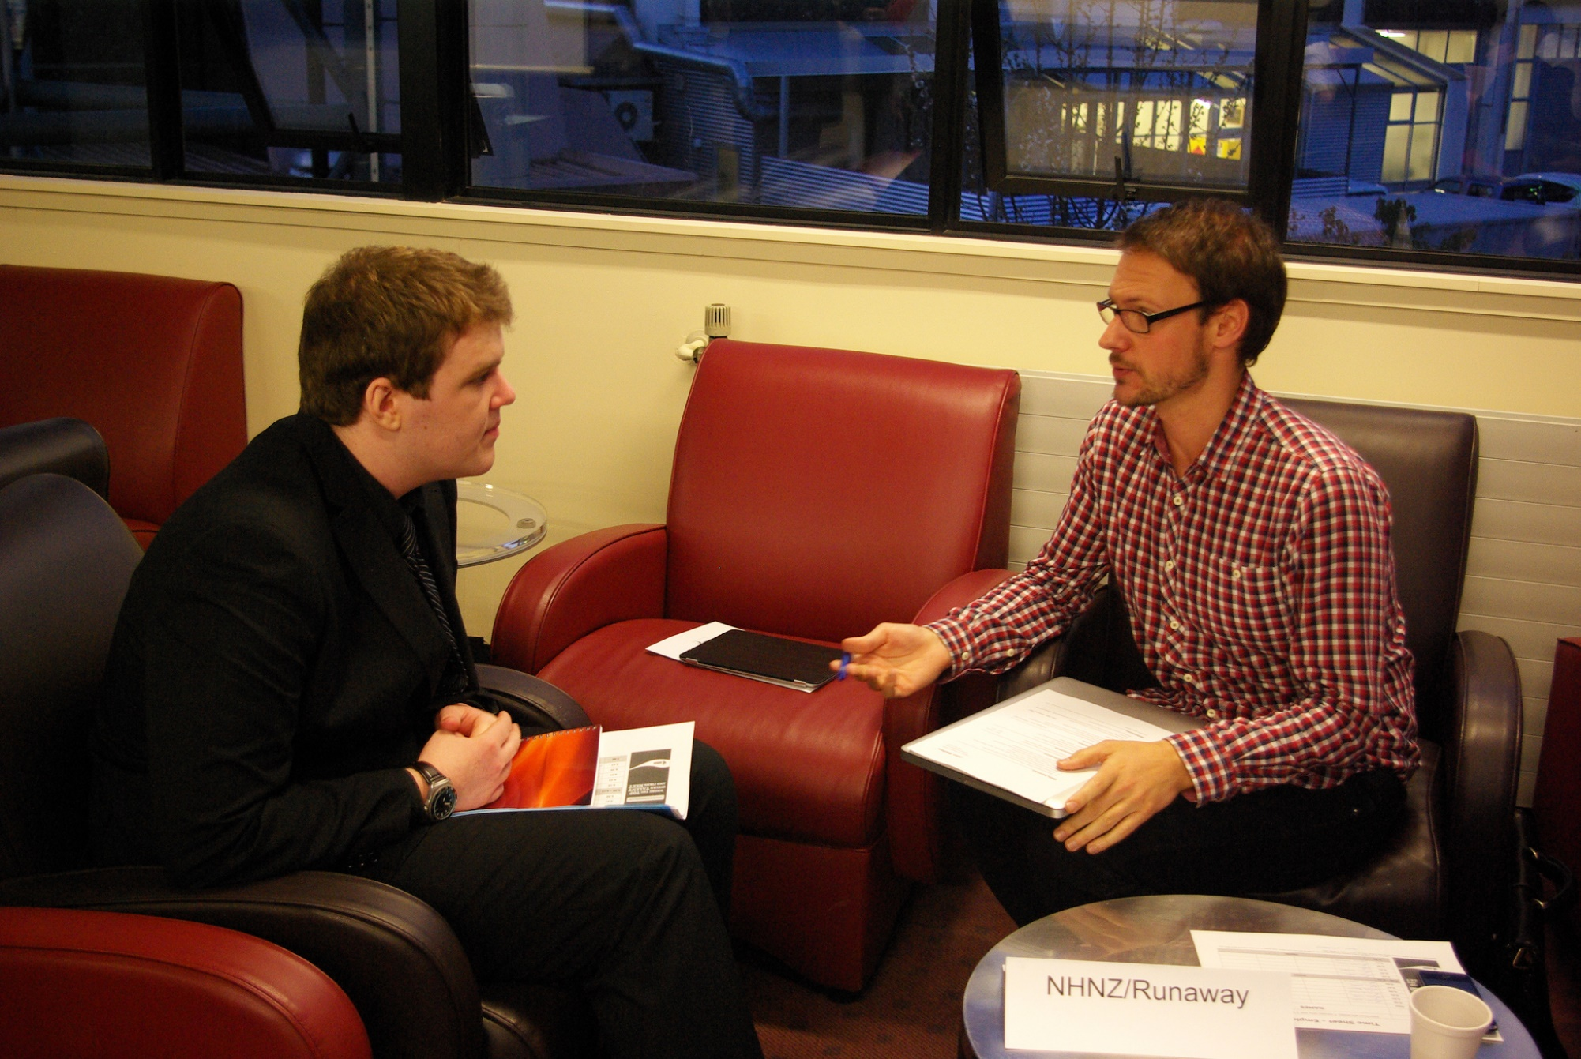
Conducting
Interviews
Use objective questions
Keep it short
Be specific, not vague
Avoid personal questions
Consider what tool you might use (survey monkey, google forms, etc.)
This Photo by Unknown Author is licensed under CC BY

Slide 20
What to Do With
All These Sources
KEEP TRACK of where you found the information.
Recognize the difference between "common knowledge" information and unique knowledge (cited).
If you find multiple sources, find WHO or WHAT those sources are citing (example, government agency).

Slide 21

Decide When to Cite
Decide
When to Cite
6.5

Slide 22
Paraphrase
  Sentence or string of sentences that shares learned information in your own words

Slide 23
Direct Quote
  Sentence or string of sentences that conveys an author’s idea word-for-word

Slide 24
Oral Citations
Include
Author’s name and credibility (if not known by the audience)
Source of the information, including publication
Date of publication

Slide 25
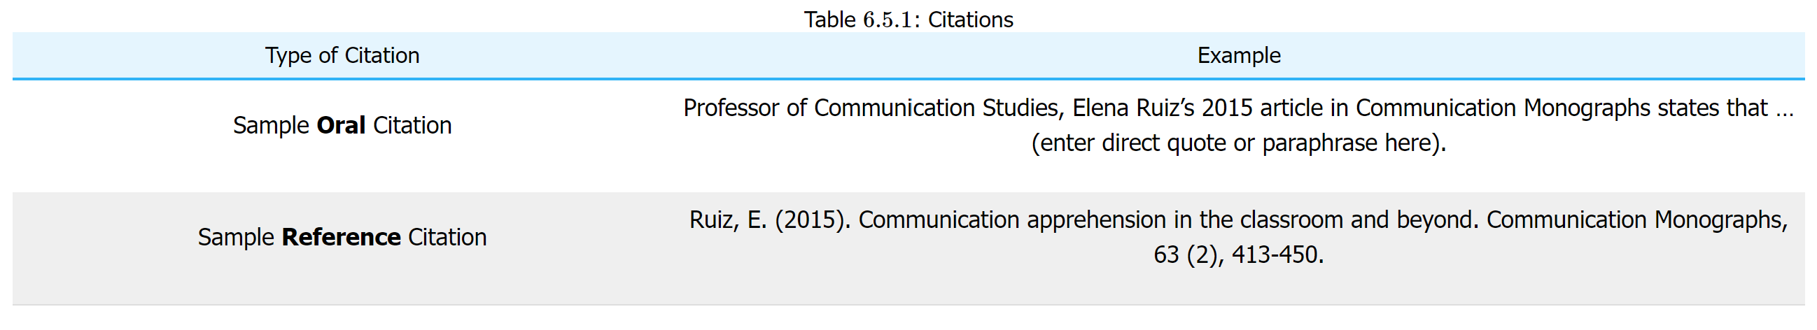

Slide 26
Plagiarism Definition
“Ethics and equity and the principles of justice do not change with the calendar.”
David Herbert Lawrence

Slide 27
Chapter 6 Review
6.1 Research
6.2 Accessing Information Through a Library
6.3 Research on the Internet
6.4 Conducting Your Own Research
6.5 Decide When to Cite

