Slide 1
Exploring Public Speaking (HACC Edition, 2021)
Chapter 8
Supporting Materials

Slide 2
Chapter 8 Overview
8.1 Why Supporting Materials are Needed
8.2 Types of Supporting Materials
8.3 Attention Factors and Supporting Materials

Slide 3
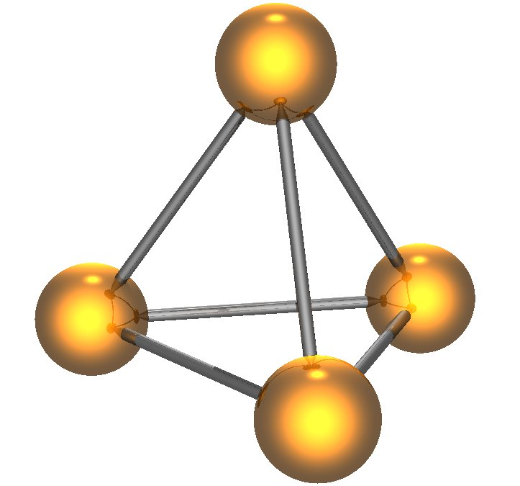
Why Supporting Materials are Needed
Why Supporting Materials
Are Needed
8.1

Slide 4
Why Supporting Materials Are Needed
Answer our questions
and desires for specific information
They draw the difference between general and specific details.

Slide 5
Two Roles of Supporting Material
Inform
Clarify
Explain
Illustrate
Give examples
Persuade
Prove
Back up arguments

Slide 6
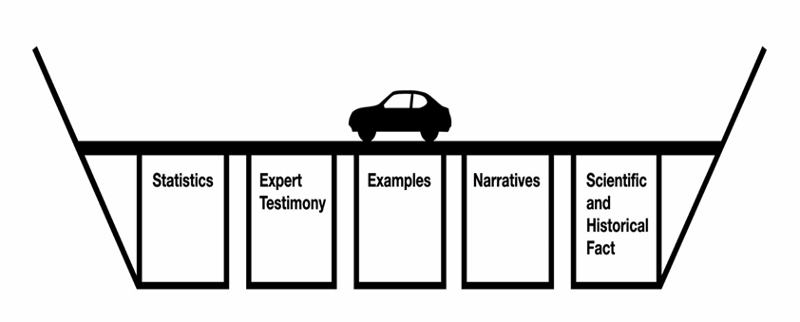
Think of Them as As Supports for a Bridge

Slide 7
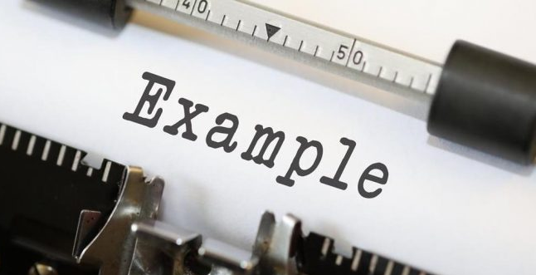
Types of Supporting Material
Types Of
Supporting Material
8.2
This Photo by Unknown Author is licensed under CC BY

Slide 8
Examples
Short but concrete specific instances to illuminate a concept
Types of Supporting Material

Slide 9
Narratives
Stories and anecdotes to interest the audience and clarify, dramatize and emphasize ideas
Can have strong, emotional power
Types of Supporting Material

Slide 10
Historical Narratives
Something that has happened in the past (at any point)
Types of Supporting Material

Slide 11
Hypothetical Narratives
Something that could happen, but has not occurred yet
Types of Supporting Material

Slide 12
Definitions
NOT ones from a dictionary
Jargon and terms that your audience might need to have defined
Types of Supporting Material

Slide 13
Stipulated Definitions
Tells how speaker will use a word or phrase in their speech
Types of Supporting Material

Slide 14
Classification and Differentiation
“X is a type of Y, but is different from the other Y’s in that….”
Types of Supporting Material

Slide 15
Operational Definitions
Give examples of an action or idea to define it
Answers--What does it look like in real life?
Types of Supporting Material

Slide 16
Definition by Contrast or Comparison
Defines a term or concept by telling audience what it is similar to or different than
Types of Supporting Material

Slide 17
Descriptions
Explains something according to five senses (sight, hearing, taste, smell, feel)
Types of Supporting Material

Slide 18
Historic and Scientific Fact
In science, an observation that has been repeatedly confirmed and, for all practical purposes, is accepted or true; never “final”
A truth known by actual experience or observation
Types of Supporting Material

Slide 19
Statistics
Collection, analysis, comparison and interpretation of numerical data, understanding its comparison with other numerical data
Types of Supporting Material

Slide 20
Expert Testimony
Someone with recognized credentials, knowledge, education and/or experience in a subject
They spend time studying the facts and putting facts together
Types of Supporting Material

Slide 21
Peer Testimony
A quotation from a friend, family member or classmate about a topic
Types of Supporting Material

Slide 22
Attention Factors and Supporting Material
Attention Factors And
Supporting Materials
This Photo by Unknown Author is licensed under CC BY-SA-NC
8.3

Slide 23
What IS Attention?
Perception
How we organize and interpret patterns of stimuli around us
Attention
Focus on one stimulus while ignoring or suppressing reactions to another

Slide 24
Why Do We Pay Attention?
We choose to focus on one thing over another
We expect to hear something and tune in for it
The information fills a personal need
Past training has prepared us
Certain things that attract our attention

Slide 25
Attention Factors
Speaker must work to keep the audience engaged by using a variety of strategies

Slide 26
Movement
Moving object
Story with moving plot
Physical movement
Transitions
Animation of words and graphics
Attention Factors

Slide 27
Conflict
Showing ideas, groups, teams, etc. in conflicts
Attention Factors

Slide 28
Novelty
Using new and fresh ideas
Attention Factors

Slide 29
Humor
Should be well-placed and intentional
Appropriate to the topic and well-practiced
Attention Factors

Slide 30
Familiarity
We like things that we are already comfortable with
Can be used to explain a new concept
Attention Factors

Slide 31
Contrast
Visual aids that stand out
Or using voice contrasts (to avoid monotone)
Attention Factors

Slide 32
Repetition
Repeated key points
Attention Factors

Slide 33
Suspense
Can be useful in an introduction to have audience pay attention (for what they expect to hear)
Attention Factors

Slide 34
Proximity
Physical closeness during delivery
Attention Factors

Slide 35
Need-oriented Subjects
What appeals to audience needs
Attention Factors

Slide 36
Intensity
Raising or lowering voice
Attention Factors

Slide 37
Concreteness
All factors tied to real or concrete experience
Attention Factors

Slide 38
Chapter 8 Review
8.1 Why Supporting Materials are Needed
8.2 Types of Supporting Materials
8.3 Attention Factors and Supporting Materials

