Slide 1
Exploring Public Speaking (HACC Edition, 2021)
Chapter 9
Introductions, Conclusions & Connective Statements
This Photo by Unknown Author is licensed under CC BY-NC

Slide 2
Chapter 9 Overview
9.1 General Guidelines for Introductions and Conclusions
9.2 Structuring the Introduction
9.3 Examples of Introductions
9.4 Structuring the Conclusion 9.5 Examples of Conclusions
9.6 Connective Statements

Slide 3
Why Supporting Materials are Needed
General Guidelines
For Introductions and Conclusions
9.1

Slide 4
Speech Length Guidelines
Introduction 10-15%
Body
75-85%
Conclusion
5-10%

Slide 5
Errors to Avoid In Introductions
Rambling and meandering, not getting to the point
Speaking to become comfortable
Saying the specific purpose statement, especially as first words;
Choosing a technique that hurts credibility
Beginning to talk as you approach the platform or lectern
Reading your introduction
Talking too fast

Slide 6
Errors to Avoid In Conclusions
Signal the end multiple times. In other words, no “multiple conclusions” or saying “As I close” more than once
Rambling
Talking as you leave the platform or lectern
Indicating with facial expression or body language that you were not happy with the speech.

Slide 7
Structuring the Introduction
Structuring
The Introduction
9.2

Slide 8
Get the Audience’s Attention
Start with an attention getter
Make sure it’s appropriate and relevant to your audience
Choose one appropriate to speech topic
This Photo by Unknown Author is licensed under CC BY

Slide 9
Anecdotes and Narratives
Brief account of interesting or humorous event
Can be a parable or personal story
Types of Attention Getters

Slide 10
Startling Statement/ Statistic/ Fact
Use a surprising statistic or strange fact but make sure you use factual information
Types of Attention Getters

Slide 11
Rhetorical Question
One in which it doesn’t require an answer
Types of Attention Getters

Slide 12
Immediate Reference to Subject
Explicitly tells the audience their subject
This is not the most entertaining or interesting
Types of Attention Getters

Slide 13
Reference to Audience or Appeal to Self-Interest
Direct reference to the audience and points out what it unique about them
Types of Attention Getters

Slide 14
Quotation
Words of someone else that directly relate to the presentation
Types of Attention Getters

Slide 15
Reference to Current Events
Refer to a current news event to show the audience how relevant your topic is
Types of Attention Getters

Slide 16
Historical Reference
Refer to a previous news event
Types of Attention Getters

Slide 17
Humor
Can be a funny story, quotation, current event
Only use when you know what your audience will find humorous
Types of Attention Getters

Slide 18
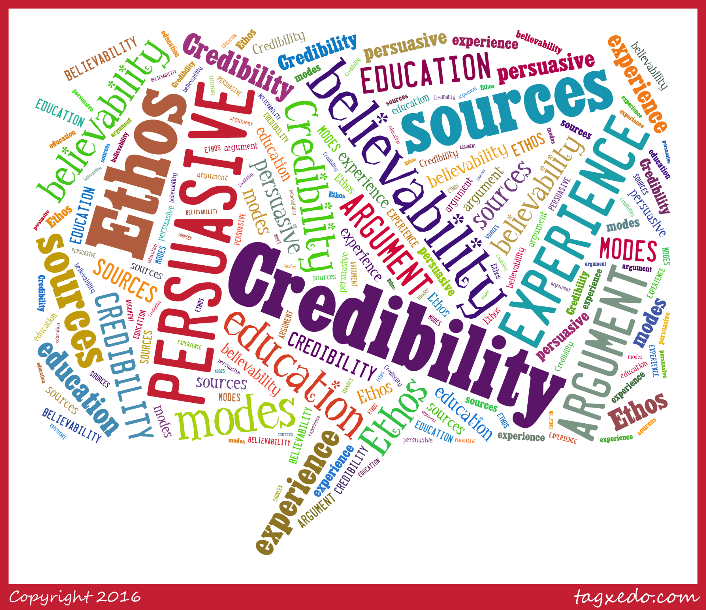
Establish or Enhance Your Credibility
Let your audience know you are a credible source by
Experience
Research
This Photo by Unknown Author is licensed under CC BY

Slide 19
Establish Rapport
Build a relationship by telling your audience why you are giving them this information and why it’s important to them (WII-FM)

Slide 20
Preview Your Topic/Purpose/ Central Idea
Reveal your purpose
Don’t make your audience guess

Slide 21
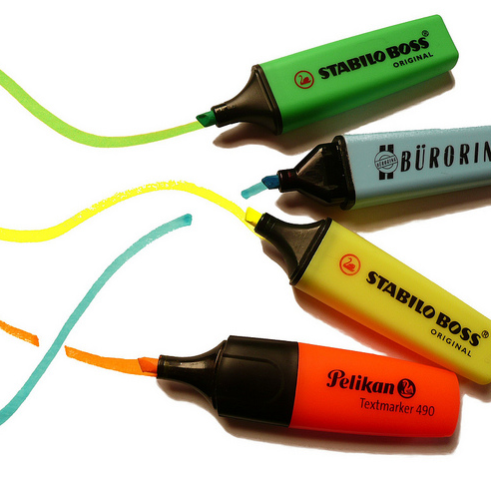
Preview Your Main Points
Briefly review your main points to the audience knows what to expect and prepares them to listen

Slide 22
Introduction Examples
For Examples
Of Introductions,
See Your Text
This Photo by Unknown Author is licensed under CC BY-SA
9.2

Slide 23
Structuring the conclusion
Structuring
The Conclusion
This Photo by Unknown Author is licensed under CC BY
9.4

Slide 24
Signal The End
Prepare your audience for the conclusion
Use words like “In conclusion,” “In summary,” or “To conclude”
This Photo by Unknown Author is licensed under CC BY-SA

Slide 25
Restate Main Points
“Planned redundancy”
Avoid bringing up new material
This Photo by Unknown Author is licensed under CC BY-NC-ND

Slide 26
Use a Clincher
Have a “concluding device” that’s memorable
The inverse of the attention getter
This Photo by Unknown Author is licensed under CC BY-NC

Slide 27
Challenge
Engage in something that requires special effort
Make it aspirational but reasonable
Have a call to action
Types of Clinchers

Slide 28
Quotations
Make it relevant to topic
Quotations can be persuasive or informative
Types of Clinchers

Slide 29
Visualizing the Future
Imagine the future you believe can occur
Types of Clinchers

Slide 30
Inspiration
Appeal to stir someone’s emotions
Types of Clinchers

Slide 31
Question
Rhetorical question that forces audience to ponder an idea
Types of Clinchers

Slide 32
Refer Back to Introduction
Remind audience of your startling statement or fact
Types of Clinchers

Slide 33
Anecdote or Personal Story
Make sure it is relevant and not too long
Types of Clinchers

Slide 34
Reference to Audience
Spell out the benefits a behavior or thought change has
Types of Clinchers

Slide 35
Conclusion examples
For Examples
Of Conclusions,
See Your Text
This Photo by Unknown Author is licensed under CC BY-SA
9.5

Slide 36
Connective statements
Connective
Statements
This Photo by Unknown Author is licensed under CC BY-SA-NC
9.6

Slide 37
Special Notes
Note the body of of a speech is developed before the introduction. You won’t know what to introduce until you’ve created that.
Connectors tie a speech together; do not leave them to chance.

Slide 38
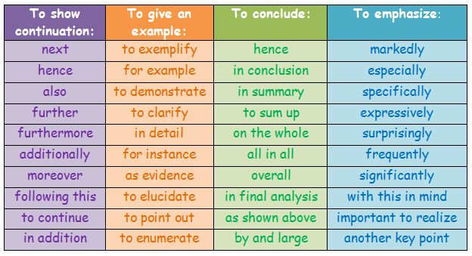
Connective Statements
Remind the audience of what has come before and the central idea of the speech
Forecast what is coming next
Explain the logical connections and your mental processes
Keep the audience’s attention
This Photo by Unknown Author is licensed under CC BY-NC-ND

Slide 39
Internal Summaries
Emphasizes what has come before and reminds audience of what has been covered
Types of Connective Statements

Slide 40
Internal Previews
Lets your audience know what is coming next
Types of Connective Statements

Slide 41
Transitions
Serve as bridges between seemingly disconnected but related material
Types of Connective Statements

Slide 42
Signposts
Emphasize physical movement (first, second, third, fourth, etc.)
Types of Connective Statements

Slide 43
Bridging Statements
They are for connecting, not providing evidence
They can be relatively short
Include on your outline
Vary connectives
Types of Connective Statements

Slide 44
Chapter 9 Review
9.1 General Guidelines for Introductions and Conclusions
9.2 Structuring the Introduction
9.3 Examples of Introductions
9.4 Structuring the Conclusion 9.5 Examples of Conclusions
9.6 Connective Statements

