Slide 1
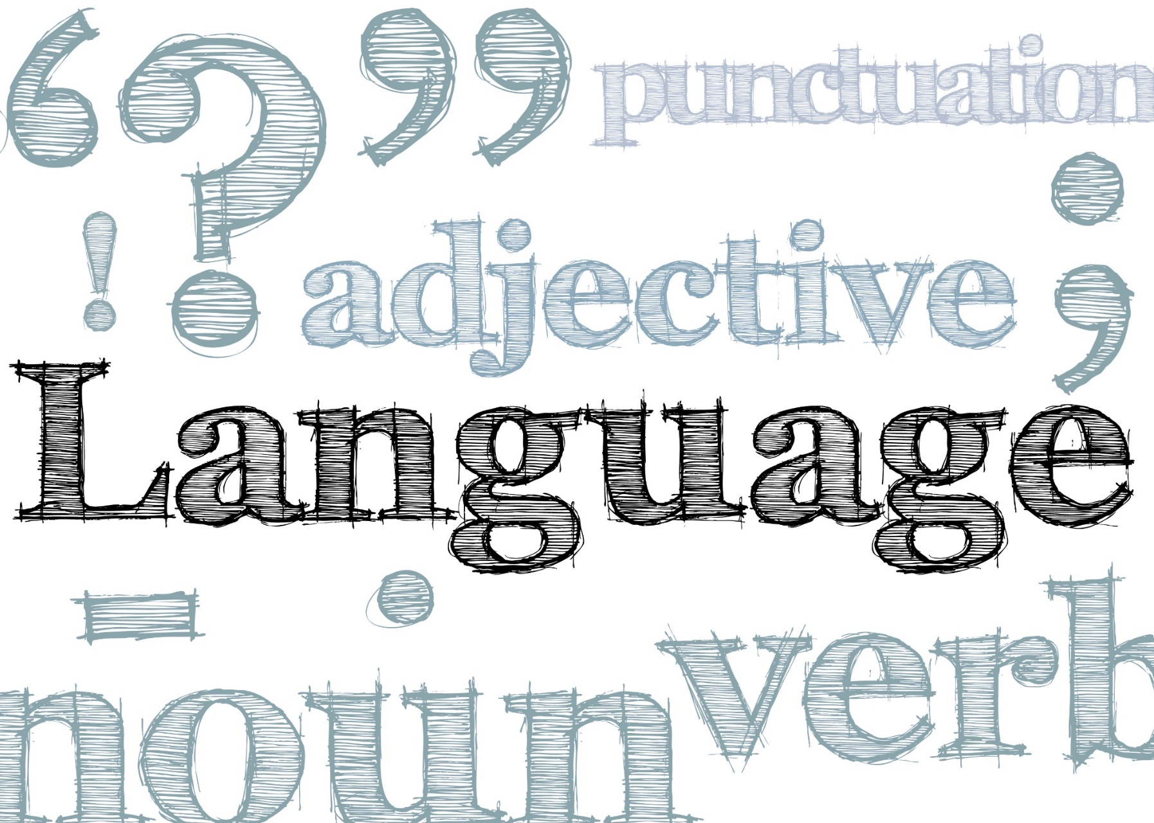
Exploring Public Speaking (HACC Edition, 2021)
Chapter 11
Language

Slide 2
Chapter 11 Overview
11.1 What Language Is and Does
11.2 Standards for Language in Public Speaking
11.3 Developing Your Ability to Use Effective Language in Public Speaking
11.4 Funny Talk: The Art and Craft of Using Humor in Public Speaking

Slide 3
What Language is and Does
What Language is and Does
11.1

Slide 4
Language Defined
Formal system of
Gestures
Signs
Sounds Symbols
Communicates
Thoughts through written, enacted or spoken means
Language Use
Mandarin (most common) followed by English, Spanish and Arabic
Historically, spoken, not written

Slide 5
Language Considerations
Denotative
“Dictionary” definition
Connotative
Meaning associated with words
Euphemism
Used to make something unpleasant sound more tolerable

Slide 6
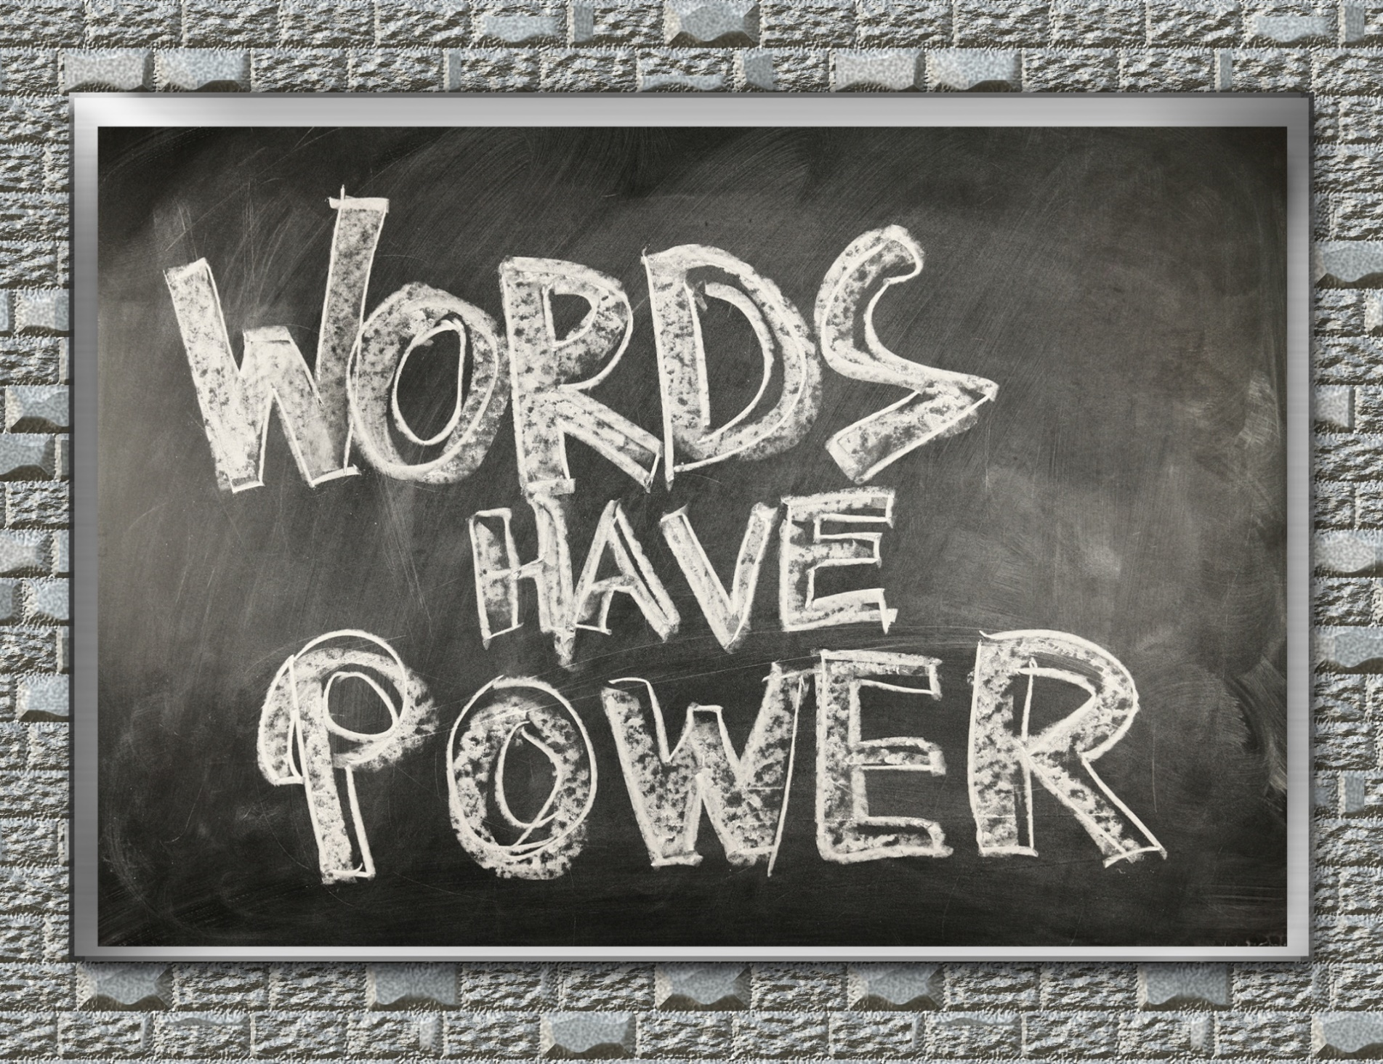
Other Ideas About Language
Study of language is controversial
Language is a part of who we are and how we think
Language is about power
Words change meaning over time

Slide 7
Why We Need Organization in Speeches
Standards for Language
11.2

Slide 8
Speaking
Clear language is powerful language
Standards for Language in Public Speaking

Slide 9
Achieving Clarity
Concreteness—that which evokes different visual images
Standards for Language in Public Speaking

Slide 10
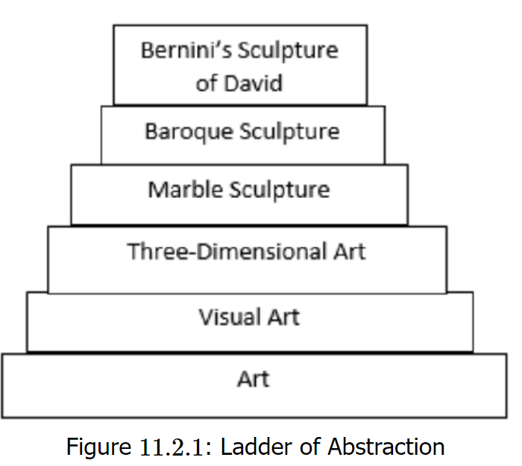
Abstract vs Specific
“Ladder of abstraction” shows how language varies from vague to precise
Speakers must choose the right words

Slide 11
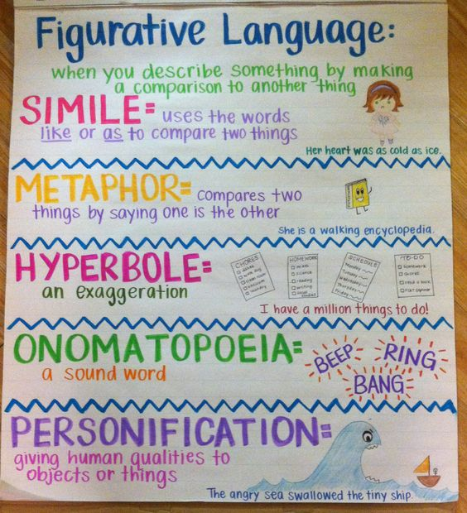
Types of Language
Literal language does not use comparisons
Figurative language uses similes (“like” or “as”
Metaphors are direct comparisons
Cliches are predictable expressions (avoid them)
This Photo by Unknown Author is licensed under CC BY-NC-ND

Slide 12
Effectiveness
Communicating the right message to the audience;
Language should be to bring people together (inclusion) and create understanding
Standards for Language in Public Speaking

Slide 13
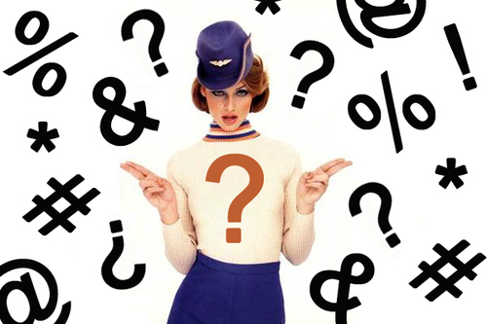
Considerations for Effectiveness
Use certain language only if it will create meaning
Avoid assumptions that your audience knows
Jargon
Slang
Complicated vocabulary
Profanity and cursing is generally not effective

Slide 14
Rhetorical Techniques
Assonance
Alliteration
Antithesis
Parallelism
Anaphora
Hyperbole
Irony
Standards for Language in Public Speaking

Slide 15
Appropriateness
Refer to people and groups based on inclusiveness and context
Standards for Language in Public Speaking

Slide 16
Gender-Inclusive Language
Avoid “he” as a generic term
Avoid assumptions about professions
Standards for Language in Public Speaking

Slide 17
Ethnic Identity
Generally avoid unless in context and then identify all ethnicities equally (“three European-American women, one Latina, and one Vietnamese male”
Standards for Language in Public Speaking

Slide 18
Disabilities
Use preferred, person-first terms
Standards for Language in Public Speaking

Slide 19
Developing Your Ability
Developing Your Ability To Use Effective Language in Public Speaking
11.3

Slide 20
Developing Your Abilities
Define terms
Use specific language
Personalize your language
Develop your vocabulary, but not to show it off

Slide 21
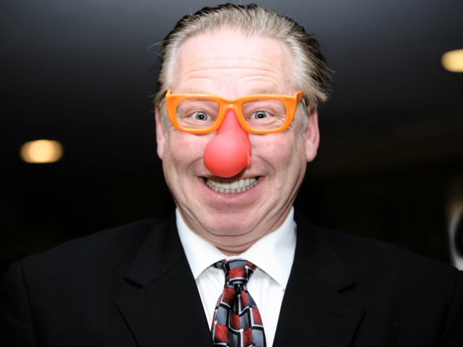
Funny Talk: The Art and Craft of Using Humor in Public Address
Funny Talk
The Art and Craft of Using Humor in Public Address
This Photo by Unknown Author is licensed under CC BY-SA-NC
11.4

Slide 22
Points about Using Humor
A speech that includes timely and well-delivered humor can be gratifying
You should not be afraid to use appropriate humor
Using humor takes study and practice

Slide 23
Pros and Cons of Humor
Pros:
Keeps interest and attention
Provides entertainment
Relaxes the audience
Builds rapport
Breaks monotony
Cons:
Potential for offensiveness or bad taste
Can be unfunny or inappropriate
Might trivialize topic

Slide 24
Chapter 11 Review
11.1 What Language Is and Does
11.2 Standards for Language in Public Speaking
11.3 Developing Your Ability to Use Effective Language in Public Speaking
11.4 Funny Talk: The Art and Craft of Using Humor in Public Speaking

