Slide 1
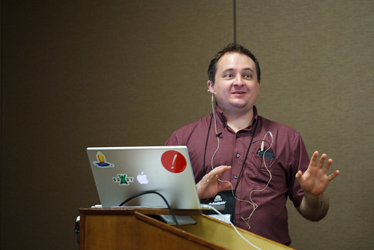
Exploring Public Speaking (HACC Edition, 2021)
Chapter 12
Delivery
This Photo by Unknown Author is licensed under CC BY-SA-NC

Slide 2
Chapter 12 Overview
12.1 The Importance of Delivery
12.2 Methods of Speech Delivery
12.3 Preparing for Your Delivery
12.4 Practicing Your Delivery
12.5 What to Do When Delivering Your Speech
12.6 Public Speaking Online

Slide 3
The Importance of Delivery
The Importance of Delivery
12.1

Slide 4
Important Points About Delivery
Delivery is actually the shortest part of the process, but we tend to focus on (and fear) it the most!
Public speaking is more than just reading and talking at the same time.
Speaking has more formality than talking and less formality than reading

Slide 5
Methods of Delivery
Methods of Speech Delivery
This Photo by Unknown Author is licensed under CC BY-NC
12.2

Slide 6
Impromptu
Without advance preparation
Generally, most successful when brief and focus on a single point
Methods of Delivery

Slide 7
Manuscript
Word-for-word iteration of a written message
May be appropriate at certain times but isn’t often interesting
Methods of Delivery

Slide 8
Extemporaneous
Carefully planned and rehearsed, spoken in a conversational manner using brief notes
Promotes that you are a credible speaker
Requires PRACTICE!
Methods of Delivery

Slide 9
Memorized
Rote recitation of a written message that speaker has committed to memory
Can be flat and uninteresting and difficult to find your place if you forget
Methods of Delivery

Slide 10
Preparing for Delivery
Preparing for Your Delivery
This Photo by Unknown Author is licensed under CC BY-SA-NC
12.3

Slide 11
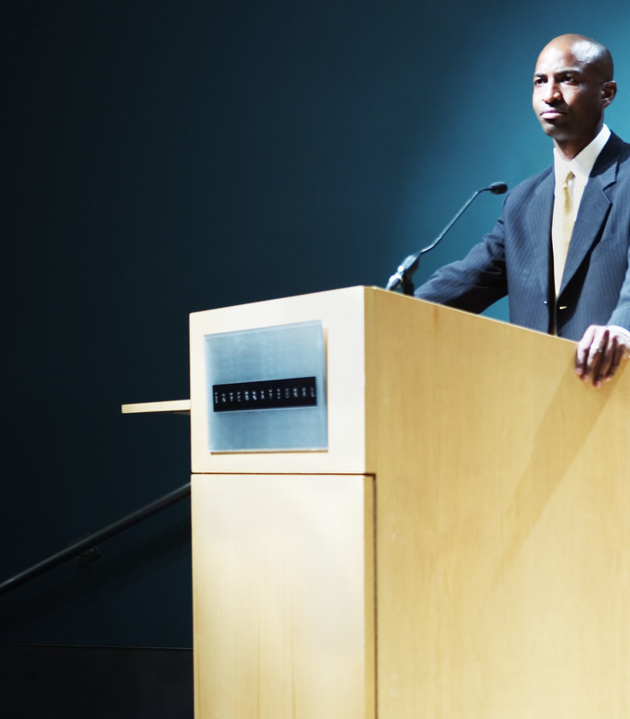
Using Lecterns
Adds a measure of formality
Tempting to grip the edges for security or to hide behind it
Use lectern for notes only; step to the side or front when speaking
This Photo by Unknown Author is licensed under CC BY

Slide 12
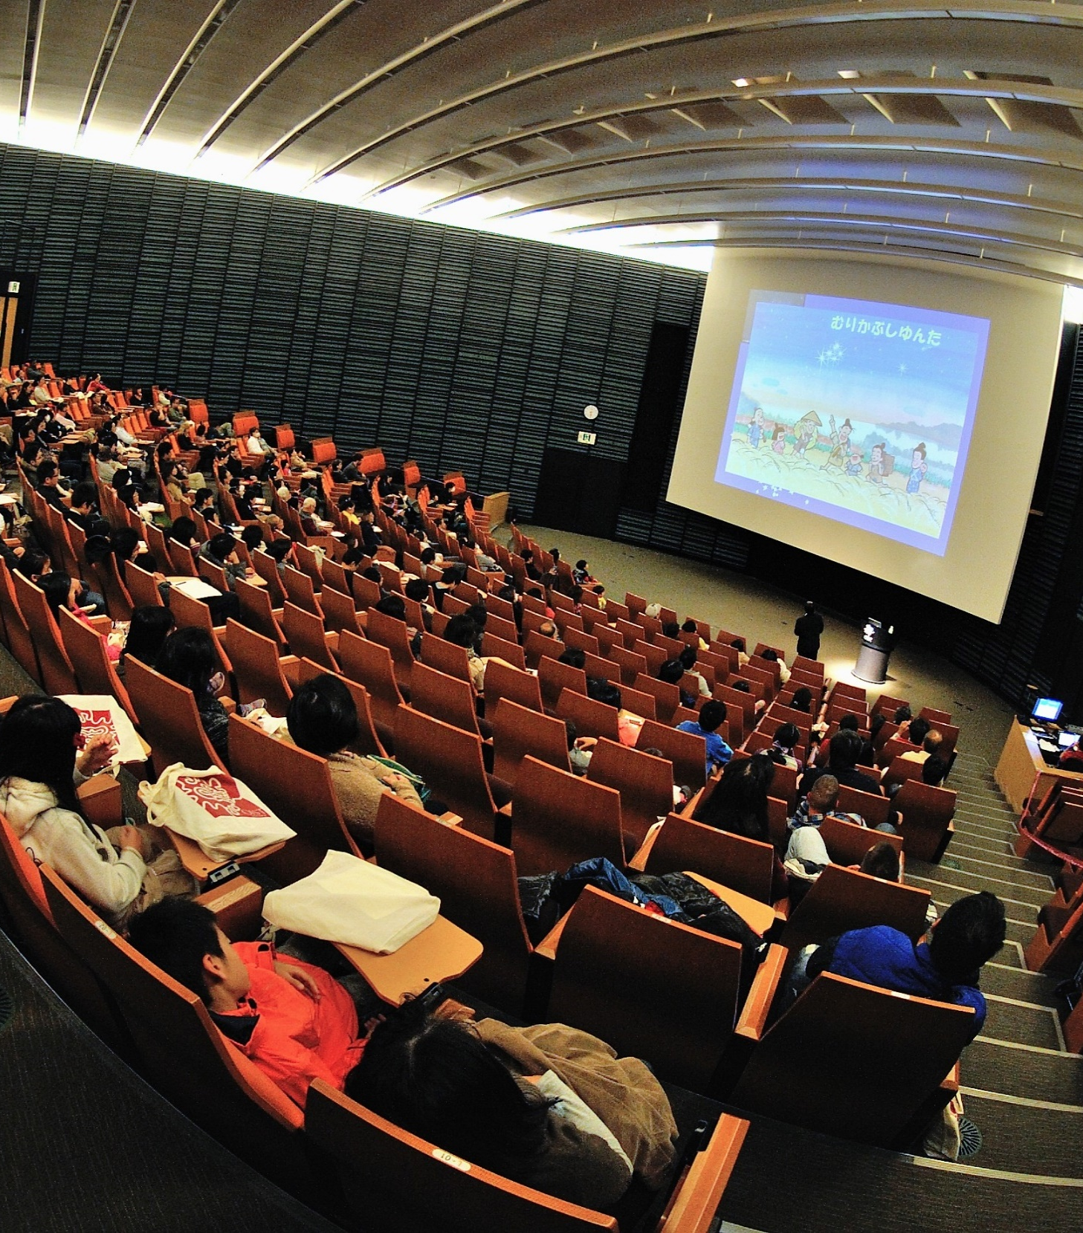
Speaking in a Small or Large Space
Make adjustments to voice and gestures (smaller and softer in small space; larger and louder in larger place)
If you have control, find a location that fits the size of your audience
This Photo by Unknown Author is licensed under CC BY

Slide 13
Speaking Outdoors
Can be charming but prone to distractions
Pose challenges with weather, sun glare and insects/birds
Make the best of your situation

Slide 14
Using a Microphone
A microphone amplifies; it does not clarify
Come in various types and sizes (clip-on, lectern, hand-held)
Do not feel obligated to use one if audience is small and close to you

Slide 15
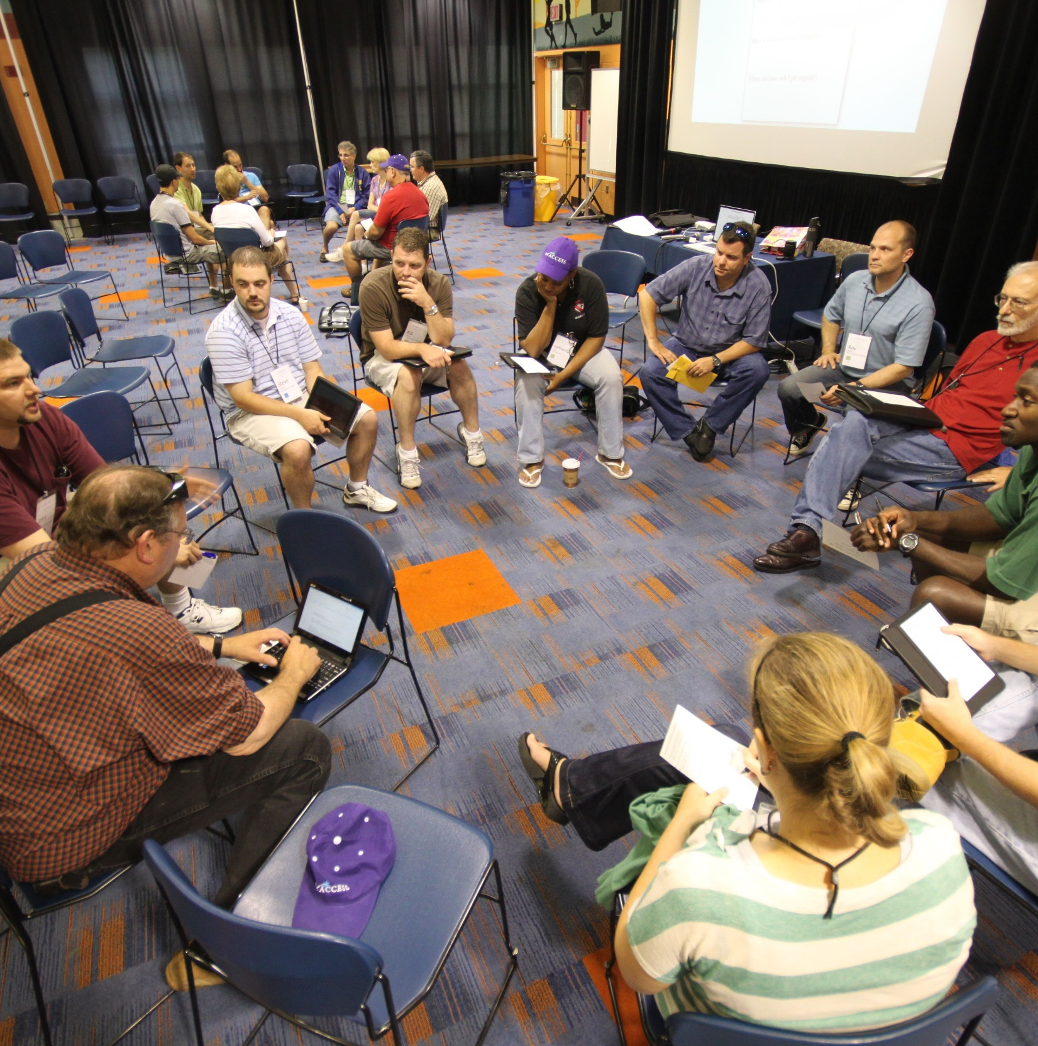
Audience Size
Small audience (8-12) allows for more contact and questions
Establish good rules so audience doesn’t feel as if they can interrupt
This Photo by Unknown Author is licensed under CC BY

Slide 16
Practicing Your Delivery
Practicing Your Delivery
12.4

Slide 17
Practice Out Loud
If you don’t, you’re not really practicing what you’ll be doing in the class.
Practicing Your Delivery

Slide 18
Practice Standing Up
The default position for delivering a speech is standing with feet shoulder-width apart
Practicing Your Delivery

Slide 19
Practice with a Lectern
Use a kitchen counter at home or find an empty classroom
Practicing Your Delivery

Slide 20
Practice with an audience
Have parents, siblings, friends or significant others listen and give you feedback
Practicing Your Delivery

Slide 21
Practice for time
Make sure you are well within the time frame to allow for going a little longer or shorter
Time yourself at least three times
Practicing Your Delivery

Slide 22
Record Yourself
By watching yourself, you can notice small things that might be distracting
Practicing Your Delivery

Slide 23
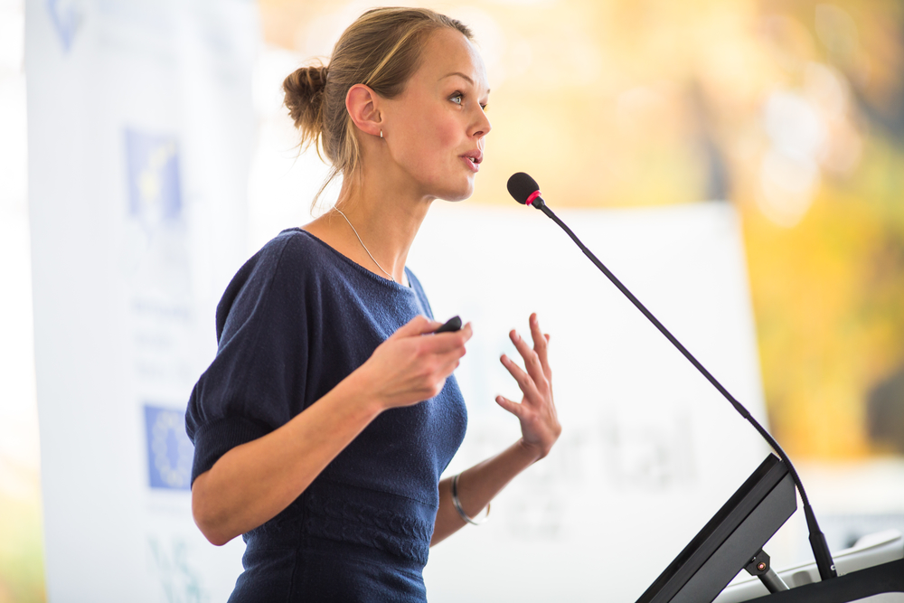
What to Do When Delivering Your Speech
What to Do When Delivering Your Speech
This Photo by Unknown Author is licensed under CC BY-NC-ND
12.5

Slide 24
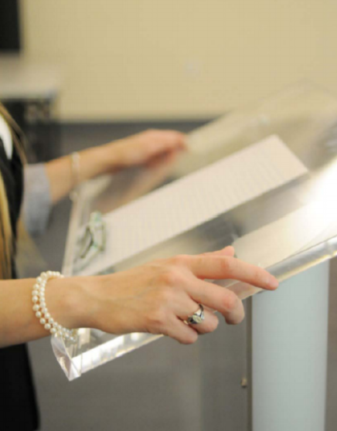
Hands
People can either use hands too much or too little
Use them naturally—as you would in conversation with friends

Slide 25
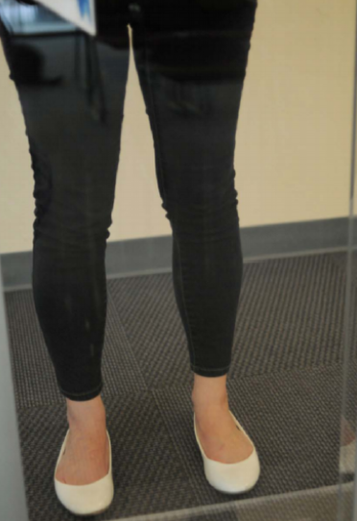
Feet
People can either “dance” or twist feet around each other or lower leg
Have them shoulder-width apart with knees slightly bent (Avoid locking knees)

Slide 26
Objects
Only bring to the lectern what you absolutely need to give a speech.
Avoid
“Jingly” jewelry
Uncomfortable shoes
Clothing with fringe or zippers
“Fixing” your hair
This Photo by Unknown Author is licensed under CC BY-SA-NC

Slide 27
Lectern and Posture
Avoid
Leaning on it
Tipping it
Being afraid to touch it
Roll your shoulders back

Slide 28
Eye Contact
Eye contact is how you establish and maintain rapport with your audience
Make it genuine, not fake

Slide 29
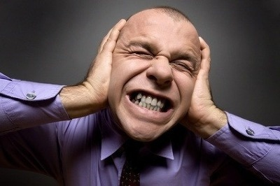
Volume
Too soft—audience will struggle to hear you and may give up trying to listen
Too loud—audience may feel you are yelling at them
Adjust for the size of the audience and the room
This Photo by Unknown Author is licensed under CC BY-SA

Slide 30
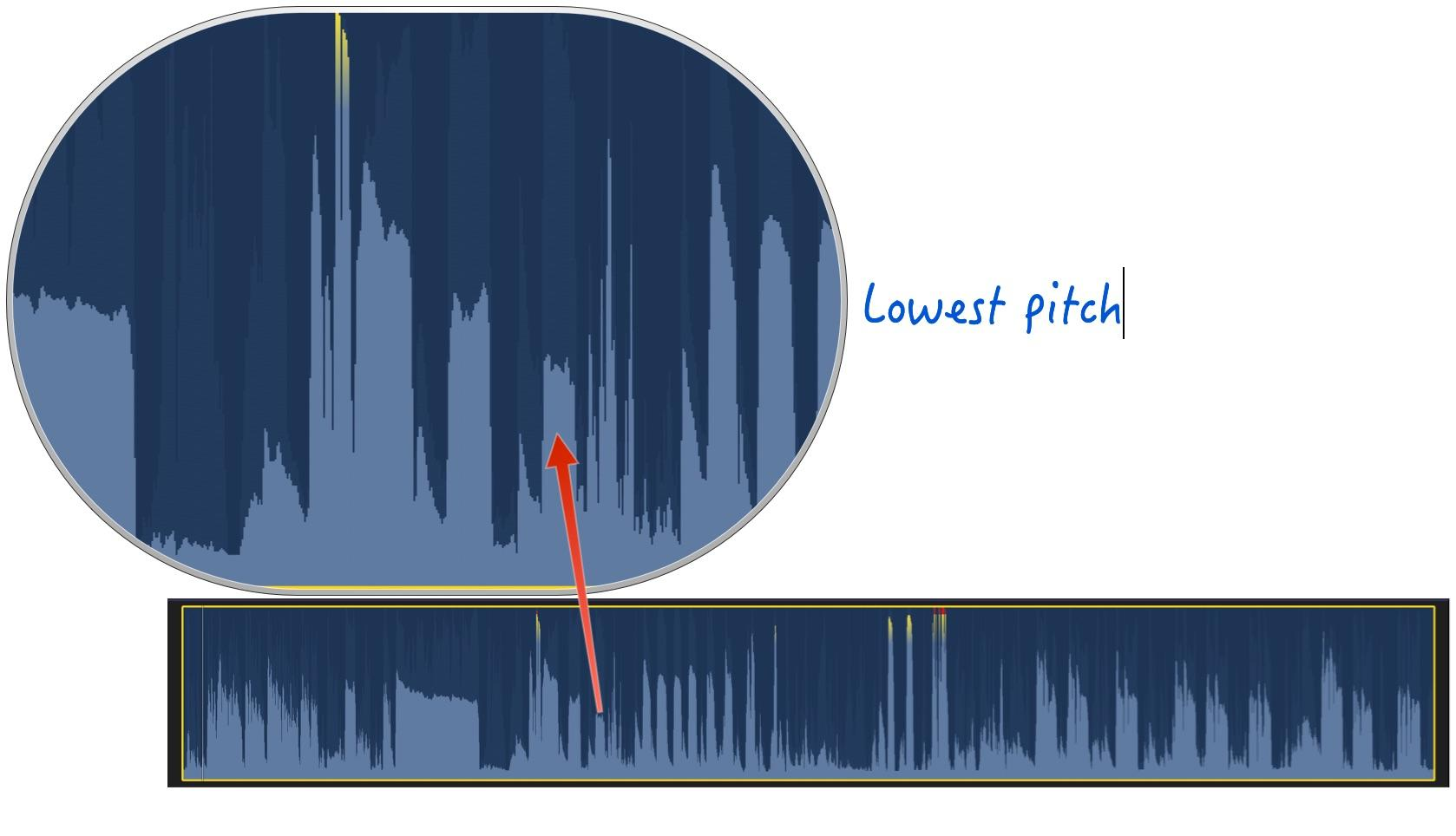
Pitch
Highness or lowness of voice
Avoid being monotone; usually caused by reading too much
This Photo by Unknown Author is licensed under CC BY-SA-NC

Slide 31
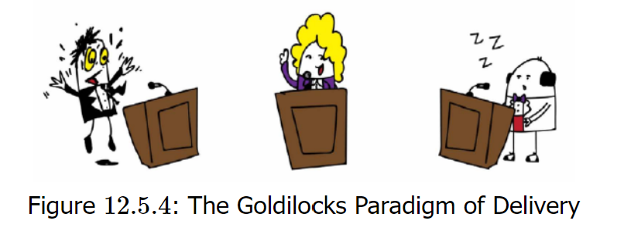
Rate
Too slowly—may make it sound like you don’t fully know your material
Too fast—affects audience’s ability to keep up with you
Maintain a good, deliberate pace

Slide 32
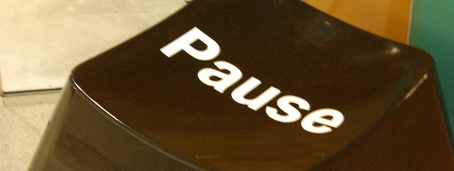
Pauses
Pauses occur in natural speaking; don’t be afraid of them
Pause when making a point or wanting a more powerful impact
Gives the audience a moment to digest what you said
This Photo by Unknown Author is licensed under CC BY-SA

Slide 33
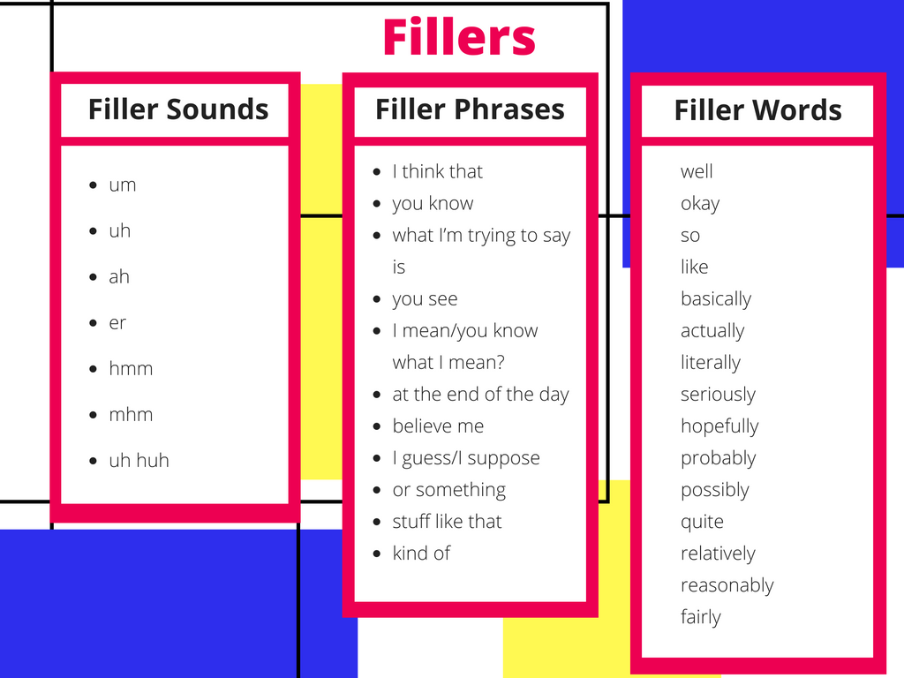
Vocalized Pauses
“Fillers”
Most common is “uh” or “um”
Try to catch yourself and be aware of how many times you use them
This Photo by Unknown Author is licensed under CC BY-SA-NC

Slide 34
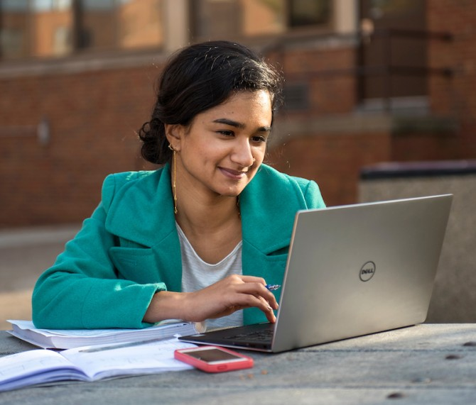
Public Speaking Online
Public Speaking Online
12.6

Slide 35
Issues with Web Conferencing
Audience Multitasking:
Not fully attending
Audience being bored

Slide 36
Tips for Speaking Online
Be energetic
Stand to deliver your speech
Avoid reading or memorization
Keep slides simple
No more than 10 slides, no more than 20 words; no font smaller than 30
Have a good background
Use neutral, non-distracting background

Slide 37
During the Web Speech
Start/End on time
Include time for questions and answers
Smile (your audience can hear that)
Consider anxiety
Use specific questions
Remember to use transitions
Look at the camera not the screen

Slide 38
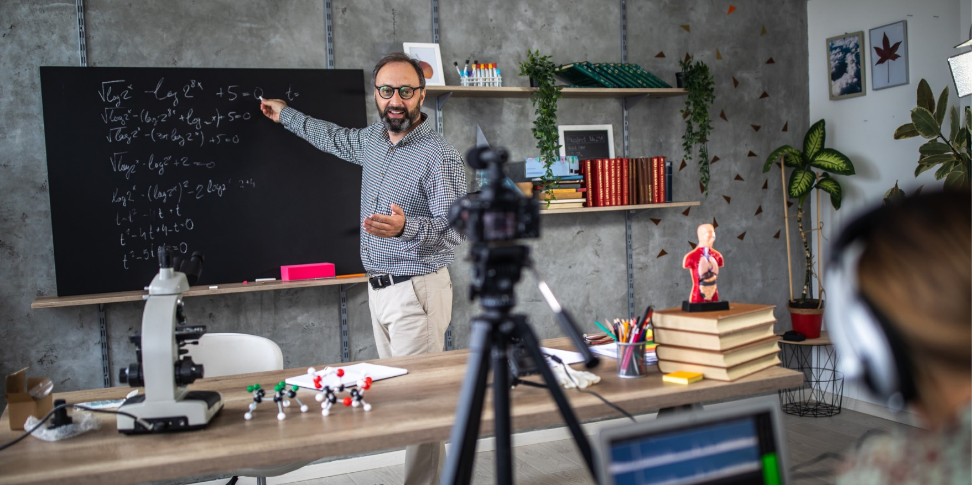
For class
Film your entire body
Do a tech walkthrough first before recording
Wear appropriate clothing
Get the room as bright as possible
This Photo by Unknown Author is licensed under CC BY-SA

Slide 39
Chapter 12 Review
12.1 The Importance of Delivery
12.2 Methods of Speech Delivery
12.3 Preparing for Your Delivery
12.4 Practicing Your Delivery
12.5 What to Do When Delivering Your Speech
12.6 Public Speaking Online

