Slide 1
Exploring Public Speaking (HACC Edition, 2021)
Chapter 13
Visual Aids
This Photo by Unknown Author is licensed under CC BY

Slide 2
Chapter 13 Overview
13.1 What are Presentation Aids?
13.2 Functions of Presentation Aids
13.3 Types of Presentation Aids
13.4 Using Presentation Slides
13.5 Low-Tech Presentation Aids

Slide 3
What Are Presentation Aids?
What Are Presentation Aids?
This Photo by Unknown Author is licensed under CC BY-SA
12.1

Slide 4
Important Points About Presentation Aids
They are resources beyond the speech words and delivery that a speaker uses to enhance the message
Most speakers use VISUAL aids (pictures, diagrams, charts, maps, etc.)
Presentation Aids can also be
Audible (music, sound effects)
Olfactory (smells)
Gustatory (taste)
Three-dimensional objects

Slide 5
Functions of Presentation Aids
Functions of Presentation Aids
This Photo by Unknown Author is licensed under CC BY-NC-ND
12.2

Slide 6
Improving Audience Understanding
Perceptions differ
Presentation aids help to clarify or emphasize
Functions of Presentation Aids

Slide 7
Clarifying
If interpretation of information is unclear, listeners may be confused or misled
Functions of Presentation Aids

Slide 8
Emphasizing
Increases the audience’s chances of remembering
Functions of Presentation Aids

Slide 9
Adding Variety and Interest
Increases the audience’s chances of being interested
Functions of Presentation Aids

Slide 10
Enhancing Speaker’s Credibility
Must have clear, clean, uncluttered, organized and large aids
Must also give credit to sources
Functions of Presentation Aids

Slide 11
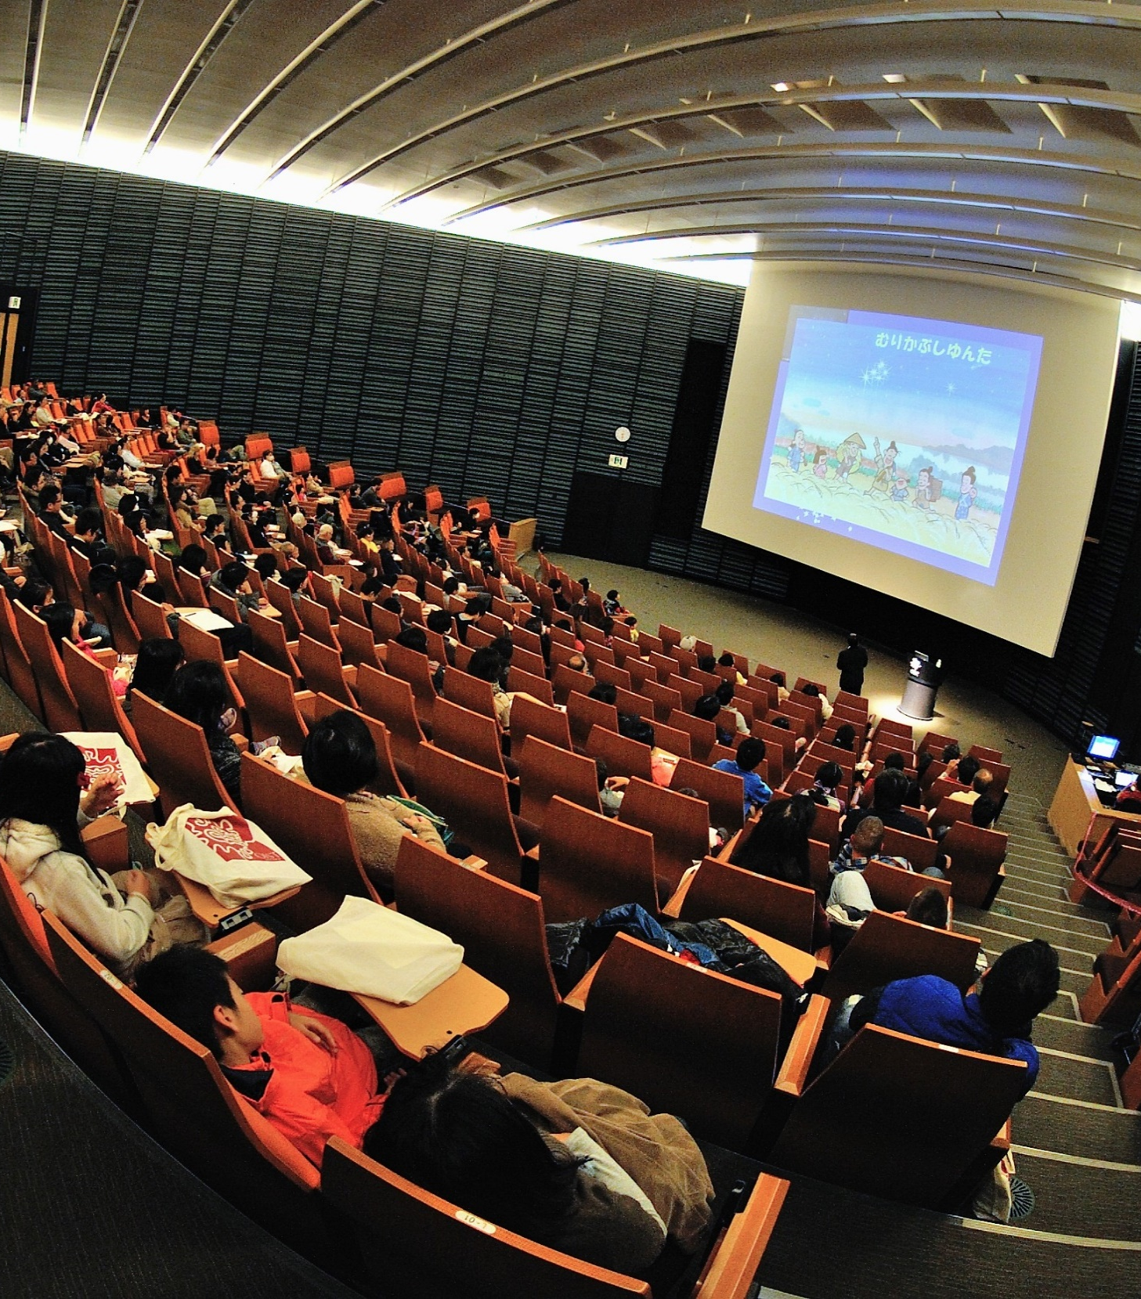
Avoid Problems With Presentation Aids
Don’t allow visual aids to overshadow your speech
Remember technology limits
Be prepared to adapt
Make sure the audience can clearly see them
Explain visual aids; they won’t explain themselves
This Photo by Unknown Author is licensed under CC BY

Slide 12
Types of Presentation Aids
Types of Presentation Aids
12.2

Slide 13
Statistical Charts
Keep simple
Explain
Make sure YOU understand
Types of Presentation Aids

Slide 14
Sequence-of-Steps Charts
Useful when trying to explain a process with several steps
Types of Presentation Aids

Slide 15
Decision Trees
Useful for showing relationships between ideas
Make sure it’s relevant
Types of Presentation Aids

Slide 16
Line Graphs
Shows trends over time
Types of Presentation Aids

Slide 17
Bar Graphs
Useful for showing the differences between quantities
Types of Presentation Aids

Slide 18
Pictograph
Uses numbers and/or sizes of iconic symbols to dramatize differences in amounts
Types of Presentation Aids

Slide 19
Diagrams
Drawings or sketches that describe something not readily seen
Types of Presentation Aids

Slide 20
Maps
Useful if the information is clear and limited
Types of Presentation Aids

Slide 21
Photographs and Drawings
Shows unfamiliar but important details
MUST be of high quality
Avoid having them be just “there”
Types of Presentation Aids

Slide 22
Video or Audio Recordings
Short video or clip
Avoid choosing ones that are too long
Practice before showing
Cue the clip to start at the right place
Give audience context before showing
Types of Presentation Aids

Slide 23
Objects or Models
Objects--Anything you can hold up and talk about
Models—recreations of physical objects not readily available
Types of Presentation Aids

Slide 24
Animals
Comes with serious risks (unpredictability, distracting, negative reactions from audience, regulations)
Consider using a picture, model, diagram or video
Types of Presentation Aids

Slide 25
People
Make arrangements with person ahead of time
Make sure they are dressed presentably and not draw attention away from your message
Types of Charts

Slide 26
Using Presentation Slides
Using Presentation Slides
This Photo by Unknown Author is licensed under CC BY-NC
12.4

Slide 27
Types of Presentation Slides
PowerPoint
Prezi
Slide Rocket
Google Slides
Keynote (Apple)
Impress (Open Office)
PrezentIt
AdobeAcrobat Presenter
ThinkFree
Canva

Slide 28
Advantages and Disadvantages of Presentation Slides
Advantages:
Allow visualization
Are portable
Can be embedded with video and audio
Are often expected
Disadvantages:
Too linear; don’t show relationships
Forces certain formats
Often have too much text or are poorly designed

Slide 29
Unity and Consistency
Use single font or two fonts consistently
Keep it simple—one message, one photo, or one graphic
Use animation to reveal one line at a time, but not for other purposes
Consider subtle slide transitions

Slide 30
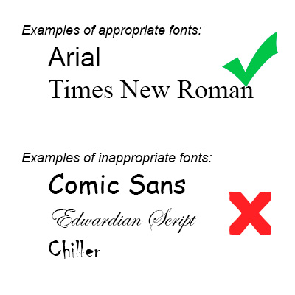
Emphasis, Focal Point and Visibility
Make text large enough to see
Standard rule is NO MORE than 7 lines of text with 7 words per line (7x7 rule)
Avoid too many slides
Templates can be “wrong”
Use high contrast
Use sans serif fonts

Slide 31
Tone
Convey the correct tone (attitude) through:
Fonts
Clip art
Photographs
Template

Slide 32
Scale and Proportion
Bullet points convey no particular order
Numbers imply order
Bullets should be short; not complete sentences
Graphics should have some empty space

Slide 33
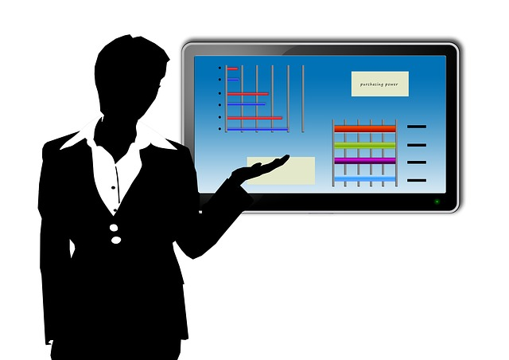
Rhythm in Presenting
Slides should have consistent look
Make sure there’s a connection between your visuals and what you are saying
Show visual aid only when you are talking about it
Pressing “B” will blank the screen; “W” will turn it white

Slide 34
Basic Rules Using Presentation Slides
Have readable file
Graphics must be cited unless from common/s site
Avoid looking back at screen
Presentation aids are aids, not the speech itself
Hyperlink any URLs
You still need verbal transitions

Slide 35
Dry Erase Board
May be seen as presenter who’s unprepared
Use only for interactive components of a speech
Write short phrases legibly in large enough font size
Low-Tech Presentation Aids

Slide 36
Flip Charts
Helpful for when you want to save pages for future reference
Follow rules for dry erase board
Low-Tech Presentation Aids

Slide 37
Posters
Quite large and involve a lot of work
Will need a special printer
Otherwise, avoid “regular” posters
Low-Tech Presentation Aids

Slide 38
Handouts
Allow audience takeaway
Make sure you need one
Avoid passing it around
Can distribute before, during or after speech, depending on your needs
Low-Tech Presentation Aids

Slide 39
Chapter 13 Review
13.1 What are Presentation Aids?
13.2 Functions of Presentation Aids
13.3 Types of Presentation Aids
13.4 Using Presentation Slides
13.5 Low-Tech Presentation Aids

