Slide 1
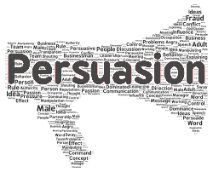
Exploring Public Speaking (HACC Edition, 2021)
Chapter 15
Persuasive Speaking
This Photo by Unknown Author is licensed under CC BY-SA-NC

Slide 2
Chapter 15 Overview
15.1 Why Persuade
15.2 A Definition of Persuasion
15.3 Why is Persuasion Hard?
15.4 Traditional Views of Persuasion 15.5 Constructing a Persuasive Speech
15.6 Sample Outline (Topical Patterns)
15.7 Sample Outline (Monroe’s)

Slide 3
Information + Change = Persuasion

Slide 4
A Definition of Persuasion
A Definition of Persuasion
This Photo by Unknown Author is licensed under CC BY-NC-ND
15.2

Slide 5
Persuasion Defined
“Process of creating, reinforcing, or changing people’s beliefs or actions
Think of it as a continuum going both ways from strongly disagree to strongly agree with you
You are trying to find people willing to listen—your target audience; your job is to reinforce and move them closer to agreement with you

Slide 6
Why is Persuasion Hard
Why is Persuasion Hard?
This Photo by Unknown Author is licensed under CC BY-SA
15.3

Slide 7
Challenges of Persuasion
We have a bias against change
We would rather keep from losing something than gain something; change is often seen as a loss
Cognitive dissonance occurs when we are confronted with ideas contrary to our beliefs
This Photo by Unknown Author is licensed under CC BY-SA

Slide 8
Solutions to the Difficulty of Persuasion
Try to move audience incrementally
Deal with reservations
Offer two-tailed arguments that bring up a valid issue which you then refute
Make sure audience sees benefit to change
This Photo by Unknown Author is licensed under CC BY

Slide 9
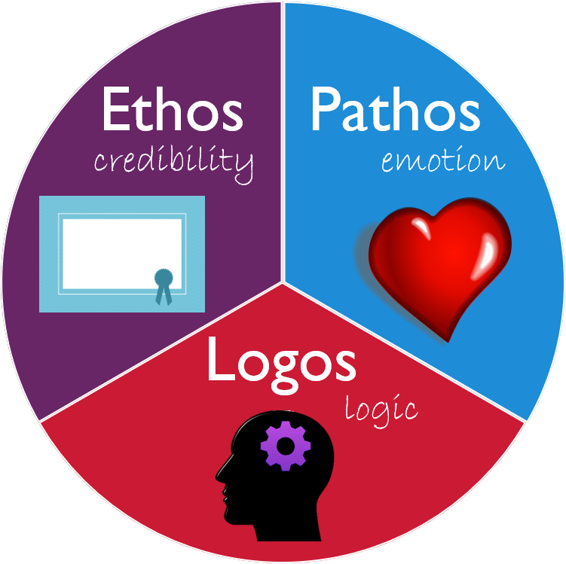
Traditional Views of Persuasion
Traditional Views of Persuasion
This Photo by Unknown Author is licensed under CC BY
15.3

Slide 10
Ethos
Speaker should build on their credibility with citing reliable, authoritative sources, strong arguments, showing awareness of audience and effective delivery
Traditional Views of Persuasion

Slide 11
Logos
Logical and organized arguments with credible evidence
Traditional Views of Persuasion

Slide 12
Pathos
Engage emotions to persuade the audience
Use strong visual aids and engaging stories
Traditional Views of Persuasion

Slide 13
Constructing a Persuasive Speech
Constructing a Persuasive Speech
15.3

Slide 14
Formulating a Proposition of Fact
Attempts to establish the truth of a statement
Best to use topical organization
Constructing a Persuasive Speech

Slide 15
Formulating a Proposition of Definition
Used in legal and scholarly arguments
Argue that a word, phrase or concept has particular meaning
Constructing a Persuasive Speech

Slide 16
Formulating a Proposition of Value
Uses words like
Good
Bad
Best
Worst
Should be organized as definition, then pro-arguments followed by reservations
Constructing a Persuasive Speech

Slide 17
Formulating a Proposition of Policy
Almost always have “should” in them
Call for a change in policy or practice
Should use Monroe’s Motivated Sequence
Constructing a Persuasive Speech

Slide 18
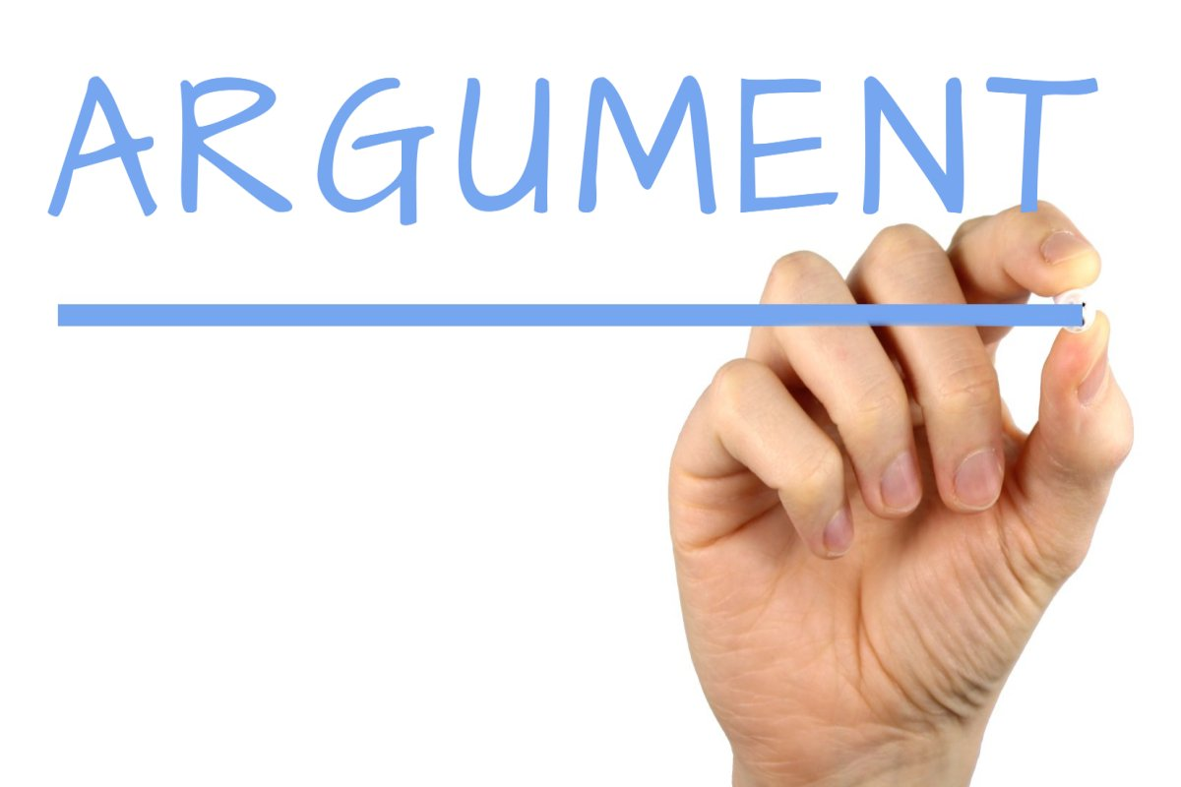
Building on Your Arguments
Evidence should be credible, new to audience, timely and relevant
Use metaphors, quotations, rhetorical devices
Take into consideration effect of visual aids
This Photo by Unknown Author is licensed under CC BY-SA

Slide 19
Introduction Examples
For Examples
Of Speeches,
See Your Text
This Photo by Unknown Author is licensed under CC BY-SA
15.6 and 15.7

Slide 20
Chapter 15 Review
15.1 Why Persuade
15.2 A Definition of Persuasion
15.3 Why is Persuasion Hard?
15.4 Traditional Views of Persuasion 15.5 Constructing a Persuasive Speech
15.6 Sample Outline (Topical Patterns)
15.7 Sample Outline (Monroe’s)

