Slide 1
Exploring Public Speaking (HACC Edition, 2021)
Chapter 16
Listening
This Photo by Unknown Author is licensed under CC BY

Slide 2
Chapter 16 Overview
16.1 Listening in Public Speaking Settings
16.2 Providing Feedback to Speakers

Slide 3
Listening in Public Speaking Settings
Listening in Public Speaking Settings
This Photo by Unknown Author is licensed under CC BY-SA-NC
15.1

Slide 4
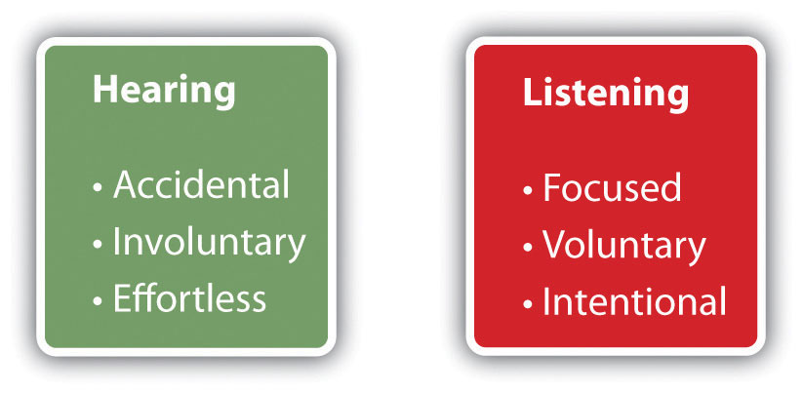
About Listening
We often focus on the “sending” part of communication, but public speakers need listeners
Listening is not the same as hearing
This Photo by Unknown Author is licensed under CC BY-ND
This Photo by Unknown Author is licensed under CC BY-SA-NC

Slide 5
Three Types of Listening
Comprehensive:Focused on understanding and remembering
Appreciative:
Takes place while listening to art forms
Critical
Evaluating the validity of arguments

Slide 6
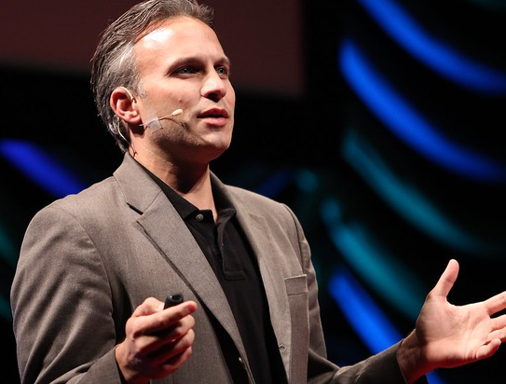
Your Audience and Listening
Speaker must make listening easier for audience through planned redundancy (introduction, transitions, visual aids)
This Photo by Unknown Author is licensed under CC BY-ND

Slide 7
Barriers To Listening
We have short attention spans
We also deal with noisiness and distractions
We process information faster than someone can say it
This Photo by Unknown Author is licensed under CC BY-NC-ND

Slide 8
How to Improve Listening
Try to improve your listening
Keep an open mind
Be prepared to listen by putting away distractions
Take notes
Avoid temptation to talk to others
This Photo by Unknown Author is licensed under CC BY-SA-NC

Slide 9
Providing Feedback to Speakers
Providing Feedback to Speakers
This Photo by Unknown Author is licensed under CC BY
16.1

Slide 10
Feedback Channels
Non-verbal:
Listen with full body
Have good eye contact
Nod head
Lean in towards speaker
Verbal:
Ask questions when appropriate
Paraphrase what the speaker said

Slide 11
Chapter 16 Review
16.1 Listening in Public Speaking Settings
16.2 Providing Feedback to Speakers

