Slide 1
Exploring Public Speaking (HACC Edition, 2021)
Chapter 17
Special Occasion Speeches
This Photo by Unknown Author is licensed under CC BY-SA-NC

Slide 2
Chapter 17 Overview
17.1 Understanding Special Occasion Speeches
17.2 Types of Special Occasion Speeches
17.3 Special Occasion Language
17.4 Special Occasion Delivery

Slide 3
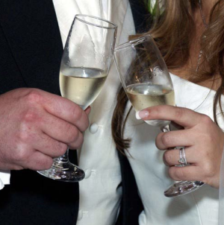
Why Anxiety and Public Speaking
Understanding Special Occasion Speeches
This Photo by Unknown Author is licensed under CC BY-SA-NC
17.1

Slide 4
Special Occasion Speeches
Designed to address and engage the context and audience’s emotions on a specific occasion
Can be given at social or business events (wedding, acceptance speech, funeral)
Many speeches given in real life are for special occasions

Slide 5
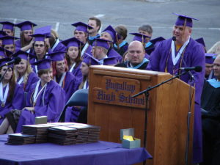
Special Occasion Tips
Be prepared
Adapt to the occasion
Adapt to your audience
Be mindful of time
This Photo by Unknown Author is licensed under CC BY-NC-ND

Slide 6
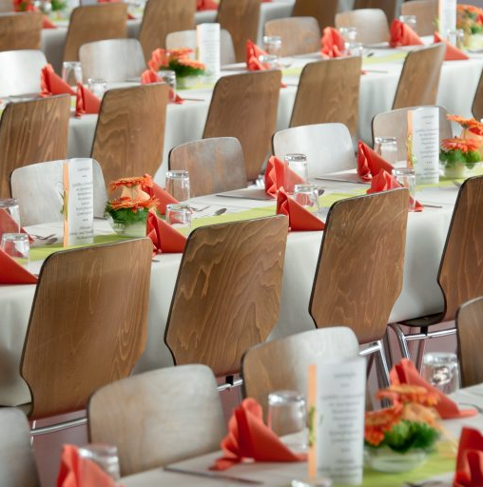
Types of Special Occasion Speeches
Types of
Special Occasion Speeches
This Photo by Unknown Author is licensed under CC BY-NC
17.2

Slide 7
Introductions
Mini speech that introduces another speaker
Should have a clear introduction, body and conclusion
Have an impressive hook about the upcoming speaker
Types of Special Occasion Speeches

Slide 8
Presentations
Brief speech to accompany a prize or honor
Explain honor and why it’s important along with what recipient accomplished
Types of Special Occasion Speeches

Slide 9
Acceptance
Brief speech to given by the recipient of an honor
Should thank the givers, those who helped and put the award in perspective; give credit to others
“Be thankful. Be gracious. Be short.”
Types of Special Occasion Speeches

Slide 10
Dedication
In honor of an opening to highlight the importance of a project
Explain how you’re involved or related and how others are involved
Talk about structure and who designed it
Types of Special Occasion Speeches

Slide 11
Toasts
A speech to congratulate, appreciate, or remember
Keep remarks brief
Focus your attention on the person being toasted
Look at person being honored
Types of Special Occasion Speeches

Slide 12
Roasts
To praise and good-naturedly insult a person being honored
Challenging to do
Consider strange habits or amusing stories
Make sure audience can relate
Types of Special Occasion Speeches

Slide 13
Eulogies
Given in honor of someone who died
Know as much information about the deceased as possible
Although a serious occasion, can add at least one humorous point
Know the audience
Praise, lament and console
Types of Special Occasion Speeches

Slide 14
Farewell
To say good-bye to part of speaker’s life
Thank people in current position
Express how much experience meant
End on a high note
Types of Special Occasion Speeches

Slide 15
Commencement
A graduation speech
Should balance humor and inspiration
Use theme
Talk about your experiences
Impart wisdom and advice
Place speech into larger context of lives
Types of Special Occasion Speeches

Slide 16
After Dinner
Generally serious speeches but can insert humor for amusement
Often, people are hired to give these speeches
Types of Special Occasion Speeches

Slide 17
Motivational
Arouse emotions and motivate the audience to do something
Types
Hero
Survivor
Religious
Types of Special Occasion Speeches

Slide 18
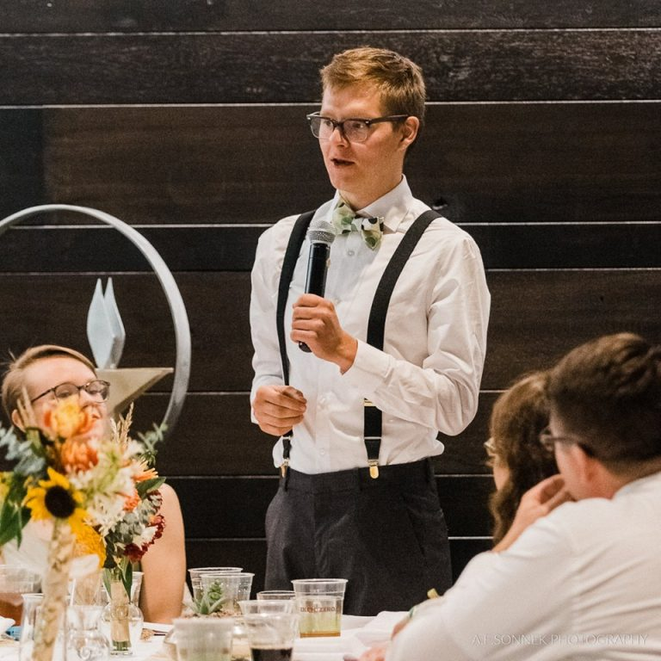
Special Occasion Language and Delivery
Special Occasion
Language and Delivery
This Photo by Unknown Author is licensed under CC BY-NC
17.3 and 17.4

Slide 19
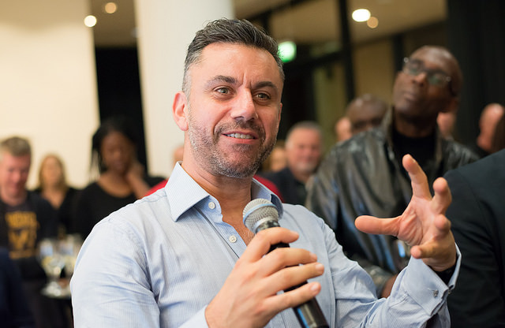
Special Occasion Language/ Delivery
Don’t use big words to sound smart
Use basic words to convey emotion
Practice
Convey emotion
This Photo by Unknown Author is licensed under CC BY-SA-NC

Slide 20
Chapter 17 Review
17.1 Understanding Special Occasion Speeches
17.2 Types of Special Occasion Speeches
17.3 Special Occasion Language
17.4 Special Occasion Delivery

