Slide 1
Information Literacy

Slide 2
information literacy: "a set of abilities requiring individuals to recognize when information is needed and have the ability to locate, evaluate, and use effectively the needed information" - American Library Association

Slide 3
Beginning your Research
Review the requirements of your assignment
How many sources do you need?
What types of sources are required?
Select a topic
Interesting to you
Relevant
Realistic for the length of assignment
Focused

Slide 4
I am selecting this topic to better understand...
Who?
On whom are you focusing? Children, teens, a particular group, specific population, men, women, etc.?
What?
On what aspect are you focusing? Is there a particular issue or theory?
When?
On what time frame are you focusing? What’s currently going on? Something historical? A particular time frame or period in life?
Where?
Are you focusing on a particular region, country or location such as college, inner city, etc.?
Why?
Why is this topic important? Why are you interested?

Slide 5
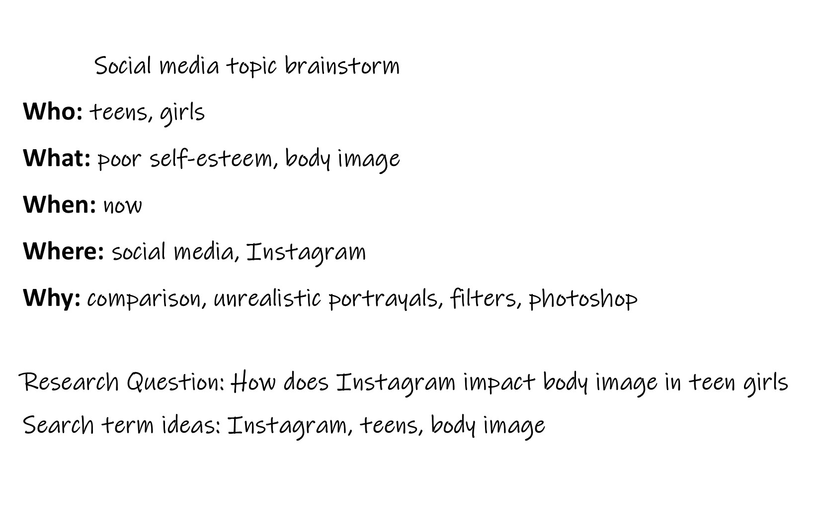

Slide 6
Locating Information
Books: often include detailed information about the context of the topic and can help you provide background information.
Scholarly Journal Articles: are written by scholars who are publishing findings about their research and providing expert analysis. These are good resources to use when you are making a claim.
Newspapers and Magazines: provide information about current topics and events and could be used to provide examples in your research. Evaluate these sources closely to determine credibility.
Web Sources: Many government and educational websites offer statistics and analysis. Evaluate these sources closely to determine credibility.

Slide 7
Evaluating Information
Who is the author?
Does the author have relevant knowledge and expertise?
Does the author have bias?
What evidence is provided?
What sources does the author use?
How can you confirm the information is accurate?
Is the information up to date and reliable?
What is the purpose of the site?
To inform?
Entertain?
Convince you to buy a product or agree with an opinion?

Slide 8
Websites ending in .edu or .gov tend to be more credible:
URL | Type | Purpose
.com | Commercial sites | Typically trying to sell products or make money through ads.
.org | Organizations, usually non-profit | Often have agendas, try to influence opinion, wide range of credibility
.edu | Educational Institutions | College and university information, libraries
.gov | Government Agencies | Statistics, public information, facts

Slide 9
Avoiding Plagiarism
Keep track of all the sources you are using.
When using the exact words of the author, be sure to include quotations around the material you are quoting.
If you are not sure if a source should be cited or not, go ahead and cite.
Remember, citing is a two-step process: an in-text citation and a works cited at the end of your paper.
Try summarizing the material in your own words. Even if you are using your own words, you still need to give credit to the author.
Use the citation resources available from the HACC library

Slide 10
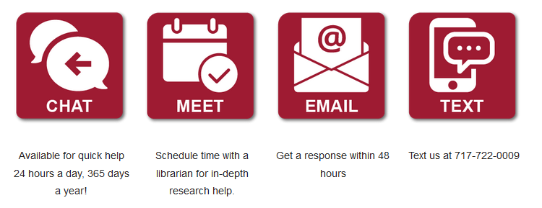
Library Support

Slide 11
Activity - Information Literacy
Use the who/what/when/where/why brainstorm to narrow a research topic. The topic can be something you are researching for a class or just something in which you are interested.
1. My topic is __________
2. I selected this topic to have a better understanding of:
Who:
What:
When:
Where:
Why:
3. Where do you think would be the best place to go to research this topic?
Notes:
Guest Speaker: Librarian

Slide 12
Video Links - Information Literacy
Scholarly vs. Popular Sources - https://youtu.be/jiUg96Tbcsg
What’s a Library Database? - https://youtu.be/KKIbnNLCh8g
Basic Database Searching - https://youtu.be/CZsB7lJPFfs
Advanced Database Searching - https://youtu.be/i7Ry53Ts1Lg

