Slide 1
Academic Success Strategies

Slide 2
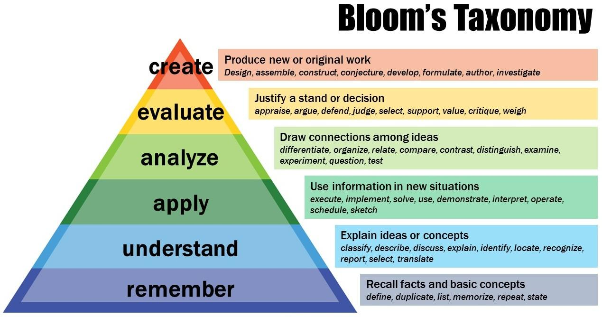
Metacognition
“Bloom’s Taxonomy” by Center for Teaching, Vanderbilt University is licensed under CC BY 2.0
Notes:
(ame picture as in OER)
For long-term learning, students need to pursue learning activities that move their cognition up from the bottom to the top of the pyramid.
Guest Speaker: Tutoring Services

Slide 3
Effectively Reading College Texts
Active reading - physical action while reading
(e.g. take notes in the margins of the book)
SQ4R
Survey, Question, Read, Recite, Reflect, Review
Notes:
Although SQ4R appears to more labor- and time-intensive, students will begin learning the material as of the first read-through, and subsequent studying won’t take as long.

Slide 4
Taking Useful Notes
Cornell Note-taking System
Concept Mapping
Outlines
Hierarchies
Chart/Matrix

Slide 5
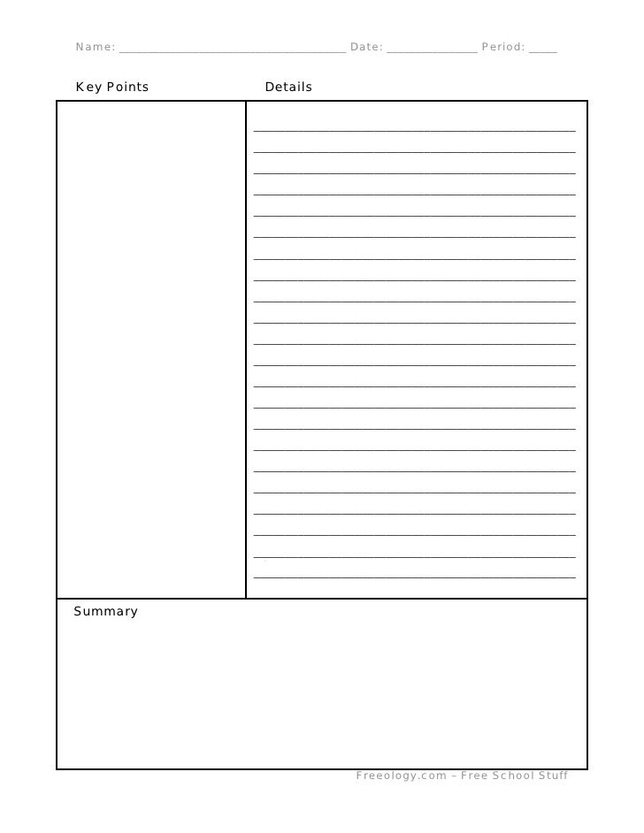
Cornell Notetaking System
Notes:
Picture: Cornell notes format (slideshare.net) William Spaulding, CC-Attribution ShareAlike License

Slide 6
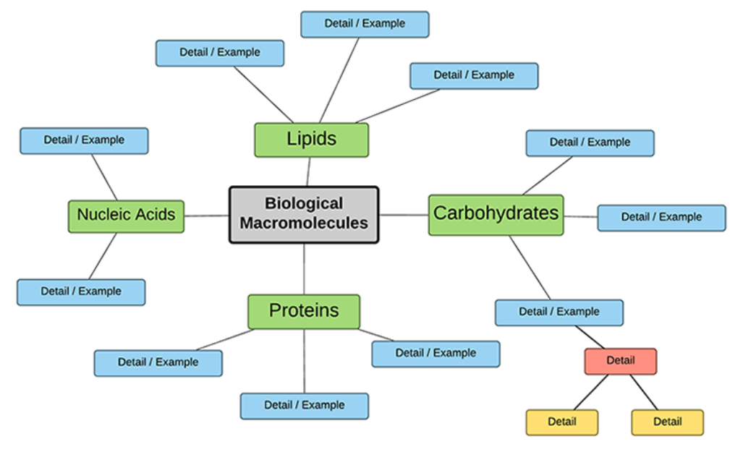
Concept Mapping
Notes:
Picture: “Create a Concept Map of Biomolecules.” 23 Feb. 2020, https://bio.libretexts.org/@go/page/27646.

Slide 7
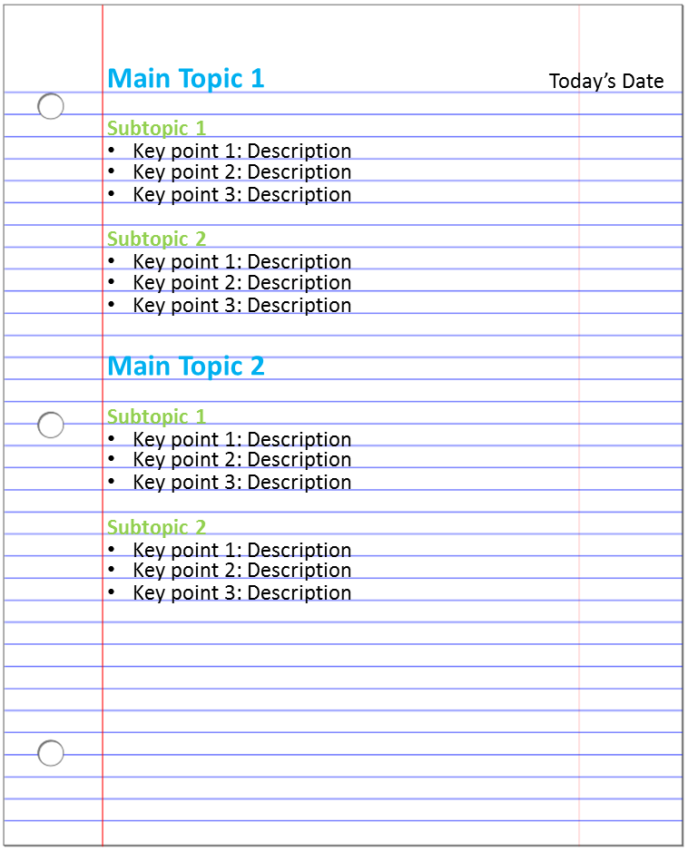
Outlines
Notes:
Picture: URL: https://guides.rdpolytech.ca/learningskills CC BY-NC-SA 4.0

Slide 8
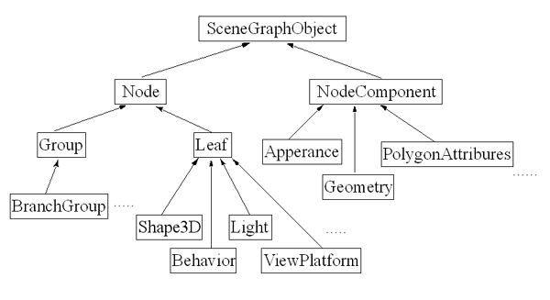
Hierarchies
Notes:
Picture: “JAVA 3D Lecture” MIT Open Courseware Java 3D Lecture | Lecture Notes | Foundations of Software Engineering | Civil and Environmental Engineering | MIT OpenCourseWare (aprende.org)CC BY NC SA

Slide 9
Chart/Matrix
Main Topics | 2nd Level Detail | 3rd Level Detail
Topic #1 | definition | example
Topic #2 | definition | example

Slide 10
Study and Memory Techniques
Distributed practice
Self-testing
Teach someone else
Study partner/groups
Mnemonics = acronyms, acrostics, rhymes, stacking, loci/memory palace

Slide 11
Preparing For and Taking Tests
Sleep
Nutrition
Arrive early
Relaxation techniques

Slide 12
Test Anxiety
Not a medical diagnosis
Learned behavior that can be “unlearned”
Strategies:
Relaxation techniques
Practice quizzes/tests

Slide 13
SMART Test-taking
S = skim over the whole test to know what to expect and look for answer clues
M = mark the ones you don’t know right away or that will take more time
A = answer easy questions first
R = return to the questions you marked
T = track your time so you have enough time for more challenging questions

Slide 14
Activity - Academic Success Strategies
Use a chapter in your text to practice an active reading strategy that will help you take notes and prepare for tests.
Page through the chapter and look for the blue headings and subheadings. Write “who, what, where, why and how” questions for each blue heading and subheading.
Under each question you’ve created about headings and subheadings, write notes in your own words summarizing that section of the chapter.
On your notes page, pull out two or three key words from each answer to the heading/subheading questions and write those key words in the left margin of your notes page.
Use those key words to create at least 10 true/false questions on a separate piece of paper.
Take your practice quiz without looking at your original notes or this text. Set a time limit of 15 minutes to answer your 10 questions.
Now grade yourself and conduct an honest appraisal: Were you able to answer those 10 questions correctly in the 15 minute timeframe? If you weren’t able to answer a question, go back and review that section one more time.

Slide 15
Video Links - Academic Success Strategies
How to Read Your Textbook Better - https://youtu.be/NdGJV4tE96A
Reading Strategies - https://youtu.be/fam4P0x-VAc
Notetaking, Leeward Community College - https://youtu.be/oxCj9ZSYIW4
Diagnosis Wenkebach (Mnemonics) - https://youtu.be/GVxJJ2DBPiQ

